Slide 1
Object Oriented Programming using JAVA Paper code: PCC – CS481
Presented By
Sudeshna Kundu (Mondal)
Mobile No. : 9564842816

Slide 2
Book
Java - The Complete Reference,
Author – Herbert Schildt
Latest Edition – 11th Edition
Publisher – McGraw Hill Education

Slide 3
Evolution of OOP
Machine language
0 1 1 0 1 1 0
Assembly Language
MOV A, B
High Level Language
Procedural Programming Approach
C, PASCAL
Object Oriented Programming Approach
C++, JAVA

Slide 4
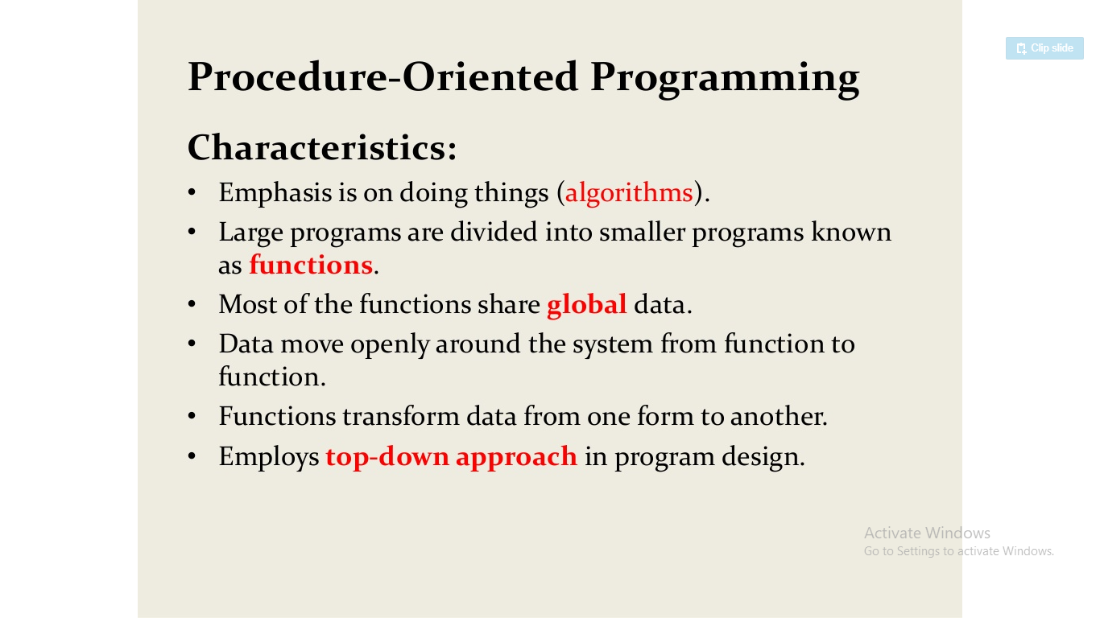
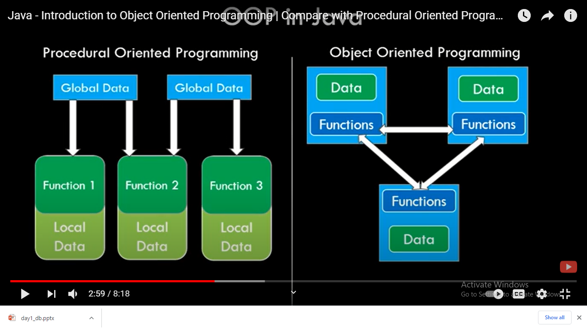

Slide 5
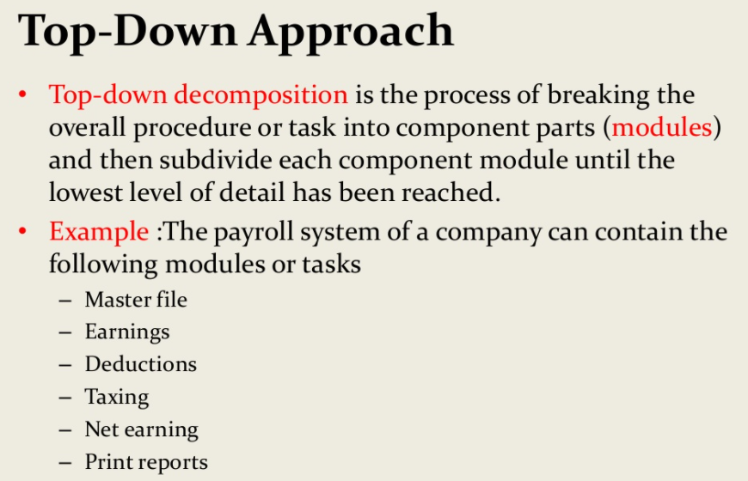

Slide 6
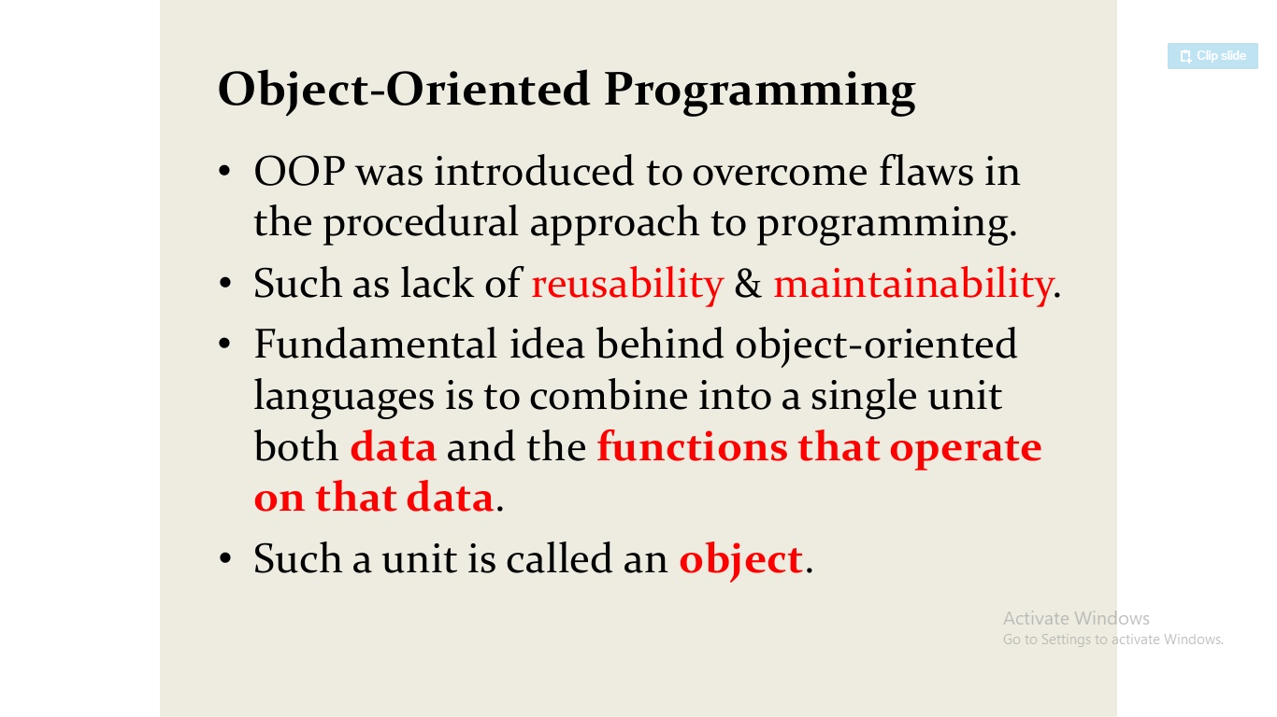
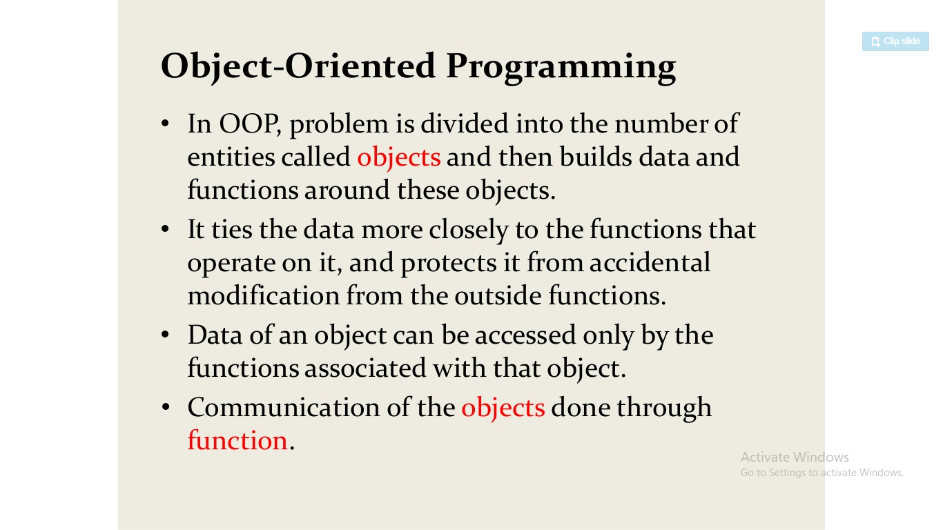

Slide 7
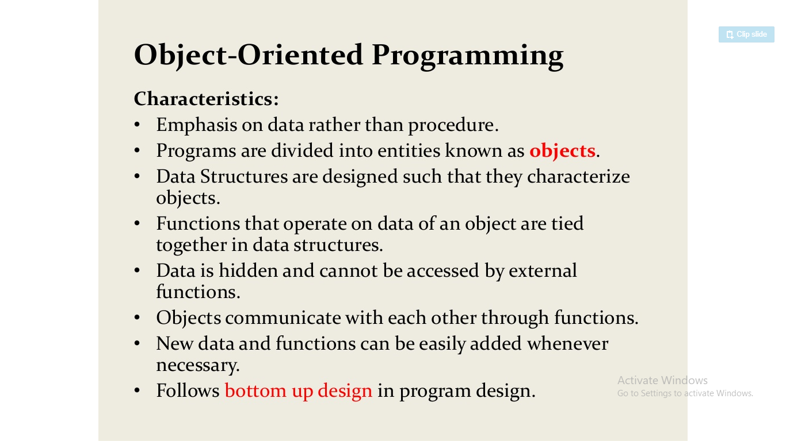

Slide 8
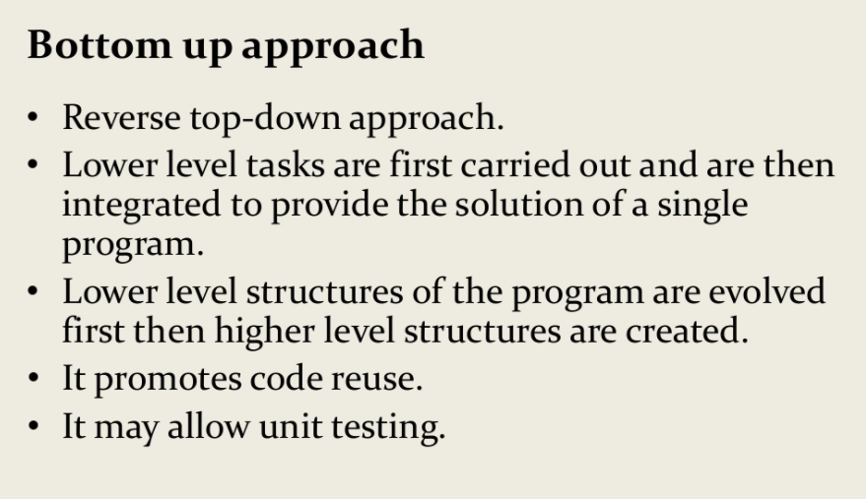

Slide 9
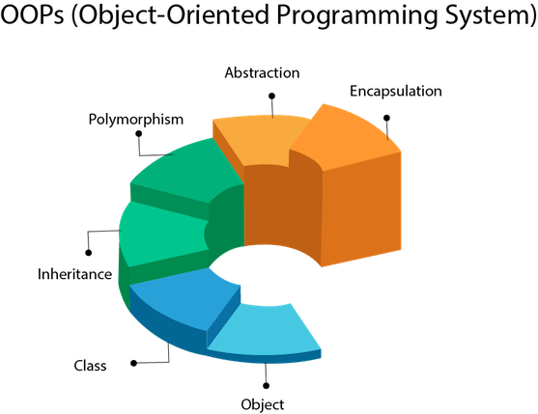
Object Oriented Programming (OOP)
Object-Oriented Programming is a methodology or paradigm to design a program using classes and objects. It simplifies the software development and maintenance by providing some concepts:
Object
Class
Inheritance
Polymorphism
Abstraction
Encapsulation

Slide 10
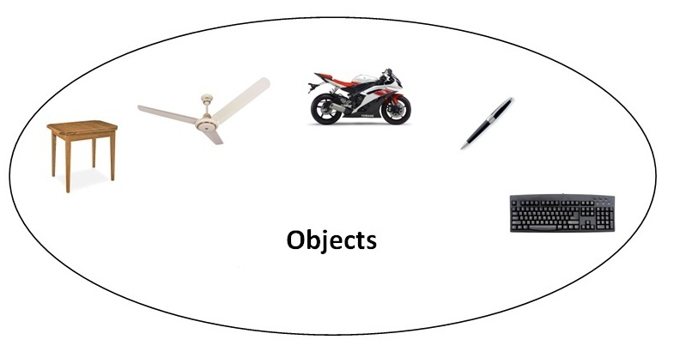
Object Oriented Programming (OOP) Features:
Object
Any entity that has state and behavior is known as an object. For example: chair, pen, table, keyboard, bike etc. It can be physical and logical.
An Object can be defined as an instance of a class. An object contains an address and takes up some space in memory.
Objects can communicate without knowing the details of each other's data or code. The only necessary thing is the type of message accepted and the type of response returned by the objects.
Example: A dog is an object because it has states like color, name, breed, etc. as well as behaviors like wagging the tail, barking, eating, etc.

Slide 11
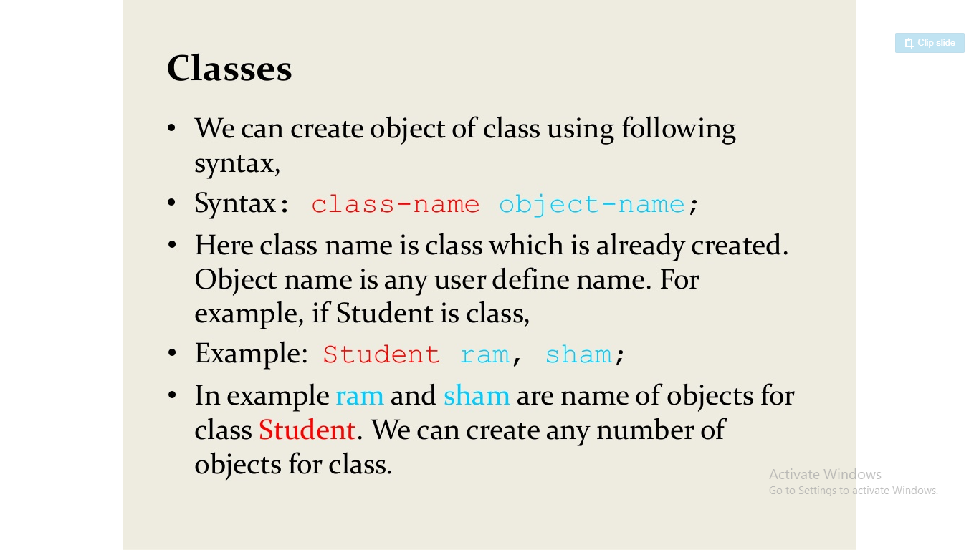
Object Oriented Programming (OOP) Features:
Class
A class is a user defined blueprint or prototype from which objects are created. It represents the set of properties or methods that are common to all objects of one type. It is a logical entity.
Class Student
State/ Attributes
Name
Roll No
Student 1
Behaviors
Student 2
displayDetails ()

Slide 12
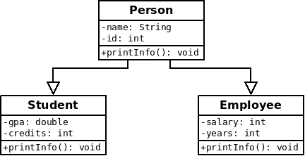
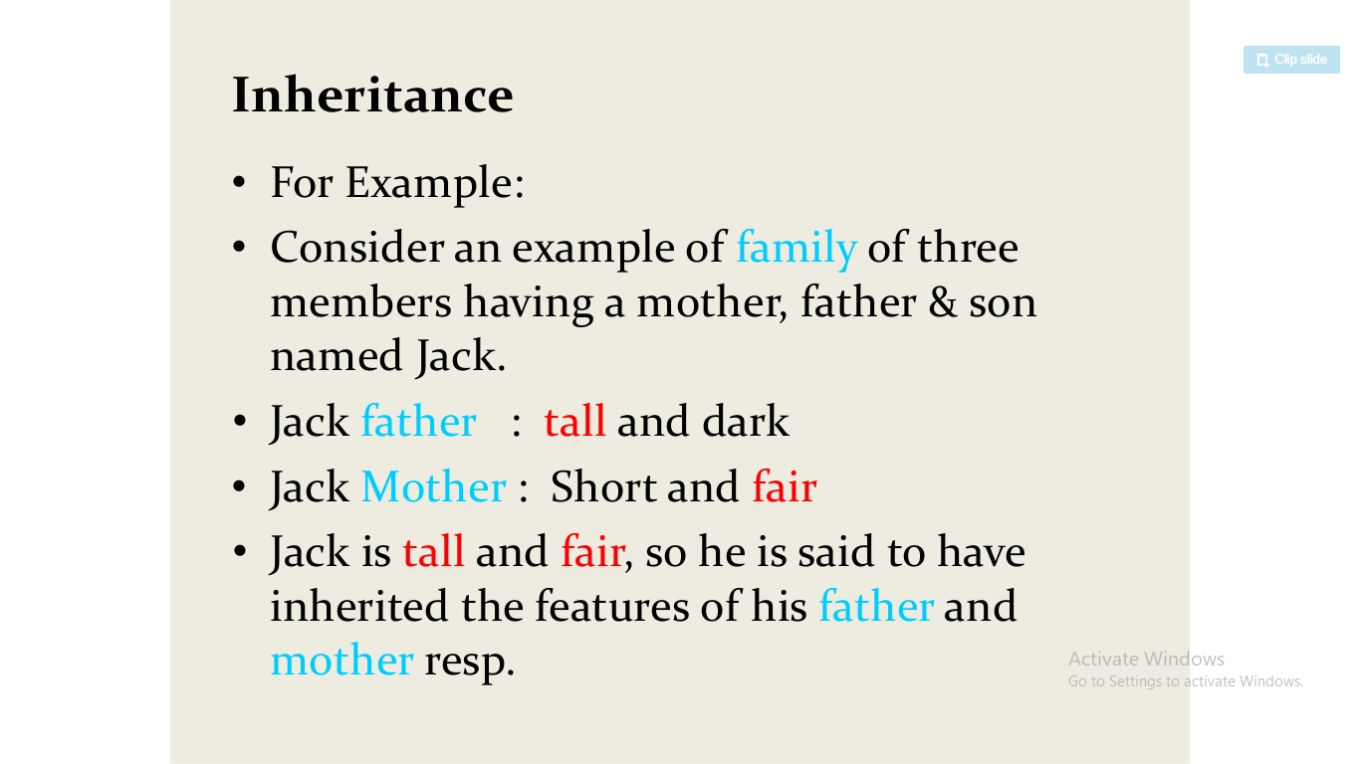
Object Oriented Programming (OOP) Features:
Inheritance
When one object acquires all the properties and behaviors of parent object i.e. known as inheritance. It provides code reusability.

Slide 13
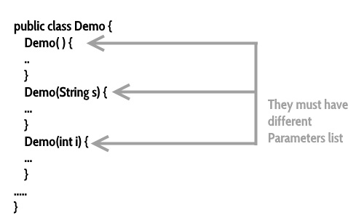
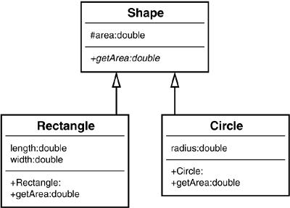
Object Oriented Programming (OOP) Features:
Polymorphism
Polymorphism is the ability of an object to one task is performed by different ways. For example: to draw something e.g. shape or rectangle etc.
In java, we use method overloading and method overriding to achieve polymorphism.

Slide 14

Object Oriented Programming (OOP) Features:
Abstraction
Hiding internal details and showing functionality is known as abstraction. For example: phone call, we don't know the internal processing.
In java, we use abstract class and interface to achieve abstraction.

Slide 15
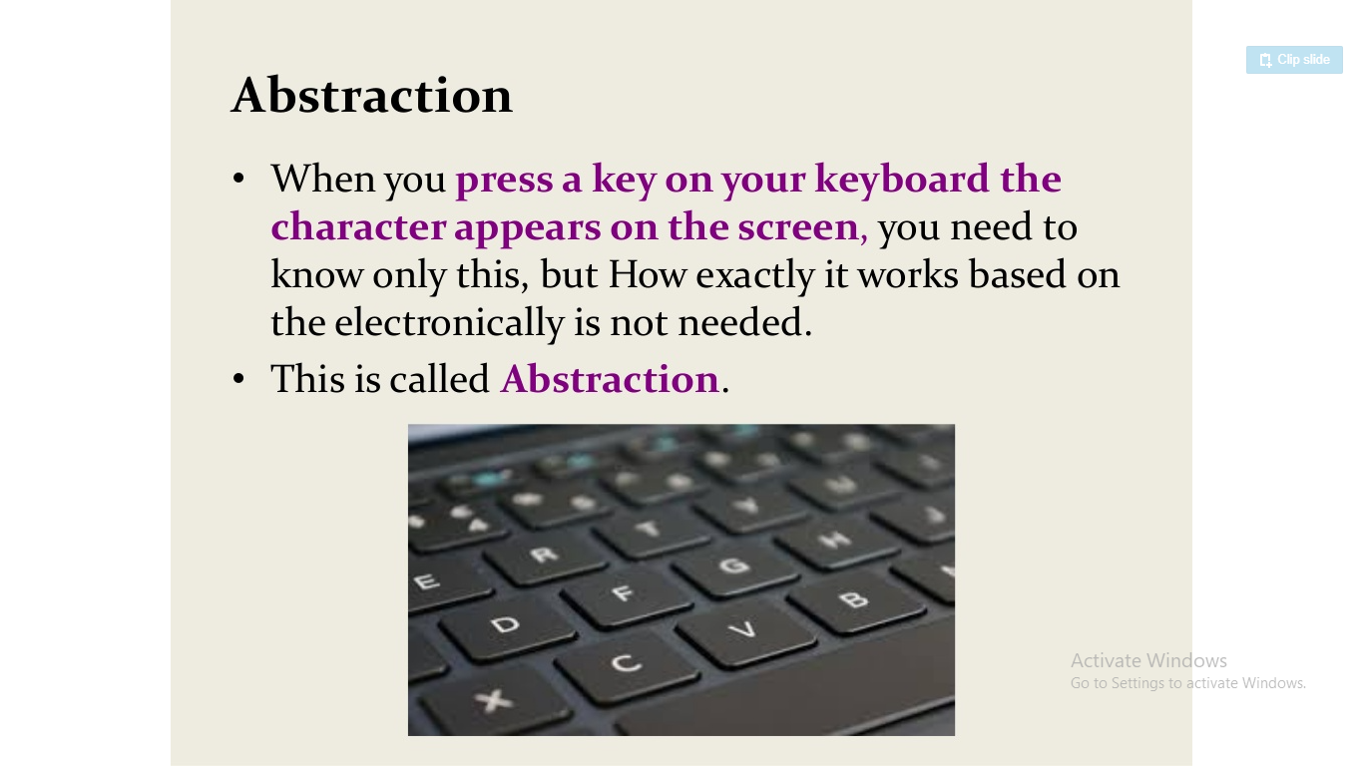
Object Oriented Programming (OOP) Features:
Abstraction

Slide 16
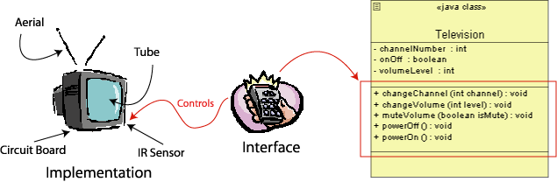
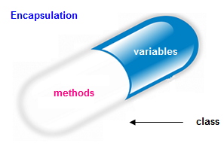
Object Oriented Programming (OOP) Features:
Encapsulation
Binding (or wrapping) code and data together into a single unit is known as encapsulation. For example: capsule, it is wrapped with different medicines.
It provides you the control over the data by declaring the variables of a class as private.
Provide public setter and getter methods to modify and view the variables values.

Slide 17
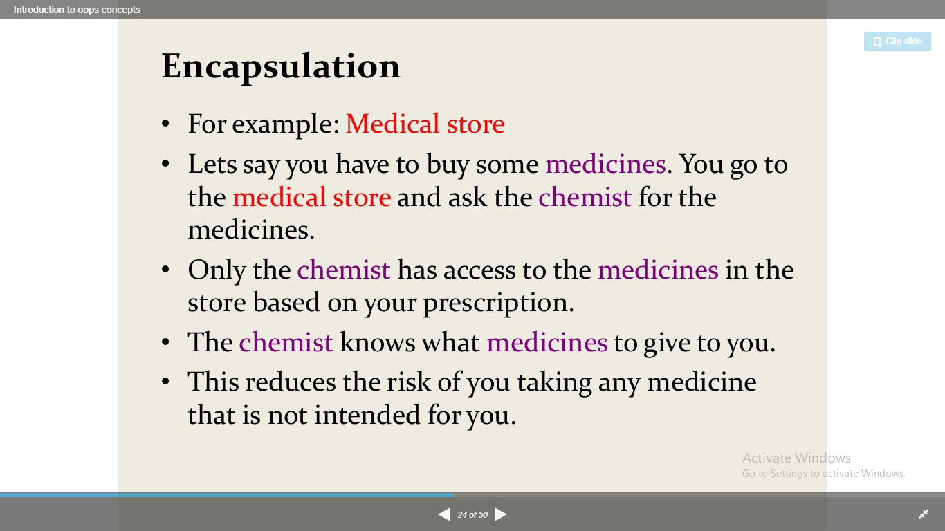
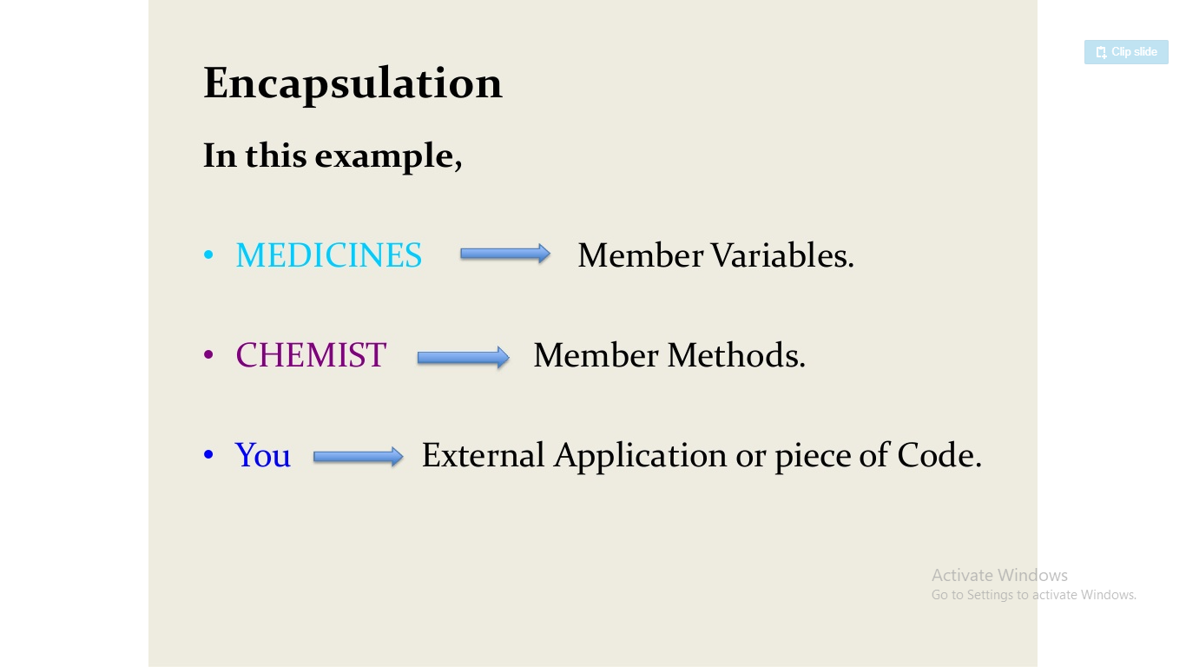
Object Oriented Programming (OOP) Features:
Encapsulation

Slide 18
Difference Between Procedure Oriented Programming (POP) & Object Oriented Programming (OOP)
Procedure Oriented Programming | Object Oriented Programming
In POP, program is divided into small parts called functions. | In OOP, program is divided into parts called objects.
In POP, Importance is not given to data but to functions as well as sequence of actions to be done. | In OOP, Importance is given to the data rather than procedures or functions because it works as a real world.
POP follows Top Down approach. | OOP follows Bottom Up approach.
POP does not have any access specifier. | OOP has access specifiers named Public, Private, Protected, etc.
POP does not have any proper way for hiding data so it is less secure. | OOP provides Data Hiding so provides more security.
In POP, Overloading is not possible. | In OOP, overloading is possible in the form of Function Overloading and Operator Overloading.
Example of POP are : C, VB, FORTRAN, Pascal. | Example of OOP are : C++, JAVA, VB.NET,

Slide 19
What is Java
Java is a programming language and a platform. Java is a high level, robust, object-oriented and secure programming language.
Java - The new programming language developed by Sun Microsystems (which is now the subsidiary of Oracle) in the year 1995. James Gosling is known as the father of Java. Before Java, its name was Oak.
Originally called Oak by James Gosling, one of the inventors of the Java Language.
Originally created for consumer electronics (TV, VCR, Freeze, Washing Machine, Mobile Phone).
Java - CPU Independent language
Internet and Web was just emerging, so Sun turned it into a language of Internet Programming.
It allows you to publish a webpage with Java code in it.
Platform: Any hardware or software environment in which a program runs, is known as a platform. Since Java has a runtime environment (JRE) and API, it is called a platform.

Slide 20

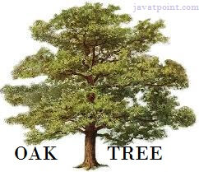
History of Java
1) James Gosling, Mike Sheridan, and Patrick Naughton initiated the Java language project in June 1991. The small team of sun engineers called Green Team.
2) Initially designed for small, embedded systems in electronic appliances like set-top boxes.
3) Firstly, it was called "Greentalk" by James Gosling, and the file extension was .gt.
4) After that, it was called Oak and was developed as a part of the Green project.
5) Since Oak was already a registered company, so James Gosling and his team changed the Oak name to Java

Slide 21
THANK YOU

Slide 22
Object Oriented Programming using JAVA Paper code: PCC – CS481
Presented By
Sudeshna Kundu (Mondal)
Mobile No. : 9564842816

Slide 23
Difference between JDK, JRE and JVM
JVM
JVM (Java Virtual Machine) is an abstract machine. It is a specification that provides runtime environment in which java bytecode can be executed.
JVMs are available for many hardware and software platforms. JVM, JRE and JDK are platform dependent because configuration of each OS differs. But, Java is platform independent.
The JVM performs following main tasks:
Loads code
Verifies code
Executes code
Provides runtime environment

Slide 24
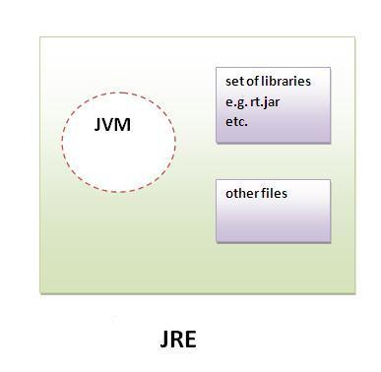
Difference between JDK, JRE and JVM
JRE
JRE is an acronym for Java Runtime Environment.
It is used to provide runtime environment. It is the implementation of JVM.
It physically exists. It contains set of libraries + other files that JVM uses at runtime.

Slide 25
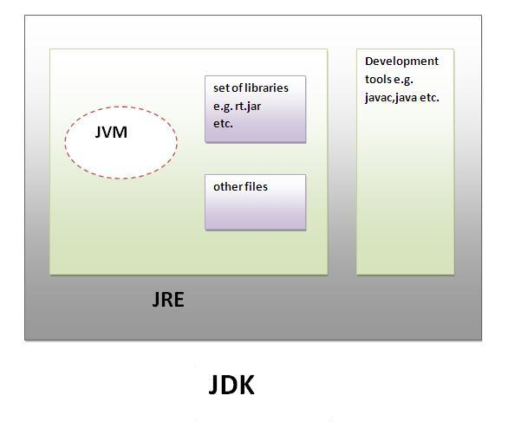
Difference between JDK, JRE and JVM
JDK
JDK is an acronym for Java Development Kit. It physically exists. It contains JRE + development tools.

Slide 26
First JAVA Program
class Hello {
public static void main(String[] args) {
System.out.println(“Hello World !!!”);
}
}
To write the simple program, open notepad by start menu -> All Programs -> Accessories -> notepad and write simple program and save it as Hello.java.
To compile and run this program, you need to open command prompt by start menu -> All Programs -> Accessories -> command prompt.

Slide 27
First JAVA Program
Hello.java
class Hello {
public static void main(String[] args) {
System.out.println(“Hello World !!!”); }
}
C:\javac Hello.java
C:\java Hello
( compilation creates Hello.class )
(Execution on the local JVM)

Slide 28
First JAVA Program
class Hello {
public static void main(String[] args) {
System.out.println(“Hello World !!!”);
}
}
class keyword is used to declare a class in java.
public keyword is an access modifier which represents visibility, it means it is visible to all.
static is a keyword, if we declare any method as static, it is known as static method. The core advantage of static method is that there is no need to create object to invoke the static method. The main method is executed by the JVM, so it doesn't require to create object to invoke the main method. So it saves memory.
void is the return type of the method, it means it doesn't return any value.
main represents startup of the program.
String[] args is used for command line argument.
System.out.println() is used print statement.

Slide 29
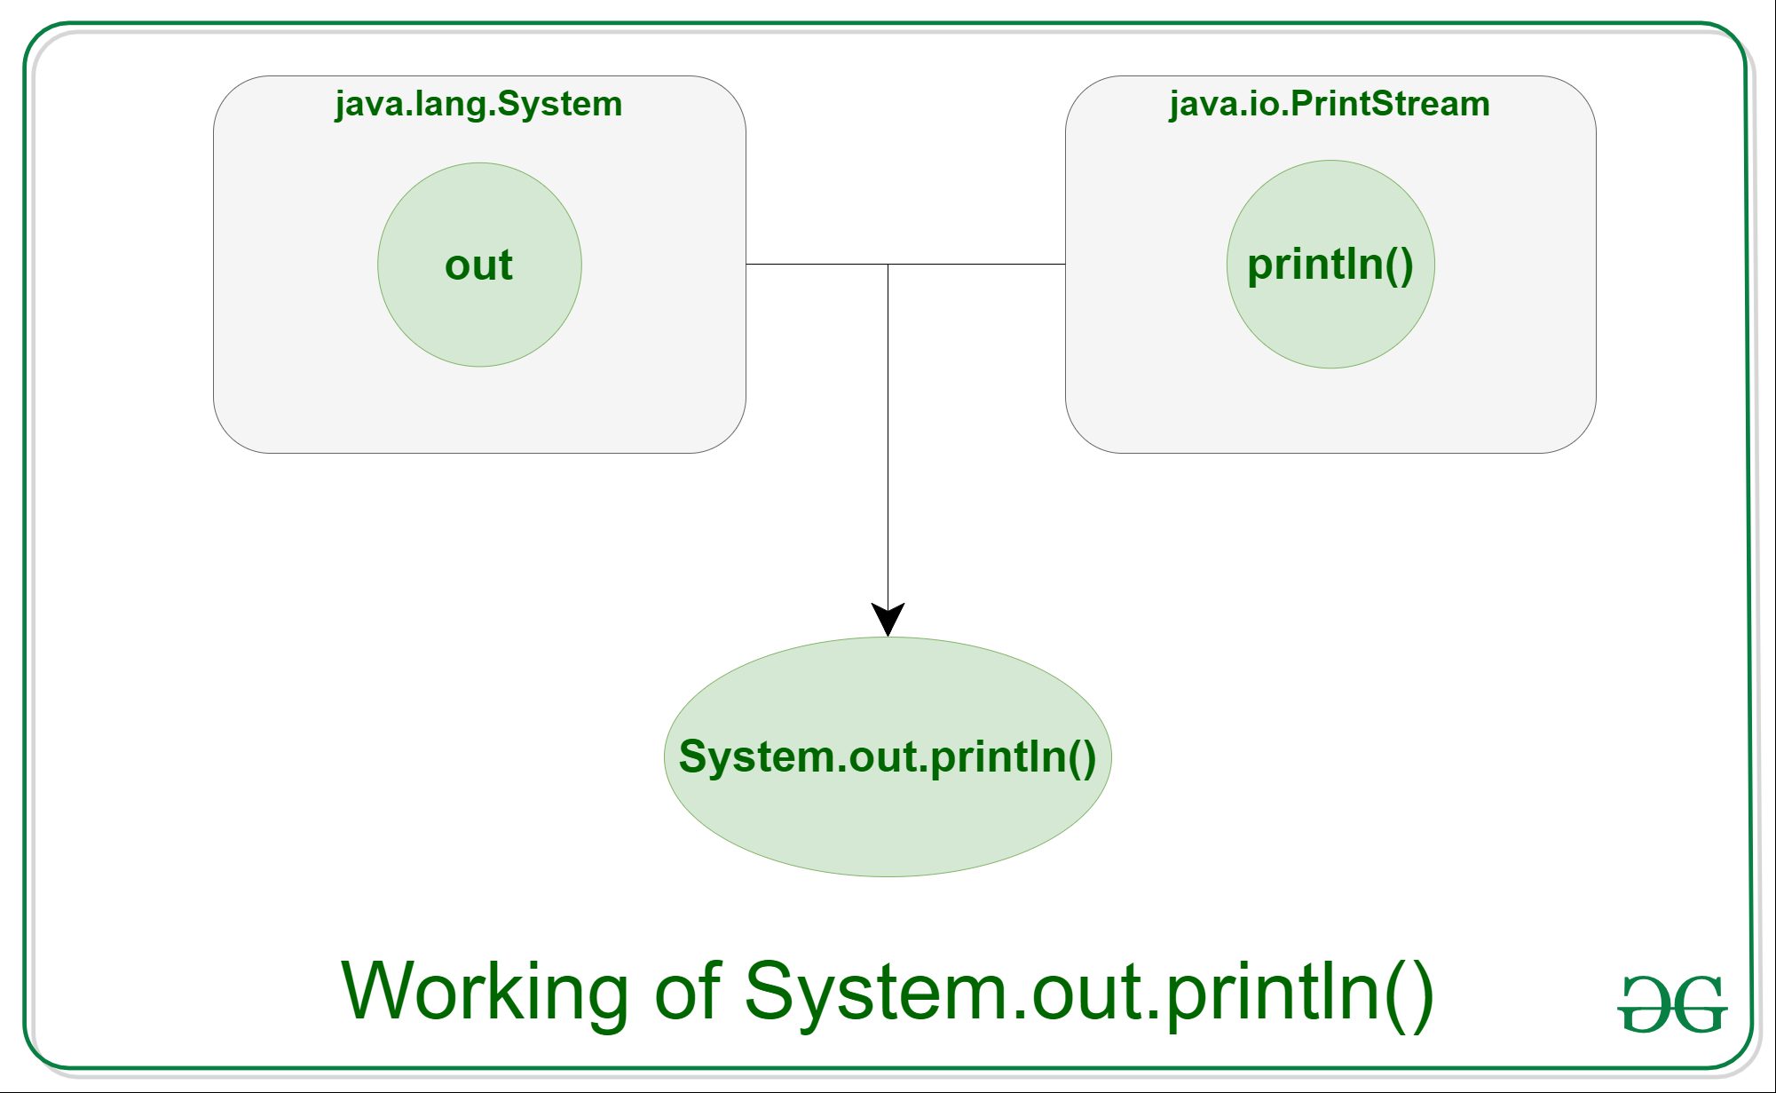
System.out.println in Java
Java System.out.println() is used to print an argument that is passed to it. The statement can be broken into 3 parts which can be understood separately as:
System: It is a final class defined in the java.lang package.
out: This is an instance of PrintStream type, which is a public and static member field of the System class.
println(): As all instances of PrintStream class have a public method println(), hence we can invoke the same on out as well. This is an upgraded version of print(). It prints any argument passed to it and adds a new line to the output. We can assume that System.out represents the Standard Output Stream.

Slide 30
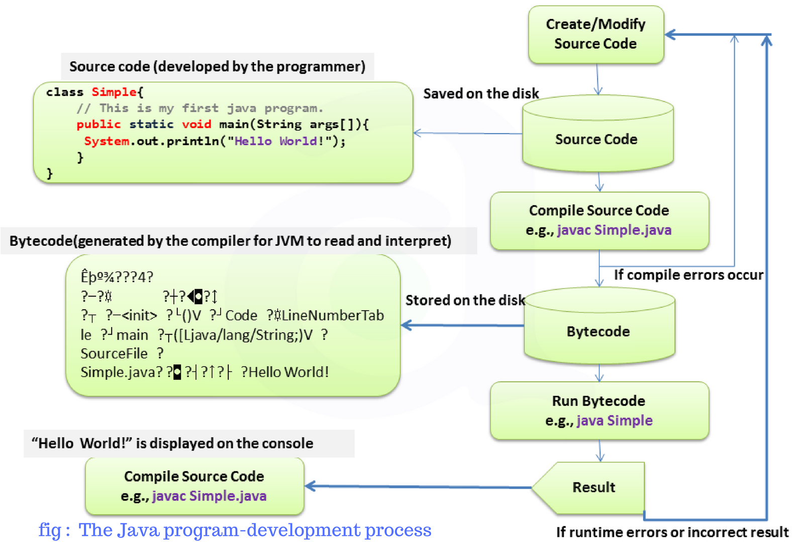

Slide 31
THANK YOU

Slide 32
Object Oriented Programming using JAVA Paper code: PCC – CS481
Presented By
Sudeshna Kundu (Mondal)

Slide 33
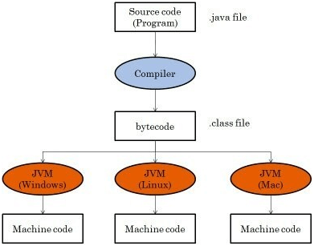
What is Java Bytecode?
Java bytecode is the instruction set for the Java Virtual Machine. As soon as a java program is compiled, java bytecode is generated. In more apt terms, java bytecode is the machine code in the form of a .class file. With the help of java bytecode we achieve platform independence in java.
Platform independence is one of the soul reasons for which James Gosling started the formation of java and it is this implementation of bytecode which helps us to achieve this. Hence bytecode is a very important component of any java program.The set of instructions for the JVM may differ from system to system but all can interpret the bytecode. A point to keep in mind is that bytecodes are non-runnable codes and rely on the availability of an interpreter to execute and thus the JVM comes into play.

Slide 34
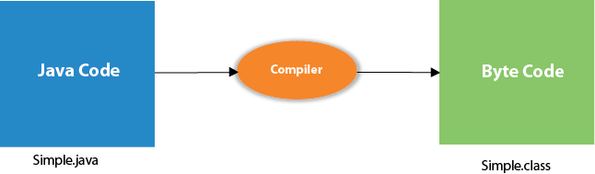
What happens at compile time?
At compile time, java file is compiled by Java Compiler (It does not interact with OS) and converts the java code into bytecode.

Slide 35
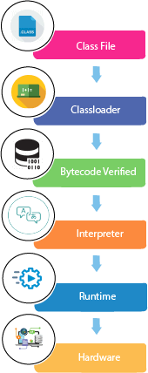
What happens at runtime?
Classloader: is the subsystem of JVM that is used to load class files.
Bytecode Verifier: checks the code fragments for illegal code that can violate access right to objects.
Interpreter: read bytecode stream then execute the instructions

Slide 36
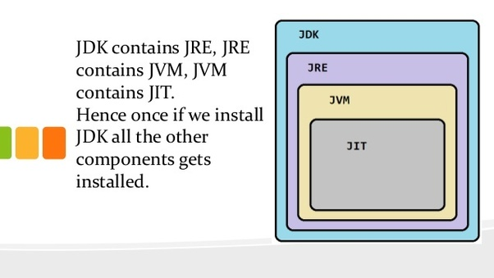
Just-In-Time(JIT) compiler:
It is used to improve the performance.
JIT compiles parts of the byte code that have similar functionality at the same time, and hence reduces the amount of time needed for compilation.
Here, the term "compiler" refers to a translator from the instruction set of a Java virtual machine (JVM) to the instruction set of a specific CPU.

Slide 37
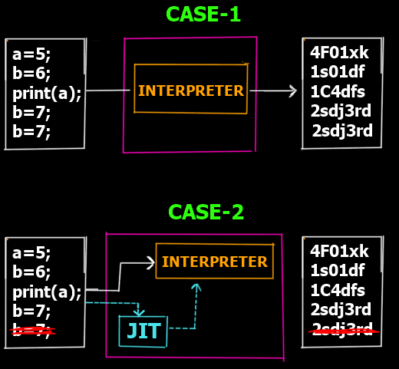
Just-In-Time(JIT) compiler:
Case 1:
In case 1 you can see that we are at the intepretation phase (Step 5 of the overall program execution). Lets assume we have 5 lines which are supposed to be interpretted to their corresponding machine code lines. So as you can see in the Case 1 there is no JIT involved. thus the interpreter converts each line into its corresponding machine code line. However if you notice the last 2 lines are the same (consider it a redundant line inserted by mistake). Clearly that line is redundant and does not have any effect on the actual output but yet since the interpreter works line by line it still creates 5 lines of machine code for 5 lines of the bytecode.
Now this is inefficient right? lets see case 2
Case 2:
In case 2 we have the JIT compiler. Now before the bytecode is passed onto the interpreter for conversion to machine code, the JIT compiler scans the full code to see if it can be optimized. As it finds the last line is redundant it removes it from the bytecode and passes only 4 lines to the interpreter thus making it more efficient and faster as the interpreter now has 1 line less to interpret.
So this is how JIT compiler speeds up the overall execution process.

Slide 38
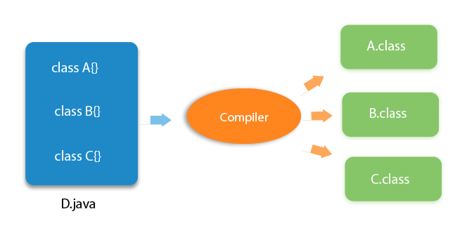
Can you have multiple classes in a java source file?
Yes, like the figure given below illustrates:

Slide 39
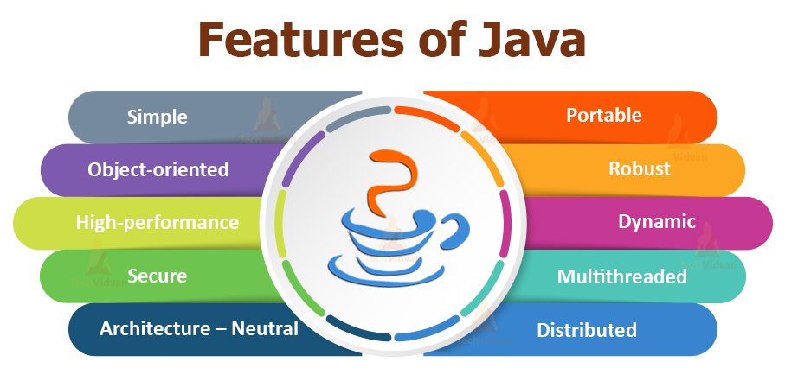
Features of Java
Simple
Object-Oriented
Portable
Platform independent
Secured
Robust
Architecture neutral
Multithreaded
Distributed

Slide 40
Features of Java
Simple
According to Sun, Java language is simple because:
syntax is based on C++ (so easier for programmers to learn it after C++).
removed many confusing and/or rarely-used features e.g., explicit pointers, operator overloading etc.
No need to remove unreferenced objects because there is Automatic Garbage Collection in java.
Object-oriented
Object-oriented means we organize our software as a combination of different types of objects that incorporates both data and behaviour.

Slide 41
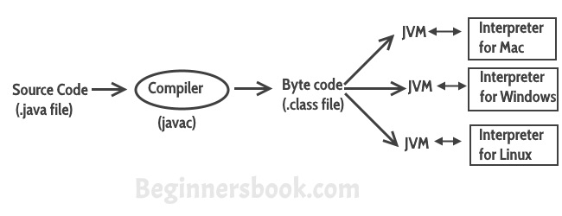
Features of Java
Platform Independent
Unlike other programming languages such as C, C++ etc which are compiled into platform specific machines. Java is guaranteed to be write-once, run-anywhere (WORA) language.
On compilation Java program is compiled into bytecode. This bytecode is platform independent and can be run on any machine, plus this bytecode format also provide security. Any machine with Java Runtime Environment can run Java Programs.

Slide 42
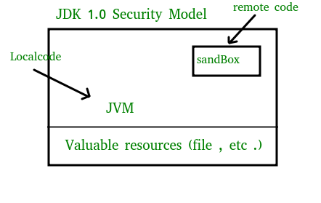
Features of Java
The essence of the sandbox model is that local code is trusted to have full access to vital system resources (such as the file system) while downloaded remote code (an applet) is not trusted and can access only the limited resources provided inside the sandbox
Secure
Java is secured because:
No explicit pointer
Java Programs run inside virtual machine sandbox

Slide 43
Features of Java
Robust
Robust simply means strong.
Java uses strong memory management.
There are lack of pointers that avoids security problem.
There is automatic garbage collection in java.
There is exception handling and type checking mechanism in java. All these points makes java robust.
Architecture-neutral
There is no implementation dependent features e.g. size of primitive types is fixed.
In C programming, int data type occupies 2 bytes of memory for 32-bit architecture and 4 bytes of memory for 64-bit architecture. But in java, it occupies 4 bytes of memory for both 32 and 64 bit architectures.

Slide 44
Features of Java
Portable
Compiler generates byte codes, which have nothing to do with a particular computer architecture, hence a Java program is easy to interpret on any machine. We may carry the java bytecode to any platform.
Multithreaded
Multithreading in java is a process of executing multiple threads simultaneously.
Thread is basically a lightweight sub-process, a smallest unit of processing.
It shares a common memory area. Threads are important for multi-media, Web applications etc.
Distributed
We can create distributed applications in java. We may access files by calling the methods from any machine on the internet.

Slide 45
Application
According to Sun, 3 billion devices run Java. There are many devices where Java is currently used. Some of them are as follows:
Desktop Applications such as acrobat reader, media player, antivirus, etc.
Web Applications such as irctc.co.in, javatpoint.com, etc.
Enterprise Applications such as banking applications.
Mobile
Embedded System
Smart Card
Robotics
Games, etc.

Slide 46
Types of Java Applications
There are mainly 4 types of applications that can be created using Java programming:
1) Standalone Application
Standalone applications are also known as desktop applications or window-based applications. These are traditional software that we need to install on every machine. Examples of standalone application are Media player, antivirus, etc. AWT and Swing are used in Java for creating standalone applications.
2) Web Application
An application that runs on the server side and creates a dynamic page is called a web application. Currently, Servlet, JSP, Struts, Spring, Hibernate etc. technologies are used for creating web applications in Java.
3) Enterprise Application
An application that is distributed in nature, such as banking applications, etc. is called enterprise application. It has advantages of the high-level security, load balancing, and clustering. In Java, EJB is used for creating enterprise applications.
4) Mobile Application
An application which is created for mobile devices is called a mobile application. Currently, Android and Java ME are used for creating mobile applications.

Slide 47

Java Platforms / Editions
There are 4 platforms or editions of Java:
1) Java SE (Java Standard Edition)
It is a Java programming platform. It includes Java programming APIs such as java.lang, java.io, java.net, java.util, java.sql, java.math etc. It includes core topics like OOPs, String, Regex, Exception, Inner classes, Multithreading, I/O Stream, Networking, AWT, Swing, Reflection, Collection, etc.
2) Java EE (Java Enterprise Edition)
It is an enterprise platform which is mainly used to develop web and enterprise applications. It is built on the top of the Java SE platform. It includes topics like Servlet, JSP, Web Services, EJB, JPA, etc.
3) Java ME (Java Micro Edition)
It is a micro platform which is mainly used to develop mobile applications.
4) JavaFX
It is used to develop rich internet applications. It uses a light-weight user interface API.

Slide 48
Java Version History
Many java versions have been released till now. The current stable release of Java is Java SE 10.
JDK Alpha and Beta (1995)
JDK 1.0 (23rd Jan 1996)
JDK 1.1 (19th Feb 1997)
J2SE 1.2 (8th Dec 1998)
J2SE 1.3 (8th May 2000)
J2SE 1.4 (6th Feb 2002)
J2SE 5.0 (30th Sep 2004)
Java SE 6 (11th Dec 2006)
Java SE 7 (28th July 2011)
Java SE 8 (18th Mar 2014)
Java SE 9 (21st Sep 2017)
Java SE 10 (20th Mar 2018)

Slide 49
THANK YOU

Slide 50
Object Oriented Programming using JAVA
Presented By Sudeshna Kundu (Mondal)

Slide 51
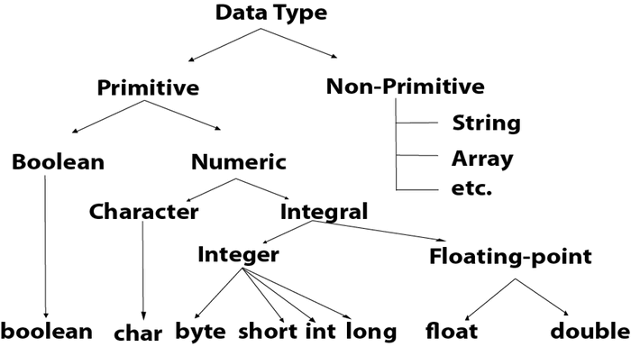
Datatypes in Java
Use float or double?
The precision of a floating point value indicates how many digits the value can have after the decimal point. The precision of float is only six or seven decimal digits, while double variables have a precision of about 15 digits. Therefore it is safer to use double for most calculations.

Slide 52
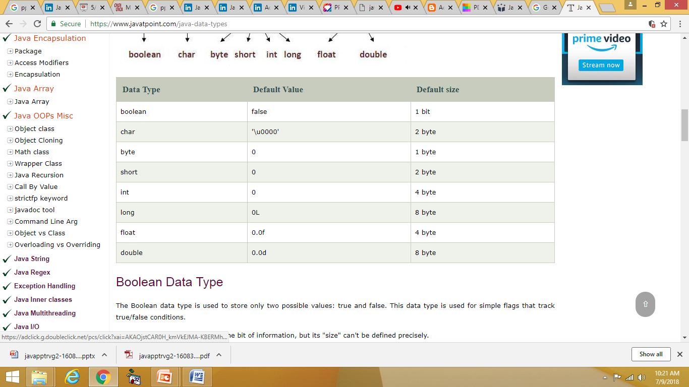
Data Type - Default Value and size

Slide 53
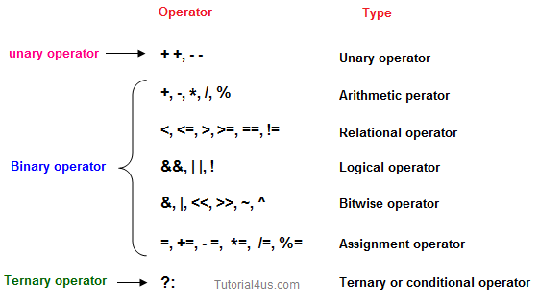
Operator in Java

Slide 54
Operator in Java
Java Unary Operator
Java Arithmetic Operator Example
class OperatorExample{
public static void main(String args[]){
int x=10;
System.out.println(x++);//10 (11)
System.out.println(++x);//12
System.out.println(x--);//12 (11)
System.out.println(--x);//10
}}
class OperatorExample{
public static void main(String args[]){
int a=10;
int b=5;
System.out.println(a+b);//15
System.out.println(a-b);//5
System.out.println(a*b);//50
System.out.println(a/b);//2
System.out.println(a%b);//0
}}

Slide 55
Operator in Java
Java AND Operator and OR Operator Example:
Java Left Shift AND Right Shift Operator
class OperatorExample{
public static void main(String args[]){
int a=10;
int b=5;
int c=20;
System.out.println(a<b&&a<c);//false && true = false
System.out.println(a<b&a<c);//false & true = false
System.out.println(a>b||a<c);//true || true = true
System.out.println(a>b|a<c);//true | true = true
}}
class OperatorExample{
public static void main(String args[]){
System.out.println(10<<2);//10*2^2=10*4=40
System.out.println(10<<3);//10*2^3=10*8=80
System.out.println(20>>2);//20/2^2=20/4=5
System.out.println(20>>3);//20/2^3=20/8=2
}}
The logical && operator doesn't check second condition if first condition is false. It checks second condition only if first one is true.
The bitwise & operator always checks both conditions whether first condition is true or false.
The logical || operator doesn't check second condition if first condition is true. It checks second condition only if first one is false.
The bitwise | operator always checks both conditions whether first condition is true or false.

Slide 56
Operator in Java
AND(&&) short circuit: In case of AND, the expression is evaluated until we get one false result because the result will always be false, independent of the further conditions. If there is an expression with &&(logical AND), and first operand itself is false, then short circuit occurs, the further expression is not evaluated and false is returned.
Short Circuiting in Java with Examples
class ShortCirAND {
public static void main(String arg[])
{
// Since first operand is false
// and operator is &&,
// Evaluation stops and
// false is returned.
if (false && true && true) {
System.out.println(
"This output will not be printed");
}
else {
System.out.println(
"This output got printed actually, due to short circuit");
}
}}
OR(||) short circuit: In case of OR, the expression is evaluated until we get one true result because the result will always be true, independent of the further conditions. If there is an expression with ||(logical OR), and first operand itself is true, then a short circuit occurs, evaluation stops and true is returned.
In Java logical operators, if the evaluation of a logical expression exit in between before complete evaluation, then it is known as Short-circuit. A short circuit happens because the result is clear even before the complete evaluation of the expression, and the result is returned. Short circuit evaluation avoids unnecessary work and leads to efficient processing.

Slide 57
Operator in Java
Java Assignment Operator Example:
Java Ternary Operator Example
class OperatorExample{
public static void main(String args[]){
int a=2;
int b=5;
int min=(a<b)?a:b;
System.out.println(min);
}}
class OperatorExample{
public static void main(String args[]){
int a=10;
int b=20;
a+=4;//a=a+4 (a=10+4)
b-=4;//b=b-4 (b=20-4)
System.out.println(a);
System.out.println(b);
}}

Slide 58
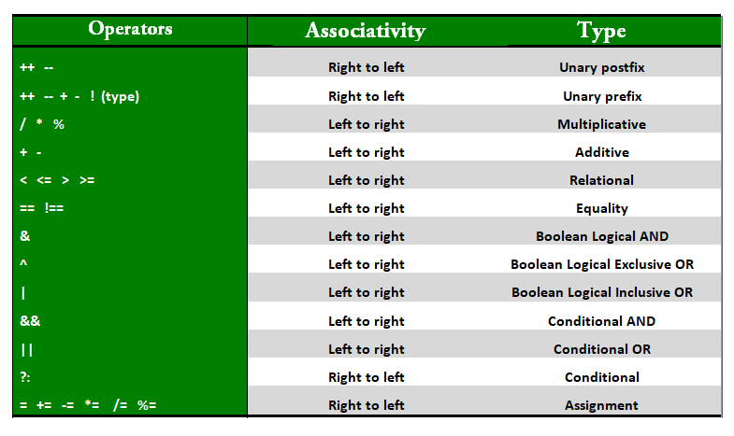
Operator in Java
Precedence and Associativity of Operators
Precedence and associative rules are used when dealing with hybrid equations involving more than one type of operator. In such cases, these rules determine which part of the equation to consider first as there can be many different valuations for the same equation. The table depicts the precedence of operators in decreasing order as magnitude with the top representing the highest precedence and bottom shows the lowest precedence.

Slide 59
Operator in Java
Precedence and Associativity of Operators
public class Operators {
public static void main(String[] args)
{
int a = 20, b = 10, c = 0, d = 20, e = 40, f = 30;
// precedence rules for arithmetic operators.
// (* = / = %) > (+ = -)
// prints a+(b/d)
System.out.println("a+b/d = " + (a + b / d));
// if same precendence then associative
// rules are followed.
// e/f -> b*d -> a+(b*d) -> a+(b*d)-(e/f)
System.out.println("a+b*d-e/f = "
+ (a + b * d - e / f));
}
}
Output:
a+b/d = 20
a+b*d-e/f = 219

Slide 60
What is dot operator in Java?
The (.) operator is also known as member operator it is used to access the member of a package or a class.
Example
public class Sample {
void display() {
double d = 20.3;
int i = (int)d;
System.out.println(i);
}
public static void main(String args[]) {
Sample s = new Sample();
s.display();
}
}
Output
20

Slide 61
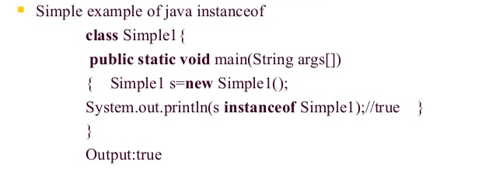
What is Java instanceof operator ?
instanceof operator is used only for object reference variables. The operator checks whether the object is of a particular type (class type or interface type). instanceof operator is written as −
( Object reference variable ) instanceof (class/interface type)
If the object referred by the variable on the left side of the operator passes the IS-A check for the class/interface type on the right side, then the result will be true. Following is an example

Slide 62
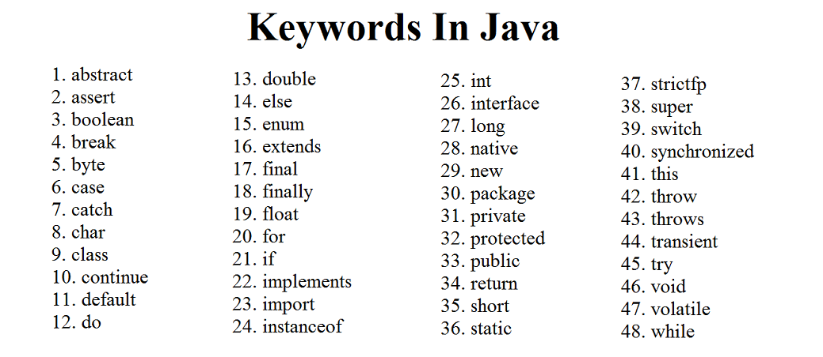

Slide 63
Unicode System
Unicode is a 16-bit character encoding standard and is capable to represent almost every character of well-known languages of the world.
Why java uses Unicode System?
Before Unicode, there were many language standards:
ASCII (American Standard Code for Information Interchange) for the United States.
ISO 8859-1 for Western European Language.
KOI-8 for Russian.
GB18030 and BIG-5 for chinese, and so on.
So to support multinational application codes, some character was using single byte, some two. An even same code may represent a different character in one language and may represent other characters in another language.
To overcome above shortcoming, the unicode system was developed where each character is represented by 2 bytes.

Slide 64
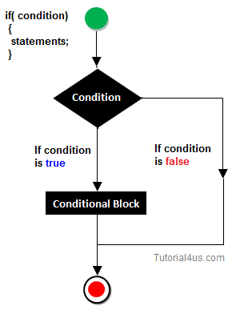
Decision Making Statement in Java
Decision making statement statements is also called selection statement.
That is depending on the condition block need to be executed or not which is decided by condition. If the condition is "true" statement block will be executed, if condition is "false" then statement block will not be executed.
if-then Statement

Slide 65
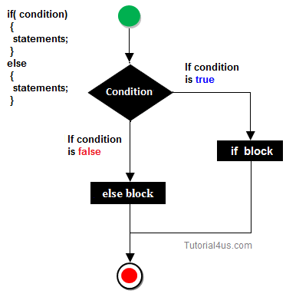
if-else Statement
//A Java Program to demonstrate the use of if-else statement.
//It is a program of odd and even number.
public class IfElseExample {
public static void main(String[] args) {
//defining a variable
int number=13;
//Check if the number is divisible by 2 or not
if(number%2==0){
System.out.println("even number");
}else{
System.out.println("odd number");
}
}
}

Slide 66
THANK YOU

Slide 67
Object Oriented Programming using JAVA
Presented By Sudeshna Kundu (Mondal)

Slide 68
Decision Making Statement in Java
Decision making statement statements is also called selection statement.
That is depending on the condition block need to be executed or not which is decided by condition. If the condition is "true" statement block will be executed, if condition is "false" then statement block will not be executed.
if-then Statement

Slide 69
if-else Statement
//A Java Program to demonstrate the use of if-else statement.
//It is a program of odd and even number.
public class IfElseExample {
public static void main(String[] args) {
//defining a variable
int number=13;
//Check if the number is divisible by 2 or not
if(number%2==0){
System.out.println("even number");
}else{
System.out.println("odd number");
}
}
}

Slide 70
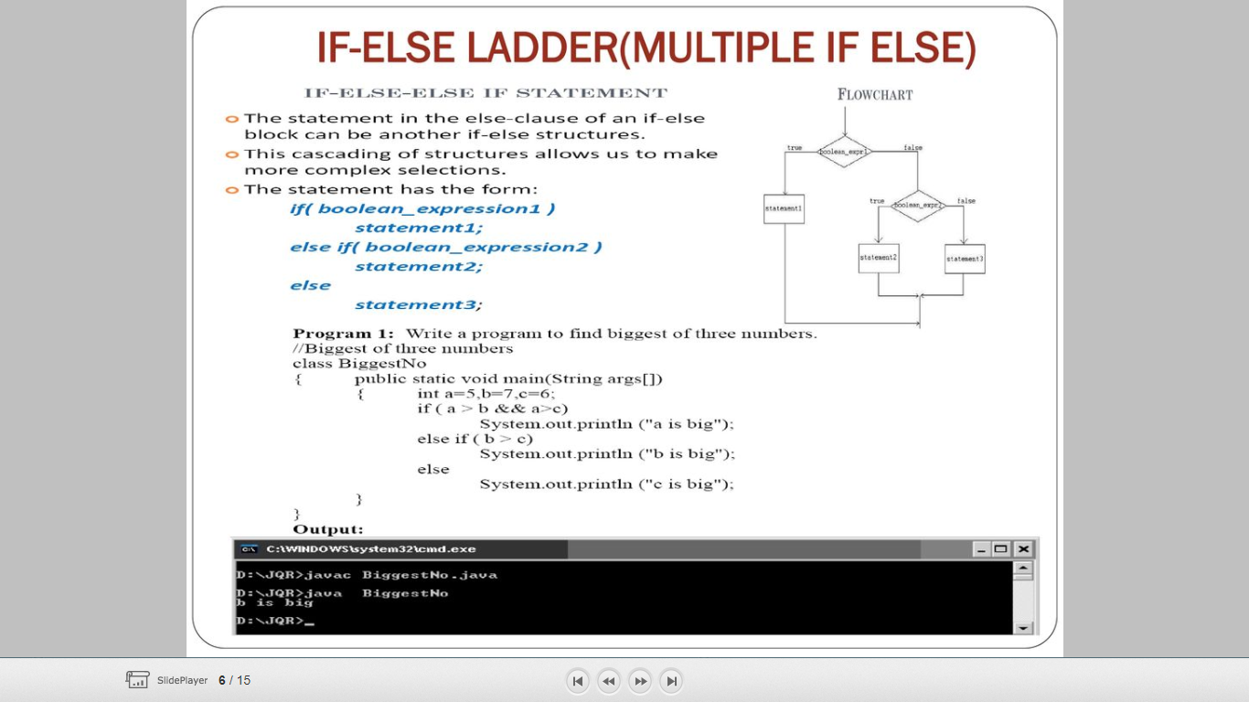
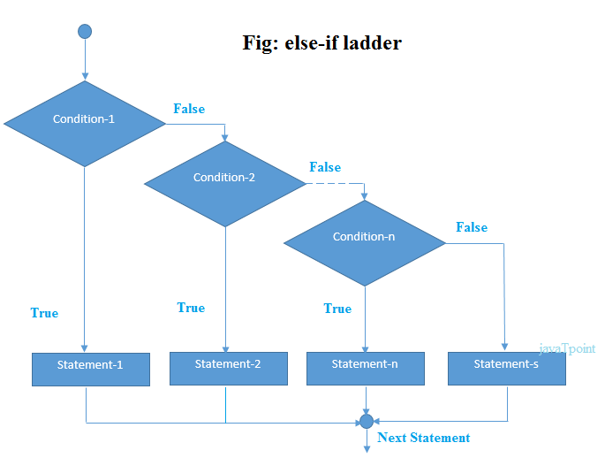
if-else Ladder

Slide 71
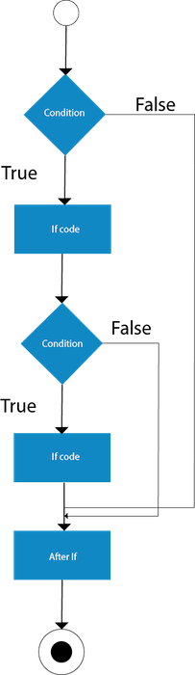
Java Nested if statement
The nested if statement represents the if block within another if block. Here, the inner if block condition executes only when outer if block condition is true.
Syntax:
if(condition){
//code to be executed
if(condition){
//code to be executed
}
}

Slide 72
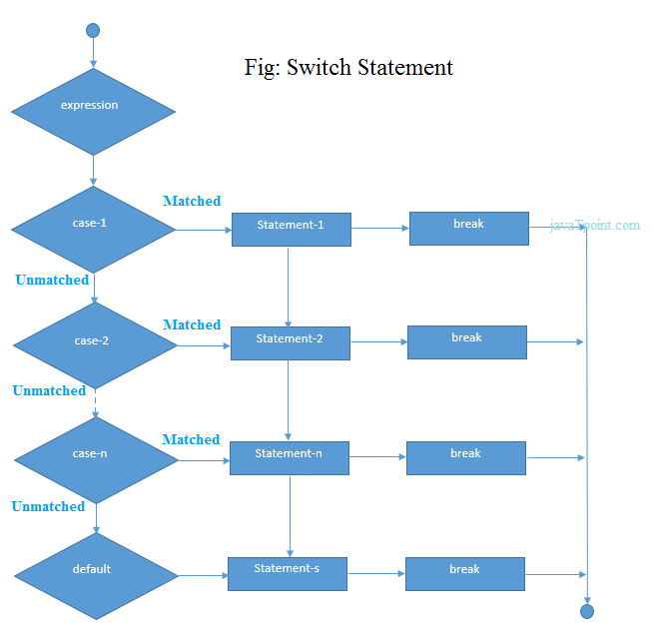
Switch Statement
switch(expression){
case value1:
//code to be executed;
break; //optional
case value2:
//code to be executed;
break; //optional
......
default:
code to be executed if all cases are not matched;
}

Slide 73
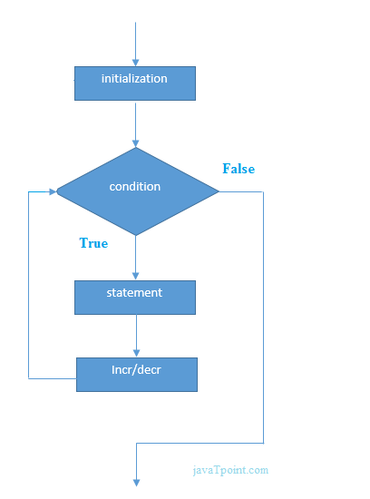
Loops in Java
In programming languages, loops are used to execute a set of instructions/functions repeatedly when some conditions become true. There are three types of loops in java.
for loop
while loop
do-while loop
public class ForExample {
public static void main(String[] args) {
for(int i=1;i<=10;i++){
System.out.println(i);
}
}
}
For Loop

Slide 74
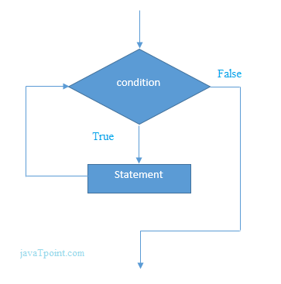
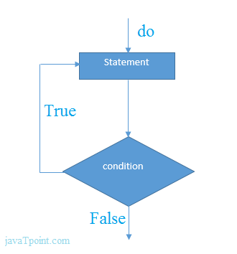
public class WhileExample {
public static void main(String[] args) {
int i=1;
while(i<=10){
System.out.println(i);
i++;
}
}
}
While Loop
Do While Loop
public class DoWhileExample {
public static void main(String[] args) {
int i=1;
do{
System.out.println(i);
i++;
}while(i<=10);
}
}

Slide 75
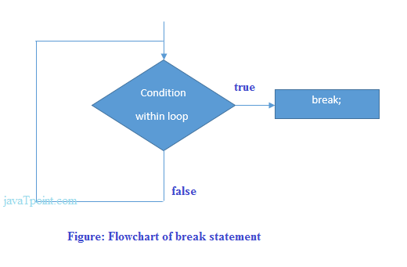
Break Statement
When a break statement is encountered inside a loop, the loop is immediately terminated and the program control resumes at the next statement following the loop.
The Java break statement is used to break loop or switch statement. It breaks the current flow of the program at specified condition. In case of inner loop, it breaks only inner loop.
We can use Java break statement in all types of loops such as for loop, while loop and do-while loop.
public class BreakExample2 {
public static void main(String[] args) {
//outer loop
for(int i=1;i<=3;i++){
//inner loop
for(int j=1;j<=3;j++){
if(i==2&&j==2){
//using break statement inside the inner loop
break;
}
System.out.println(i+" "+j);
}
}
}
}
Output:
1 1
1 2
1 3
2 1
3 1
3 2
3 3

Slide 76
Continue Statement
The continue statement is used in loop control structure when you need to jump to the next iteration of the loop immediately.
The Java continue statement is used to continue the loop. It continues the current flow of the program and skips the remaining code at the specified condition. In case of an inner loop, it continues the inner loop only.
We can use Java continue statement in all types of loops such as for loop, while loop and do-while loop.
public class ContinueExample {
public static void main(String[] args) {
//for loop
for(int i=1;i<=10;i++){
if(i==5){
//using continue statement
continue;//it will skip the rest statement
}
System.out.println(i);
}
}
}
Output:
1
2
3
4
6
7
8
9
10

Slide 77
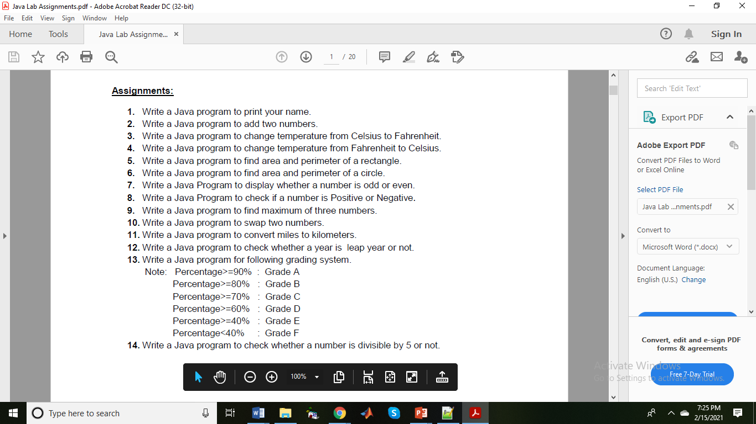

Slide 78


Slide 79


Slide 80
Object Oriented Programming using JAVA
Presented By Sudeshna Kundu (Mondal)

Slide 81

Java Comments
The Java comments are the statements that are not executed by the compiler and interpreter. The comments can be used to provide information or explanation about the variable, method, class or any statement. It can also be used to hide program code.
Types of Java Comments
There are three types of comments in Java.
Single Line Comment
Multi Line Comment
Documentation Comment

Slide 82
Java Comments
2) Java Multi Line Comment
The multi line comment is used to comment multiple lines of code.
Syntax:
/*
This
is
multi line
comment
*/
3) Java Documentation Comment
The documentation comment is used to create documentation API. To create documentation API, you need to use javadoc tool .
Syntax:
/**
This
is
documentation
comment
*/
1) Java Single Line Comment
The single line comment is used to comment only one line.
Syntax:
//This is single line comment

Slide 83



1-D Array

Slide 84


class Testarray{
public static void main(String args[]){
int a[]=new int[5];//declaration and instantiation
a[0]=10;//initialization
a[1]=20;
a[2]=70;
a[3]=40;
a[4]=50;
//printing array
for(int i=0;i<a.length;i++)//length is the property of array
System.out.println(a[i]);
}}

Slide 85

Processing elements in an array

Slide 86


Creating and Loading a 2D array

Slide 87

2D Array Implementation
public class MatrixAdditionExample{
public static void main(String args[]){
//creating two matrices
int a[][]={{1,3,4},{2,4,3},{3,4,5}};
int b[][]={{1,3,4},{2,4,3},{1,2,4}};
//creating another matrix to store the sum of two matrices
int c[][]=new int[3][3]; //3 rows and 3 columns
//adding and printing addition of 2 matrices
for(int i=0;i<3;i++){
for(int j=0;j<3;j++){
c[i][j]=a[i][j]+b[i][j];
System.out.print(c[i][j]+" ");
}
System.out.println();//new line
}
}}

Slide 88


Variable sized 2D array
// Manually allocate differing size second dimensions.
class TwoDAgain {
public static void main(String args[]) {
int twoD[][] = new int[4][];
twoD[0] = new int[1];
twoD[1] = new int[2];
twoD[2] = new int[3];
twoD[3] = new int[4];
int i, j, k = 0;
for(i=0; i<4; i++)
for(j=0; j<i+1; j++) {
twoD[i][j] = k;
k++;
}
for(i=0; i<4; i++) {
for(j=0; j<i+1; j++)
System.out.print(twoD[i][j] + " ");
System.out.println();
}
}
}
This program generates the following output:
0
1 2
3 4 5
6 7 8 9
The array created by this program looks like this:

Slide 89
Java Naming conventions
Java naming convention is a rule to follow as you decide what to name your identifiers such as class, package, variable, constant, method, etc.
But, it is not forced to follow. So, it is known as convention not rule. These conventions are suggested by several Java communities such as Sun Microsystems and Netscape.
All the classes, interfaces, packages, methods and fields of Java programming language are given according to the Java naming convention. If you fail to follow these conventions, it may generate confusion or erroneous code.
Advantage of naming conventions in java
By using standard Java naming conventions, you make your code easier to read for yourself and other programmers. Readability of Java program is very important. It indicates that less time is spent to figure out what the code does.
The following are the key rules that must be followed by every identifier:
The name must not contain any white spaces.
The name should not start with special characters like & (ampersand), $ (dollar), _ (underscore).

Slide 90
Examples of naming conventions in java
Class
It should start with the uppercase letter.
It should be a noun such as Color, Button, System, Thread, etc.
Use appropriate words, instead of acronyms.
Example: -
public class Employee
{
//code snippet
}
Method
It should start with lowercase letter.
It should be a verb such as main(), print(), println().
If the name contains multiple words, start it with a lowercase letter followed by an uppercase letter such as actionPerformed().
Example:-
class Employee
{
//method
void draw()
{
//code snippet
}
}

Slide 91
Variable
It should start with a lowercase letter such as id, name.
It should not start with the special characters like & (ampersand), $ (dollar), _ (underscore).
If the name contains multiple words, start it with the lowercase letter followed by an uppercase letter such as firstName, lastName.
Avoid using one-character variables such as x, y, z.
Example :-
class Employee
{
//variable
int id;
//code snippet
}
Constant
It should be in uppercase letters such as RED, YELLOW.
If the name contains multiple words, it should be separated by an underscore(_) such as MAX_PRIORITY.
It may contain digits but not as the first letter.
Example :-
class Employee
{
//constant
static final int MIN_AGE = 18;
//code snippet
}

Slide 92
Package
It should be a lowercase letter such as java, lang.
If the name contains multiple words, it should be separated by dots (.) such as java.util, java.lang.
Example :-
package com.javatpoint; //package
class Employee
{
//code snippet
}
Interface
It should start with the uppercase letter.
It should be an adjective such as Runnable, Remote, ActionListener.
Use appropriate words, instead of acronyms.
Example: -
interface Printable
{
//code snippet
}

Slide 93
CamelCase in java naming conventions
Java follows camel-case syntax for naming the class, interface, method, and variable.
If the name is combined with two words, the second word will start with uppercase letter always such as actionPerformed(), firstName, ActionEvent, ActionListener, etc.

Slide 94

Classes & Objects
A class is a group of objects which have common properties. It is a template or blueprint from which objects are created. It is a logical entity. It can't be physical.
Syntax to declare a class:
class <class_name>{
field;
method;
}

Slide 95

Classes & Objects
Object is an instance of a class. Class is a template or blueprint from which objects are created. So object is the instance(result) of a class.
Object Definitions:
Object is a real world entity.
Object is a run time entity.
Object is an entity which has state and behavior.
Object is an instance of a class.

Slide 96

Characteristics of an object in Java
An object has three characteristics:
1. State: State represents properties of an object. It is represented by instance variable/attribute of an object. The properties of an object are important because the outcome of functions depend on the properties.
2. Behavior: Behavior represents functionality or actions. It is represented by methods in Java.
3. Identity: Identity represents the unique name of an object. It differentiates one object from the other. The unique name of an object is used to identify the object.
Let’s take a real-world example to understand all these points clearly.

Slide 97

Real-time Examples of Objects in Java
We are taking the example “person”. A person has three characteristics: Identity (name), State (properties), and behavior (actions or functionality). Look at the below figure.
In the above figure, a person is an object. First state of the person (object) is black hair which can be represented in Java like this: hairColor = “black”.
In the same way, second property of the object is eye color which can be represented in Java like eyeColor = “black” and so on. These are called attributes that define the properties of a person.
Let’s consider the behaviors or actions of a person. The actions of a person may be “eat, sleep, walk, play, and study”. These actions are represented in Java like this: eat(), sleep(), walk(), play(), and study(). These are called methods.
Thus, when properties and actions are combined together of any real-world object make an object in Java.

Slide 98
Classes in Java
In Java programming, a class is basically user-defined data types that act as a template for creating objects of the identical type. It represents the common properties and actions (functions) of an object.
In other words, a class can also be defined as “a class is a group of objects which are common to all objects of one type”.
A class is the type of an object. Let’s understand it with realtime examples.
Realtime Examples of Class in Java
Let us consider two objects Samsung Galaxy S4 and iPhone. Suppose Samsung Galaxy S4 have some properties like width = “6.98 cms”, height = “13.6 cm”, OS = “Android”, brand = “Samsung”, price = “1000$” and actions are call(), sendMessage(), browser(), share().
Now, suppose iPhone has some properties such as width = “5.86 cm”, height = “12.3 cms”, OS = “iOS”, brand = “Apple”, price = “1200$” and actions are call(), sendMessage(), browse(), share().
Both objects have some different properties and actions but the type is the same “Phone”. This is the class. i.e the name of the class is “Phone”.

Slide 99

Object and Class Example: main within the class
In this example, we have created a Student class which has two data members id and name. We are creating the object of the Student class by new keyword and printing the object's value.
Here, we are creating a main() method inside the class.
//Java Program to illustrate how to define a class and fields
//Defining a Student class.
class Student{
//defining fields
int id;//field or data member or instance variable
String name;
//creating main method inside the Student class
public static void main(String args[]){
//Creating an object or instance
Student s1=new Student();
System.out.println(s1.id);//accessing member through reference variable
System.out.println(s1.name);
}
}
Output:
0
null

Slide 100
Classes & Objects
Creating Objects
Class name Dynamically create the object
Student s1= new Student();
Name of an object Automatically calls the constructor
A class provides the blueprints for objects. So basically, an object is created from a class. In Java, the new keyword is used to create new objects.
There are three steps when creating an object from a class −
Declaration − A variable declaration with a variable name with an object type.
Instantiation − The 'new' keyword is used to dynamically allocates memory for an object an returns a reference to it.
Initialization − The 'new' keyword is followed by a call to a constructor. This call initializes the new object.

Slide 101
Object and Class Example: main outside the class
In real time development, we create classes and use it from another class. It is a better approach than previous one. Let's see a simple example, where we are having main() method in another class.
We can have multiple classes in different Java files or single Java file. If you define multiple classes in a single Java source file, it is a good idea to save the file name with the class name which has main() method.
//Java Program to demonstrate having the main method in
//another class
//Creating Student class.
class Student{
int id;
String name;
}
//Creating another class TestStudent1 which contains the main method
class TestStudent1{
public static void main(String args[]){
Student s1=new Student();
System.out.println(s1.id);
System.out.println(s1.name);
}
}
Output:
0
null

Slide 102
Object Oriented Programming using JAVA
Presented By Sudeshna Kundu (Mondal)

Slide 103
Object and Class Example:
when you create a class, you are creating a new data type. You can use this type to declare objects of that type.
However, obtaining objects of a class is a two-step process. First, you must declare a variable of the class type. This variable does not define an object. Instead, it is simply a variable that can refer to an object. Second, you must acquire an actual, physical copy of the object and assign it to that variable.
The new operator dynamically allocates (that is, allocates at run time) memory for an object and returns a reference to it. This reference is, more or less, the address in memory of the object allocated by new. This reference is then stored in the variable. Thus, in Java, all class objects must be dynamically allocated.
The class name followed by parentheses specifies the constructor for the class. However, if no explicit constructor is specified, then Java will automatically supply a default constructor.
class Box {
double width;
double height;
double depth;
}
Box mybox; // declare reference to object
mybox = new Box(); // allocate a Box object

Slide 104
Object and Class Example: main within the class
In this example, we have created a Student class which has two data members id and name. We are creating the object of the Student class by new keyword and printing the object's value.
Here, we are creating a main() method inside the class.
//Java Program to illustrate how to define a class and fields
//Defining a Student class.
class Student{
//defining fields
int id;//field or data member or instance variable
String name;
//creating main method inside the Student class
public static void main(String args[]){
//Creating an object or instance
Student s1=new Student();
System.out.println(s1.id);//accessing member through reference variable
System.out.println(s1.name);
}
}
Output:
0
null

Slide 105
Classes & Objects
Creating Objects
Class name Dynamically create the object
Student s1= new Student();
Name of an object Automatically calls the constructor
A class provides the blueprints for objects. So basically, an object is created from a class. In Java, the new keyword is used to create new objects.
There are three steps when creating an object from a class −
Declaration − A variable declaration with a variable name with an object type.
Instantiation − The 'new' keyword is used to dynamically allocates memory for an object an returns a reference to it.
Initialization − The 'new' keyword is followed by a call to a constructor. This call initializes the new object.

Slide 106
Object and Class Example: main outside the class
In real time development, we create classes and use it from another class. It is a better approach than previous one. Let's see a simple example, where we are having main() method in another class.
We can have multiple classes in different Java files or single Java file. If you define multiple classes in a single Java source file, it is a good idea to save the file name with the class name which has main() method.
//Java Program to demonstrate having the main method in
//another class
//Creating Student class.
class Student{
int id;
String name;
}
//Creating another class TestStudent1 which contains the main method
class TestStudent1{
public static void main(String args[]){
Student s1=new Student();
System.out.println(s1.id);
System.out.println(s1.name);
}
}
Output:
0
null

Slide 107
How to Initialize State of Object in Java?
There are three ways by which we can initialize state of an object. In other words, we can initialize value of variables in Java by using three ways. They are as follows:
1. By using a reference variable
2. By using a method.
3. By using constructor
Object Initialization by using Reference variable
We can also initialize the value of objects through the reference variable.

Slide 108
Object Initialization by using Reference variable
We can also initialize the value of objects through the reference variable.
class Student{
int id;
String name;
}
class TestStudent2{
public static void main(String args[]){
Student s1=new Student();
s1.id=101;
s1.name=“Kartik";
System.out.println(s1.id+" "+s1.name);//printing members with a white space
}
}
We can also create multiple objects and store information in it through reference variable.
Output:
101 Kartik

Slide 109

2. Initialization through method
class Student{
int rollno;
String name;
void insertRecord(int r, String n){
rollno=r;
name=n;
}
void displayInformation(){System.out.println(rollno+" "+name);}
}
class TestStudent4{
public static void main(String args[]){
Student s1=new Student();
Student s2=new Student();
s1.insertRecord(111,"Karan");
s2.insertRecord(222,"Aryan");
s1.displayInformation();
s2.displayInformation();
}
}
rollno=222
Name= Ayan
s2
rollno=111
Name= Karan
Stack Memory
Heap Memory

Slide 110

Input through Scanner class

Slide 111


Scanner class in Java is found in the java.util package. Java provides various ways to read input from the keyboard, the java.util.Scanner class is one of them.

Slide 112


The Java Scanner class breaks the input into tokens using a delimiter which is whitespace by default. It provides many methods to read and parse various primitive values.

Slide 113


Input through Scanner class
Scanner is one of the predefined class which is used for reading the data dynamically from the keyboard.

Slide 114
Object Oriented Programming using JAVA Paper code: PCC – CS481
Presented By
Sudeshna Kundu (Mondal)

Slide 115
Constructor in Java
A constructor in java is similar to a method that is used to initialize objects of a class through a new operator.
In other words, a constructor is basically a special method that is used to initialize instance variables in a program. The sole purpose of the constructor is to initialize the objects of the class.
Key points of Constructor:
1. Constructor name must be the same as its name of the class in which it is declared and defined.
2. The constructor should not have any return type even void also because if there is return type then JVM would consider as a method, not a constructor. Compiler and JVM differentiate constructor and method definitions on the basis of the return type. (Suppose you define the method and constructor with the same name as that of the class name then JVM would differentiate between them by using return type.)
3. Whenever you create an object/instance of a class, the constructor will be automatically called by the JVM. If you don’t define any constructor inside the class, the compiler automatically creates a default constructor at compile-time and assigns default values for all variables declared in the class.
The default values for variables are as follows:
a. Numeric variables are set to 0.
b. Strings are set to null.
c. Boolean variables are set to false.

Slide 116

Types of Constructors in Java
Basically, there are two types of constructors in java. They are:
1. Default Constructor (No-argument constructor)
2. Parameterized Constructor (Argument constructor)
Default Constructor in Java with Example
A constructor which has no parameter is known as default constructor in Java. When a class does not declare a constructor, JVM automatically creates a constructor for that class. This constructor is called default constructor.
We cannot pass any argument to the default constructor. That’s why it is known as a no-argument constructor. It does not do anything but it allows to create the instance of the class.

Slide 117
Default Constructors in Java
// Static method or main method.
public static void main(String[] args)
{
// Create the object of the class using new keyword.
Person p = new Person(); // Calling default constructor.
// Call the method using object reference variable p.
p.display(); // Calling display method.
}
}
public class Person
{
// Declaration of Instance variables.
String name;
int age;
String address;
// Here, We are not creating any constructor. So Compiler will automatically insert a default constructor.
// Create one method to print the default values.
void display()
{
System.out.println(name+ " " +age+ " " +address );
}
Output:
null 0 null
In the preceding example program, we did not create any constructor. So, the java compiler provides a default constructor. null, 0, null is the default values of the instance variables provided by the default constructor.

Slide 118

Default Constructors in Java
Person()
{
// Initialization of values of Instance variables.
name = "Vivek";
age = 25;
address = "Gandhi Nagar";
}
display(){
//Print the values on the console.
System.out.println(name+ " " +age+ " " +address);
}
Output:
Vivek 28 Gandhi Nagar.
We know that p is an object reference variable which contains the address of the memory location of the object. Here, 5575 is the address on the stack where we can find other detail of the class like name, age, and address on this address.
Key point:
👉 A reference variable never contains an object directly. It contains an address that points to data stored in the memory location.
In the above image, you can see that when we did not initialize the values of the instance variable in the constructor in program 1, default values for variables have been stored on the heap after calling constructor.
But, when we initialized the values of variables in the constructor in program 2, After calling the constructor, default values are eliminated from the memory location and initialized values are stored in the memory location of heap.

Slide 119
Parameterized Constructor in Java
A constructor that takes parameters is known as parameterized constructor in java or argument constructor. The parameterized constructor is used to provide different values to the distinct object.
To call the parameterized constructor, we pass arguments while creating the object. The argument can be of any type like integer, array, character or an object. It can take any number of arguments. Java does not provide a parameterized constructor by default.
public class Demo
{
// Declare parameterized constructor with zero argument.
Demo()
{
System.out.println("Zero argument constructor");
}
// Declare parameterized constructor with one argument.
Demo(int a)
{
System.out.println("One argument constructor");
}
// Declare parameterized constructor with two arguments.
Demo(int a, int b)
{
System.out.println("Two arguments constructor");
}
public static void main(String[] args)
{
// Create an object of the class.
Demo d = new Demo(); // Calling Default constructor.
d = new Demo(20); // Calling one argument constructor.
d = new Demo(10,15); // Calling two argument constructor.
}
}
Output:
Zero argument constructor
One argument constructor
Two arguments constructor

Slide 120


Slide 121

this Reference in Java
There can be a lot of usage of java this keyword. In java, this is a reference variable that refers to the current object.
Usage of java this keyword:
this can be used to refer current class instance variable.
this can be used to invoke current class method (implicitly)
this() can be used to invoke current class constructor.
1) this: to refer current class instance variable
The this keyword can be used to refer current class instance variable. If there is ambiguity between the instance variables and parameters, this keyword resolves the problem of ambiguity.

Slide 122





Slide 123
public class Student
{
// Declaration of instance variables.
String name;
String schoolName;
int rollNo;
Student(String name, String sName)
{
this.name = name; // Here, 'this' reference is used.
schoolName = sName;
}
Student(String name, String sName, int rollNo)
{
this.name = name; // this reference.
schoolName = sName;
this.rollNo = rollNo;
}
void details()
{
System.out.println(name+ " " +schoolName+ " " +rollNo);
}
public static void main(String[] args)
{
// Create an object of class and pass the arguments to its constructors.
Student st = new Student("Riddhi", "DPS");
Student st2 = new Student("Siddhi", "RSVM", 05);
st.details();
st2.details();
}
}

Slide 124

2) this: to invoke current class method
You may invoke the method of the current class by using the this keyword. If you don't use the this keyword, compiler automatically adds this keyword while invoking the method. Let's see the example
class A{
void m(){System.out.println("hello m");}
void n(){
System.out.println("hello n");
//m();//same as this.m()
this.m();
}
}
class TestThis4{
public static void main(String args[]){
A a=new A();
a.n();
}}
Output:
hello n
hello m

Slide 125


3) this() : to invoke current class constructor
The this() constructor call can be used to invoke the current class constructor. It is used to reuse the constructor. In other words, it is used for constructor chaining.

Slide 126

Assigning Object Reference Variables
Object reference variables act differently than you might expect when an assignment takes
place. For example, what do you think the following fragment does?
Box b1 = new Box();
Box b2 = b1;
You might think that b2 is being assigned a reference to a copy of the object referred to by
b1. That is, you might think that b1 and b2 refer to separate and distinct objects. However,
this would be wrong. Instead, after this fragment executes, b1 and b2 will both refer to the
same object.

Slide 127

Array of Objects in Java Java is an object-oriented programming language. Most of the work done with the help of objects. We know that an array is a collection of the same data type that dynamically creates objects and can have elements of primitive types. Java allows us to store objects in an array. In Java, the class is also a user-defined data type. An array that contains class type elements are known as an array of objects. It stores the reference variable of the object.

Slide 128
Array of Objects in Java
public class ArrayOfObjects
{
public static void main(String args[])
{
//create an array of product object
Product[] obj = new Product[5] ;
//create & initialize actual product objects using constructor
obj[0] = new Product(23907,"Dell Laptop");
obj[1] = new Product(91240,"HP 630");
obj[2] = new Product(29823,"LG OLED TV");
obj[3] = new Product(11908,"MI Note Pro Max 9");
obj[4] = new Product(43590,"Kingston USB");
//display the product object data
System.out.println("Product Object 1:");
obj[0].display();
System.out.println("Product Object 2:");
obj[1].display();
System.out.println("Product Object 3:");
obj[2].display();
System.out.println("Product Object 4:");
obj[3].display();
System.out.println("Product Object 5:");
obj[4].display();
}
}
class Product
{
int pro_Id;
String pro_name;
//Product class constructor
Product(int pid, String n)
{
pro_Id = pid;
pro_name = n;
}
public void display()
{
System.out.print("Product Id = "+pro_Id + " " + " Product Name = "+pro_name);
System.out.println();
}
}

Slide 129
Object Oriented Programming using JAVA
Presented By Sudeshna Kundu (Mondal)

Slide 130


Java Variables
Types of Variables
There are three types of variables in Java:
local variable
instance variable
static variable
A variable in Java is a container that holds the value during the execution of Java program. In other words, Variable is the name of the memory location reserved for storing value.
Each variable in Java has a specific type that determines size of the memory. The size of the memory reserved depends on the data type

Slide 131


Java Variables

Slide 132



Slide 133




Slide 134

Instance Variables in Java
1. A variable that is declared inside the class but outside the body of the method, constructor, or any block is called instance variable in java.
It is called instance variable because its value is instance specific and is not shared among instances.
2. Instance variables are created when an object is created using the keyword ‘new’ and destroyed when the object is destroyed.
3. We can also use access modifiers with instance variables. If we do not specify any modifiers, the default access modifiers will be used which can be accessed in the same package only.
4. It is not necessary to initialize the instance variable.
5. Instance variables have default values. For numbers, the default value is 0, for Booleans it is false. Values can be assigned during the declaration or within the constructor.
Class Example{

Slide 135
import java.io.*;
class Marks {
// These variables are instance variables.
// These variables are in a class
// and are not inside any function
int engMarks;
}
class MarksDemo {
public static void main(String args[])
{
// first object
Marks obj1 = new Marks();
obj1.engMarks = 50;
// second object
Marks obj2 = new Marks();
obj2.engMarks = 80;
// displaying marks for first object
System.out.println("Marks for first object:");
System.out.println(obj1.engMarks);
// displaying marks for second object
System.out.println("Marks for second object:");
System.out.println(obj2.engMarks);
}
}
Output:
Marks for first object:
50
Marks for second object:
80

Slide 136

Static Variables
Static variables are also known as Class variables.
These variables are declared similarly as instance variables, the difference is that static variables are declared using the static keyword within a class outside any method constructor or block.
Unlike instance variables, we can only have one copy of a static variable per class irrespective of how many objects we create.
Static variables are created at the start of program execution and destroyed automatically when execution ends.
Initialization of Static Variable is not Mandatory. Its default value is 0
If we access the static variable like Instance variable (through an object), the compiler will show the warning message and it won’t halt the program. The compiler will replace the object name to class name automatically.
If we access the static variable without the class name, Compiler will automatically append the class name.
To access static variables, we need not create an object of that class, we can simply access the variable as
class_name.variable_name;

Slide 137
Difference between Instance Variables and Static variables in Java
Instance variables | Static (class) variables
Instance variables are declared in a class, but outside a method, constructor or any block. | Class variables also known as static variables are declared with the static keyword in a class, but outside a method, constructor or a block.
Instance variables are created when an object is created with the use of the keyword 'new' and destroyed when the object is destroyed. | Static variables are created when the program starts and destroyed when the program stops.
Instance variables can be accessed directly by calling the variable name inside the class. However, within static methods (when instance variables are given accessibility), they should be called using the fully qualified name. ObjectReference.VariableName. | Static variables can be accessed by calling with the class name ClassName.VariableName.
Instance variables hold values that must be referenced by more than one method, constructor or block, or essential parts of an object's state that must be present throughout the class. | There would only be one copy of each class variable per class, regardless of how many objects are created from it.

Slide 138
Method in Java
In general, a method is a way to perform some task. Similarly, the method in Java is a collection of instructions that performs a specific task.
It is used to achieve the reusability of code. We write a method once and use it many times. We do not require to write code again and again.
It also provides the easy modification and readability of code, just by adding or removing a chunk of code.

Slide 139

Types of methods in Java
Generally, there are two basic types of methods in Java but programmers can develop any kind of method depending on the scenario. 1. Predefined methods 2. User-defined methods (Programmer-defined methods)

Slide 140

Method Declaration
The method declaration provides information about method attributes, such as visibility, return-type, name, and arguments. It has six components that are known as method header, as we have shown in the following figure.
Method in Java
Method Signature: Every method has a method signature. It is a part of the method declaration. It includes the method name and parameter list.
Access Specifier: Access specifier or modifier is the access type of the method. It specifies the visibility of the method. Java provides four types of access specifier:

Slide 141
Method Declaration
Public: The method is accessible by all classes when we use public specifier in our application.
Private: When we use a private access specifier, the method is accessible only in the classes in which it is defined.
Protected: When we use protected access specifier, the method is accessible within the same package or subclasses in a different package.
Default: When we do not use any access specifier in the method declaration, Java uses default access specifier by default. It is visible only from the same package only.
Return Type: Return type is a data type that the method returns. It may have a primitive data type, object, collection, void, etc. If the method does not return anything, we use void keyword.
Method Name: It is a unique name that is used to define the name of a method. It must be corresponding to the functionality of the method. Suppose, if we are creating a method for subtraction of two numbers, the method name must be subtraction(). A method is invoked by its name.
Parameter List: It is the list of parameters separated by a comma and enclosed in the pair of parentheses. It contains the data type and variable name. If the method has no parameter, left the parentheses blank.
Method Body: It is a part of the method declaration. It contains all the actions to be performed. It is enclosed within the pair of curly braces.

Slide 142
Predefined methods in Java with Example Program
Predefined methods are those methods that are already defined in the Java API (Application Programming Interface) to use in an application. Java Programming language contains predefined classes that are organized in different predefined packages.
Within these predefined classes, there are located predefined methods. In fact, Java has over 160 predefined packages that contain more than 3000 predefined classes.
These classes have many more thousands of individual predefined methods. All are available to the programmers via Java API.
For example:
1. print() is a predefined method present in the package java.io.PrintSteam. The print(“….”) prints the string inside the quotation marks.
2. sqrt() is a method of Math class which is present in package java.lang. It calculates the square root of a number. Let’ take an example program based on java predefined methods.

Slide 143
Predefined methods in Java with Example Program
public class Demo
{
public static void main(String[] args)
{
// using the max() method of Math class
System.out.print("The maximum number is: " + Math.max(9,7));
}
}

Slide 144

The different forms of declaration a static method can be seen at the below screenshot.

Slide 145
User-defined methods in Java with Example Program
Static Method
A method that has static keyword is known as static method. In other words, a method that belongs to a class rather than an instance of a class is known as a static method. We can also create a static method by using the keyword static before the method name.
The main advantage of a static method is that we can call it without creating an object. It can access static data members and also change the value of it. It is used to create an instance method. It is invoked by using the class name. The best example of a static method is the main() method.
public class Display
{
public static void main(String[] args)
{
show();
}
static void show()
{
System.out.println("It is an example of static method.");
}
}

Slide 146
User-defined methods in Java with Example Program
Instance Method
The method of the class is known as an instance method. It is a non-static method defined in the class. Before calling or invoking the instance method, it is necessary to create an object of its class. Let's see an example of an instance method.
public class InstanceMethodExample
{
int s;
//user-defined method because we have not used static keyword
public int add(int a, int b)
{
s = a+b;
//returning the sum
return s;
}
public static void main(String [] args)
{
//Creating an object of the class
InstanceMethodExample obj = new InstanceMethodExample();
//invoking instance method
System.out.println("The sum is: "+obj.add(12, 13));
}
}

Slide 147

Difference between Instance Methods and Static Methods

Slide 148
Why instance variable is not available to static method?
When we declare a static method in Java, the JVM first executes the static method, and then it creates the objects of the class. Since the objects are not available at the time of calling the static method.
Therefore, the instance variables are also not available to a static method. Due to which a static method cannot access an instance variable in the class.

Slide 149
Objective: To understand the concepts of Array and Constructor.
Assignments 3:
1. Write a Java program to calculate Sum & Average of an integer array.
2. Write a Java program to implement stack using array.
3. Write a Java program to implement Queue using array.
4. Write a Java program to calculate Sum of two 2-dimensional arrays.
5. Write a Java program to find the range of a 1D array.
6. Write a Java program to search an element in an array.
7. Write a Java program to find the sum of even numbers in an integer array.
8. Write a Java program to find the sum of diagonal elements in a 2D array.
9. Reverse the elements in an array of integers without using a second array.
10. Write a Java program to enter n elements in an array and find smallest number among them.
11. Write Java program to find the sum of all odd numbers in a 2D array.
12. Write a Java program to print transpose of matrix.
13. Write a Java program to check whether a given matrix is sparse or not.
14. Write a Java program to count the prime numbers in an array.
15. Write a Java program to find second highest element of an array.
16. Write a Java program which counts the non-zero elements in an integer array.
17. Write a Java program to merge two float arrays.

Slide 150
18. Write a Java program where elements of two integer arrays get added index wise and get stored into a third array.
19. Write a Java program to multiply two matrices.
20. Write a Java program to subtract two matrices.
21. Write a Java program to find duplicate elements in a 1D array and find their frequency of occurrence.
22. Write a Java program to print every alternate number of a given array.
23. Given are two one-dimensional arrays A & B, which are sorted in ascending order. Write a Java program to merge them into single sorted array C that contains every item from arrays A & B, in ascending order.
24. Write a Java program to show 0-arguments constructor.
25. Write a Java program to show parameterized constructor.
26. Write a class, Grader, which has an instance variable, score, an appropriate constructor and appropriate methods. A method, letterGrade() that returns the letter grade as O/E/A/B/C/F.
Now write a demo class to test the Grader class by reading a score from the user, using it to create a Grader object after validating that the value is not negative and is not greater than 100. Finally, call the letterGrade() method to get and print the grade.
27. Write a class, Commission, which has an instance variable, sales; an appropriate constructor; and a method, commission() that returns the commission.
Now write a demo class to test the Commission class by reading a sale from the user, using it to create a Commission object after validating that the value is not negative. Finally, call the commission() method to get and print the commission. If the sales are negative, your demo should print the message “Invalid Input”.

Slide 151
Object Oriented Programming using JAVA
Presented By Sudeshna Kundu (Mondal)

Slide 152

Polymorphism in Java
The process of representing one form in multiple forms is known as Polymorphism.
Polymorphism is derived from 2 greek words: poly and morphs. The word "poly" means many and "morphs" means forms. So polymorphism means many forms.
Real life example of polymorphism in Java
Suppose if you are in class room that time you behave like a student, when you are in market at that time you behave like a customer, when you at your home at that time you behave like a son or daughter, Here one person present in different-different behaviors.

Slide 153


Slide 154


Slide 155
Method Overloading in Java
If a class has multiple methods having same name but different in parameters, it is known as Method Overloading.
If we have to perform only one operation, having same name of the methods increases the readability of the program.
Suppose you have to perform addition of the given numbers but there can be any number of arguments, if you write the method such as a(int,int) for two parameters, and b(int,int,int) for three parameters then it may be difficult for you as well as other programmers to understand the behavior of the method because its name differs.

Slide 156
Method Overloading in Java
Advantage of method overloading
Method overloading increases the readability of the program.
Different ways to overload the method
There are two ways to overload the method in java
By changing number of arguments
By changing the data type

Slide 157
Method Overloading in Java
1) Method Overloading: changing no. of arguments
In this example, we have created two methods, first add() method performs addition of two numbers and second add method performs addition of three numbers.
In this example, we are creating static methods so that we don't need to create instance for calling methods.
class Adder{
static int add(int a,int b){return a+b;}
static int add(int a,int b,int c){return a+b+c;}
}
class TestOverloading1{
public static void main(String[] args){
System.out.println(Adder.add(11,11));
System.out.println(Adder.add(11,11,11));
}}
Output:
22
33

Slide 158
Method Overloading in Java
2) Method Overloading: changing data type of arguments
In this example, we have created two methods that differs in data type. The first add method receives two integer arguments and second add method receives two double arguments.
class Adder{
static int add(int a, int b){return a+b;}
static double add(double a, double b){return a+b;}
}
class TestOverloading2{
public static void main(String[] args){
System.out.println(Adder.add(11,11));
System.out.println(Adder.add(12.3,12.6));
}}
Output:
22
24.9

Slide 159
Method Overloading in Java
Why Method Overloading is not possible by changing the return type of method only?
In java, method overloading is not possible by changing the return type of the method only because of ambiguity. Let's see how ambiguity may occur:
class Adder{
static int add(int a,int b){return a+b;}
static double add(int a,int b){return a+b;}
}
class TestOverloading3{
public static void main(String[] args){
System.out.println(Adder.add(11,11));//ambiguity
}}
Output:
Compile Time Error: method add(int,int) is already defined in class Adder

Slide 160
Method Overloading in Java
Can we overload java main() method?
Yes, by method overloading. You can have any number of main methods in a class by method overloading. But JVM calls main() method which receives string array as arguments only. Let's see the simple example:
class TestOverloading4{
public static void main(String[] args){System.out.println("main with String[]");}
public static void main(String args){System.out.println("main with String");}
public static void main(){System.out.println("main without args");}
}
Output:
main with String[]

Slide 161

Constructor Overloading in Java
Constructor overloading in Java means to define multiple constructors but each one must have a different signature. It is a technique in Java in which a class can have more than one constructor that differ in the parameters list.
The Java compiler differentiates these constructors based on the number of the parameter list and their types. Therefore, the signature of each constructor must be different. The signature of a constructor consists of its name and sequence of parameter types.

Slide 162
Advantage of Constructor Overloading in Java
The advantages of using constructor overloading in java programming are as follows:
1. Java constructor overloading helps to achieve static polymorphism.
2. The main advantage of constructor overloading is to allow an instance of a class to be initialized in various ways.
3. It allows to define multiple constructors of a class with different signatures.

Slide 163

Method Overloading and Type Promotion
One type is promoted to another implicitly if no matching datatype is found. Let's understand the concept by the figure given below:
As displayed in the above diagram, byte can be promoted to short, int, long, float or double. The short datatype can be promoted to int, long, float or double. The char datatype can be promoted to int,long,float or double and so on.

Slide 164
Method Overloading and Type Promotion
Example of Method Overloading with TypePromotion
class OverloadingCalculation1{
void sum(int a,long b){System.out.println(a+b);}
void sum(int a,int b,int c){System.out.println(a+b+c);}
public static void main(String args[]){
OverloadingCalculation1 obj=new OverloadingCalculation1();
obj.sum(20,20);//now second int literal will be promoted to long
obj.sum(20,20,20);
}
}
Output:
40
60

Slide 165
Method Overloading and Type Promotion
Example of Method Overloading with Type Promotion if matching found
If there are matching type arguments in the method, type promotion is not performed.
class OverloadingCalculation2{
void sum(int a,int b){System.out.println("int arg method invoked");}
void sum(long a,long b){System.out.println("long arg method invoked");}
public static void main(String args[]){
OverloadingCalculation2 obj=new OverloadingCalculation2();
obj.sum(20,20);//now int arg sum() method gets invoked
}
}
Output:
int arg method invoked

Slide 166
Method Overloading and Type Promotion
Example of Method Overloading with Type Promotion in case of ambiguity
If there are no matching type arguments in the method, and each method promotes similar number of arguments, there will be ambiguity.
class OverloadingCalculation3{
void sum(int a,long b){System.out.println("a method invoked");}
void sum(long a,int b){System.out.println("b method invoked");}
public static void main(String args[]){
OverloadingCalculation3 obj=new OverloadingCalculation3();
obj.sum(20,20);//now ambiguity
}
}
Output:
Compile Time Error

Slide 167
Passing and Returning Objects in Java
Although Java is strictly pass by value, the precise effect differs between whether a primitive type or a reference type is passed.
When we pass a primitive type to a method, it is passed by value. But when we pass an object to a method, the situation changes dramatically, because objects are passed by what is effectively call-by-reference. Java does this interesting thing that’s sort of a hybrid between pass-by-value and pass-by-reference.
While creating a variable of a class type, we only create a reference to an object. Thus, when we pass this reference to a method, the parameter that receives it will refer to the same object as that referred to by the argument.
This effectively means that objects act as if they are passed to methods by use of call-by-reference.
Changes to the object inside the method do reflect in the object used as an argument.

Slide 168

R

Slide 169
// Java program to demonstrate objects
// passing to methods.
class ObjectPassDemo
{
int a, b;
ObjectPassDemo(int i, int j)
{
a = i;
b = j;
}
// return true if o is equal to the invoking
// object notice an object is passed as an
// argument to method
boolean equalTo(ObjectPassDemo o)
{
return (o.a == a && o.b == b);
}
}
// Driver class
public class Test
{
public static void main(String args[])
{
ObjectPassDemo ob1 = new ObjectPassDemo(100, 22);
ObjectPassDemo ob2 = new ObjectPassDemo(100, 22);
ObjectPassDemo ob3 = new ObjectPassDemo(-1, -1);
System.out.println("ob1 == ob2: " + ob1.equalTo(ob2));
System.out.println("ob1 == ob3: " + ob1.equalTo(ob3));
}
}
Output:
ob1 == ob2: true
ob1 == ob3: false

Slide 170


Illustrative images for the above program
Three objects ‘ob1’ , ‘ob2’ and ‘ob3’ are created:
ObjectPassDemo ob1 = new ObjectPassDemo(100, 22);
ObjectPassDemo ob2 = new ObjectPassDemo(100, 22);
ObjectPassDemo ob3 = new ObjectPassDemo(-1, -1);
boolean equalTo(ObjectPassDemo o);

Slide 171


System.out.println("ob1 == ob2: " + ob1.equalTo(ob2));
As we call the method equalTo, the reference ‘o’ will be assigned to the object which is passed as an argument, i.e. ‘o’ will refer to ‘ob2’ as following statement execute.
Now as we can see, equalTo method is called on ‘ob1’ , and ‘o’ is referring to ‘ob2’. Since values of ‘a’ and ‘b’ are same for both the references, so if(condition) is true, so boolean true will be return.
if(o.a == a && o.b == b)
Again ‘o’ will reassign to ‘ob3’ as the following statement execute.
System.out.println("ob1 == ob3: " + ob1.equalTo(ob3));

Slide 172
Assignments:
1. Create a “circle” class & a “point” class. The coordinates of the circle are given and used within the “circle” class as object of the “point” class. Display the area of circle.
2. Create a class called Time, which has three private instance variables – hour, min and sec. It contains a method called add( ) which takes one Time object as parameter and print the added value of the calling Time object and passes Time object. In the main method, declare two Time objects and assign values using constructor and call the add() method.
3. Create a class called Complex, which has three private instance variables –real and imaginary. It contains a method called add( ) which takes one Complex object as parameter and print the added value of the calling Complex object and passes Complex object. In the main method, declare two Complex objects and assign values using constructor and call the add() method.
4. Write a program to define a class having one 3-digit number, num as data member. Initialize and display reverse of that number.
5. Write a program to define a class Student with four data members such as name, roll no., sub1, and sub2. Define appropriate methods to initialize and display the values of data members. Also calculate total marks and percentage scored by student.
6. Write a program to define a class Employee to accept emp_id, emp _name, basic_salary from the user and display the gross_salary.

Slide 173
7. Write a program to define a class Fraction having data members numerator and denominator. Initialize three objects using different constructors and display its fractional value.
8. Write a program to define a class Item containing code and price. Accept this data for five objects using array of objects. Display code, price in tabular form and also, display total price of all items.
9. Write a program to define a class Tender containing data members cost and company name. Accept data for five objects and display company name for which cost is minimum.
10. Write a program to define a class 'employee' with data members as empid, name and salary. Accept data for 5 objects using Array of objects and print it.
11. Define a class called circle that contains:
• Two private instance variables: radius (of type double) and color (of type String),
• Initialize the variables radius and color with default value of 1.0 and "red", respectively using default constructor.
• Include a second constructor that will use the default value for color and sets the
radius to the value passed as parameter.
• Two public methods: getRadius() and getArea() for returning the radius and area of
the circle
• Invoke the above methods and constructors in the main.

Slide 174
12. Write a program which will accept an integer from the user and pass the value to a method called PrintNumberInWord that will print "ONE", "TWO",... , "NINE", "ZERO" if the integer variable "number" is 1, 2,... , 9, or 0, respectively.
13. Design a class named Account that contains:
I. A private int data field named id for the account (default 0).
II. A private double data field named balance for the account (default 0).
III. A private double data field named annualInterestRate that stores the cur-rent interest rate (default 0). Assume all accounts have the same interest rate.
IV. A private Date data field named dateCreated that stores the date when the account was created.
V. A no-arg constructor that creates a default account.
VI. A constructor that creates an account with the specified id and initial balance.
VII. The accessor and mutator methods for id,balance, and annualInterestRate.
VIII. The accessor method for dateCreated.
IX. A method named getMonthlyInterestRate() that returns the monthly interest rate.
X. A method named getMonthlyInterest() that returns the monthly interest.
XI. A method named withdraw that withdraws a specified amount from the account.
XII. A method named deposit that deposits a specified amount to the account.

Slide 175
14. Write a test program that prompts the user to enter the investment amount (e.g., 1000) and the interest rate (e.g., 9%), and print a table that displays future value for the years from 1 to 30, as shown below:
The amount invested: 1000
Annual interest rate: 9%
Years Future Value
1 1093.8
2 1196.41
...
29 13467.25
30 14730.57

Slide 176
15. Write method headers for the following methods:
a. Computing a sales commission, given the sales amount and the commission rate.
b. Printing the calendar for a month, given the month and year.
c. Computing a square root.
d. Testing whether a number is even, and returning true if it is.
e. Printing a message a specified number of times.
f. Computing the monthly payment, given the loan amount, number of years, and annual interest rate.
16. Write a program that reads ten numbers, computes their average, and finds out how many numbers are above the average. [Use this keyword]
17. Write a program that reads ten integers and displays them in the reverse of the order in which they were read.
18. Write a program to demonstrate use of 'this' keyword.
19. Write a program to demonstrate use of 'static' keyword.
20. Write a program to accept value of apple sales for each day of the week (using array of type float) and then, calculate the average sale of the week.
21. Write program, which finds the sum of numbers formed by consecutive digits. Input : 2415 output : 24+41+15=80.

Slide 177
Object Oriented Programming using JAVA
Presented By Sudeshna Kundu (Mondal)

Slide 178

Pointing to same instance memory
Demo D1 = new Demo();
// point to same reference
Demo G1 = D1;

Slide 179
Java Copy Constructor
Why copy constructor is required?
Sometimes, we face a problem where we required to create an exact copy of an existing object of the class. There is also a condition, if we have made any changes in the copy it should not reflect in the original one and vice-versa. For such cases, Java provides the concept of a copy constructor.
Copy Constructor
In Java, a copy constructor is a special type of constructor that creates an object using another object of the same Java class. It returns a duplicate copy of an existing object of the class.

Slide 180
public class Fruit
{
private double fprice;
private String fname;
//constructor to initialize roll number
and name of the student
Fruit(double fPrice, String fName)
{
fprice = fPrice;
fname = fName;
}
//creating a method that returns the price of the fruit
double showPrice()
{
return fprice;
}
//creating a method that returns the name of the fruit
String showName()
{
return fname;
}

Slide 181
//creating a copy constructor
Fruit(Fruit fruit)
{
System.out.println("\nAfter invoking the Copy Constructor:\n");
fprice = fruit.fprice;
fname = fruit.fname;
}
//class to create student object and print roll number and name of the student
public static void main(String args[])
{
Fruit f1 = new Fruit(399, "Ruby Roman Grapes");
System.out.println("Name of the first fruit: "+ f1.showName());
System.out.println("Price of the first fruit: "+ f1.showPrice());
//passing the parameters to the copy constructor
Fruit f2 = new Fruit(f1);
System.out.println("Name of the second fruit: "+ f2.showName());
System.out.println("Price of the second fruit: "+ f2.showPrice());
}
}

Slide 182
Inheritance
Inheritance is a fundamental Object Oriented concept
A class can be defined as a "subclass" of another class.
The subclass inherits all data attributes of its superclass
The subclass inherits all methods of its superclass
The subclass can:
Add new functionality
Use inherited functionality
Override inherited functionality
superclass:
Person
- name: String
subclass:
Employee
- employeeID: int
- salary: int

Slide 183
The idea behind inheritance in Java is that you can create new classes that are built upon existing classes. When you inherit from an existing class, you can reuse methods and fields of the parent class. Moreover, you can add new methods and fields in your current class also.
Inheritance represents the IS-A relationship which is also known as a parent-child relationship.
Why use inheritance in java
For Method Overriding (so runtime polymorphism can be achieved).
For Code Reusability.

Slide 184
What really happens?
In this example, we can say that an Employee "is a kind of" Person.
An Employee object inherits all of the attributes, methods and associations of Person
Person
name = "John Smith"
Person
- name: String
Employee
name = "Sally Halls"
employeeID = 37518
salary = 65000
is a kind of
Employee
- employeeID: int
- salary: int

Slide 185
Inheritance in Java
Inheritance is declared using the "extends" keyword
class Person
{
String name;
[...]
Person
- name: String
class Employee extends Person
{
int employeID;
int salary;
[...]
Employee
- employeeID: int
- salary: int
Employee anEmployee = new Employee();

Slide 186

Types of Inheritance in Java

Slide 187

Single level Inheritance
class Employee{
float salary=40000;
}
class Programmer extends Employee{
int bonus=10000;
void display()
{
System.out.println("Programmer salary is:"+salary);
System.out.println("Bonus of Programmer is:"+bonus);
}
}
class EmployeeMain{
public static void main(String args[]){
Programmer p=new Programmer();
p.display();
}
}

Slide 188

Multi-level Inheritance
class Animal{
void eat(){System.out.println("eating...");}
}
class Dog extends Animal{
void bark(){System.out.println("barking...");}
}
class BabyDog extends Dog{
void weep(){System.out.println("weeping...");}
}
class TestInheritance2{
public static void main(String args[]){
BabyDog d=new BabyDog();
d.weep();
d.bark();
d.eat();
}}

Slide 189

Multiple Inheritance
class A{
void msg(){System.out.println("Hello");}
}
class B{
void msg(){System.out.println("Welcome");}
}
class C extends A,B
{
int c=10;
}
class TestInheritance3
{
public static void main(String args[]){
C obj=new C();
obj.msg();//Now which msg() method
would be invoked?
}
}

Slide 190

Hierarchical Inheritance
A class which is inherited by many subclasses is known as hierarchical inheritance. In other words, when one class is extended by many subclasses, it is known as hierarchical inheritance. In this kind of inheritance, one class can be a parent of many other classes. Hierarchical inheritance is as shown in the below diagram.

Slide 191
Hierarchical Inheritance
public class MyClass
{
public static void main(String[] args)
{
// Create the object of class B, class C, and class D.
B obj1 = new B();
C obj2 = new C();
D obj3 = new D();
// Calling inherited function from the base class.
obj1.msgA();
obj2.msgA();
obj3.msgA();
}
}
public class A
{
public void msgA()
{
System.out.println("Method of class A");
}
}
public class B extends A
{
// Empty class B, inherits msgA of parent class A.
}
public class C extends A
{
// Empty class C, inherits msgA of parent class A.
}
public class D extends A
{
// Empty class D, inherits msgA of parent class A.
}

Slide 192

Hybrid Inheritance
A hybrid inheritance in Java is a combination of single and multiple inheritance. A typical flow diagram is shown in the below image. A hybrid inheritance can be achieved in the same way as multiple inheritance using interfaces in Java.
By using interfaces, we can achieve multiple as well as a hybrid inheritance in Java. It is not allowed in Java.

Slide 193

Method Overriding
If subclass (child class) has the same method as declared in the parent class, it is known as method overriding in Java.
In other words, If a subclass provides the specific implementation of the method that has been declared by one of its parent class, it is known as method overriding.
Usage of Java Method Overriding
Method overriding is used to provide the specific implementation of a method which is already provided by its superclass.
Method overriding is used for runtime polymorphism
Rules for Java Method Overriding
The method must have the same name as in the parent class
The method must have the same parameter as in the parent class.
There must be an IS-A relationship (inheritance).

Slide 194
Method Overriding
If subclass (child class) has the same method as declared in the parent class, it is known as method overriding in Java.
In other words, If a subclass provides the specific implementation of the method that has been declared by one of its parent class, it is known as method overriding.
class Vehicle{
//defining a method
void run(){System.out.println("Vehicle is running");}
}
//Creating a child class
class Bike2 extends Vehicle{
//defining the same method as in the parent class
void run(){System.out.println("Bike is running safely");}
}
class OverrideMain
public static void main(String args[]){
Bike2 obj = new Bike2();//creating object
obj.run();//calling method
}
}

Slide 195
Object Oriented Programming using JAVA
Presented By Sudeshna Kundu (Mondal)

Slide 196

Super Keyword in Java
The super keyword in Java is a reference variable which is used to refer immediate parent class object.
Whenever you create the instance of subclass, an instance of parent class is created implicitly which is referred by super reference variable.

Slide 197
Super Keyword in Java
Base Class | Derived class
Variables Methods | Variables with same name Methods with same name
super keyword
super.variable (Base class)
super.method (Base class)
Example:
a=20;
void display()
{
}
Example:
a=10;
void display()
{
super.a
super.display()
}

Slide 198

Super Keyword in Java
The super keyword in Java is a reference variable which is used to refer immediate parent class object.
Whenever you create the instance of subclass, an instance of parent class is created implicitly which is referred by super reference variable.
Usage of Java super Keyword
super can be used to refer immediate parent class instance variable.
super can be used to invoke immediate parent class method.
super() can be used to invoke immediate parent class constructor.

Slide 199
super to refer immediate parent class instance variable
We can use super keyword to access the data member or field of parent class. It is used if parent class and child class have same fields.
class Animal{
String color="white";
}
class Dog extends Animal{
String color="black";
void printColor(){
System.out.println(color);//prints color of Dog class
System.out.println(super.color);//prints color of Animal class
}
}
class TestSuper1{
public static void main(String args[]){
Dog d=new Dog();
d.printColor();
}}

Slide 200
super can be used to invoke parent class method
class Animal{
void eat(){System.out.println("eating...");}
}
class Dog extends Animal{
void eat(){System.out.println("eating bread...");}
void bark(){System.out.println("barking...");}
void work(){
super.eat();
bark();
}
}
class TestSuper2{
public static void main(String args[]){
Dog d=new Dog();
d.work();
}}
The super keyword can also be used to invoke parent class method. It should be used if subclass contains the same method as parent class. In other words, it is used if method is overridden.

Slide 201

super invoke parent class constructor.
class Animal{
Animal(){System.out.println("animal is created");}
}
class Dog extends Animal{
Dog(){
super();
System.out.println("dog is created");
}
}
class TestSuper3{
public static void main(String args[]){
Dog d=new Dog();
}}
The super keyword can also be used to invoke the parent class constructor. Let's see a simple example:

Slide 202
Difference between method overloading and method overriding in java
There are many differences between method overloading and method overriding in java. A list of differences between method overloading and method overriding are given below:
No. | Method Overloading | Method Overriding
1) | Method overloading is used to increase the readability of the program. | Method overriding is used to provide the specific implementation of the method that is already provided by its super class.
2) | Method overloading is performed within class. | Method overriding occurs in two classes that have IS-A (inheritance) relationship.
3) | In case of method overloading, parameter must be different. | In case of method overriding, parameter must be same.
4) | Method overloading is the example of compile time polymorphism. | Method overriding is the example of run time polymorphism.
5) | In java, method overloading can't be performed by changing return type of the method only. Return type can be same or different in method overloading. But you must have to change the parameter. | Return type must be same or covariant in method overriding.

Slide 203


Slide 204

Runtime Polymorphism in Java
Runtime polymorphism or Dynamic Method Dispatch is a process in which a call to an overridden method is resolved at runtime rather than compile-time.
Dynamic Method Dispatch is related to a principle that states that a super class reference can store the reference of subclass object. However, it can't call any of the newly added methods by the subclass but a call to an overridden methods results in calling a method of that object whose reference is stored in the super class reference. It simply means that which method would be executed, simply depends on the object reference stored in super class object.
In this process, an overridden method is called through the reference variable of a superclass. The determination of the method to be called is based on the object being referred to by the reference variable.
class A
{
void m1( ) { }
}
class B extends A
{
void m1( ) { }
}
class A{}
class B extends A{}
A a=new B();//upcasting
Upcasting
If the reference variable of Parent class refers to the object of Child class, it is known as upcasting. For example:

Slide 205
class A
{
void display(){ System.out.println("class A"); }
}
class B extends A
{
void display( ) { System.out.println("class B"); }
}
class BasicPolymorphism
{
public static void main(String args[])
{
A a1 = new A();
A a2 = new B();
a1.display();
a2.display();
}
}

Slide 206

Java Runtime Polymorphism Example: Bank
Consider a scenario where Bank is a class that provides a method to get the rate of interest. However, the rate of interest may differ according to banks. For example, SBI, ICICI, and AXIS banks are providing 8.4%, 7.3%, and 9.7% rate of interest.

Slide 207
class Bank{
float getRateOfInterest(){return 0;}
}
class SBI extends Bank{
float getRateOfInterest(){return 8.4f;}
}
class ICICI extends Bank{
float getRateOfInterest(){return 7.3f;}
}
class AXIS extends Bank{
float getRateOfInterest(){return 9.7f;}
}
class TestPolymorphism{
public static void main(String args[]){
Bank b;
b=new SBI();
System.out.println("SBI Rate of Interest: "+b.getRateOfInterest());
b=new ICICI();
System.out.println("ICICI Rate of Interest: "+b.getRateOfInterest());
b=new AXIS();
System.out.println("AXIS Rate of Interest: "+b.getRateOfInterest());
}
}
Output:
SBI Rate of Interest: 8.4
ICICI Rate of Interest: 7.3
AXIS Rate of Interest: 9.7

Slide 208
Can we override a static method?
No, we cannot override static methods because method overriding is based on dynamic binding at runtime and the static methods are bonded using static binding at compile time. So, we cannot override static methods.
The calling of method depends upon the type of object that calls the static method. It means:
If we call a static method by using the parent class object, the original static method will be called from the parent class.
If we call a static method by using the child class object, the static method of the child class will be called.
In the following example, the ParentClass has a static method named display() and the ChildClass also has the same method signature. The method in the derived class (ChildClass) hides the method in the base class. let's see an example.
//parent class
class ParentClass
{
//we cannot override the display() method
public static void display()
{
System.out.printf("display() method of the parent class.");
}
}

Slide 209
//child class
class ChildClass extends ParentClass
{
//the same method also exists in the ParentClass
//it does not override, actually it is method hiding
public static void display()
{
System.out.println("Overridden static method in Child Class in Java");
}
}
public class OverloadStaticMethodExample3
{
public static void main(String args[])
{
ParentClass pc = new ChildClass();
//calling display() method by parent class object
pc.display();
}
}
Output:
display() method of the parent class.

Slide 210

Final keyword in java
It is used to make a variable as a constant, Restrict method overriding, Restrict inheritance. It is used at variable level, method level and class level. In java language final keyword can be used in following way.
Final Keyword at Variable Level
Final Keyword at Method Level
Final Keyword at Class Level

Slide 211
Final at variable level
Final keyword is used to make a variable as a constant. This is similar to const in other language. A variable declared with the final keyword cannot be modified by the program after initialization. This is useful to universal constants, such as "PI".
Final Keyword in java Example
public class Circle
{
public static final double PI=3.14159;
public static void main(String[] args)
{
System.out.println(PI);
}
}

Slide 212
Final Keyword at method level
It makes a method final, meaning that sub classes can not override this method. The compiler checks and gives an error if you try to override the method.
When we want to restrict overriding, then make a method as a final.
Example of final keyword at method level
class Employee
{
final void disp()
{
System.out.println("Hello Good Morning");
}
}
class Developer extends Employee
{
void disp()
{
System.out.println("How are you ?");
}
}
class FinalDemo
{
public static void main(String args[])
{
Developer obj=new Developer();
obj.disp();
}
}
Output
It gives an error

Slide 213
Final Keyword at Class Level
It makes a class final, meaning that the class can not be inheriting by other classes. When we want to restrict inheritance then make class as a final.
Example of final keyword at class level
final class Employee
{
int salary=10000;
}
class Developer extends Employee
{
void show()
{
System.out.println("Hello Good Morning");
}
}
class FinalDemo
{
public static void main(String args[])
{
Developer obj=new Developer();
Developer obj=new Developer();
obj.show();
}
}
Output:
It gives an error

Slide 214
Objective: To understand the concepts of OOPs Properties (Inheritance and Dynamic Polymorphism).
Assignments:
1. Write a Java program to implement the concept of inheritance.
2. Write a Java program to show method overloading.
3. Write a Java program to show method overriding.
4. Create a general class ThreeDObject and derive the classes Box, Cube, Cylinder and Cone from it. The class ThreeDObject has methods wholeSurfaceArea ( ) and volume ( ). Override these two methods in each of the derived classes to calculate the volume and whole surface area of each type of three-dimensional objects. The dimensions of the objects are to be taken from the users and passed through the respective constructors of each derived class. Write a main method to test these classes.
5. Write a program to create a class named Vehicle having protected instance variables regnNumber, speed, color, ownerName and a method showData ( ) to show “This is a vehicle class”. Inherit the Vehicle class into subclasses named Bus and Car having
individual private instance variables routeNumber in Bus and manufacturerName in Car and both of them having showData ( ) method showing all details of Bus and Car respectively with content of the super class’s showData ( ) method.

Slide 215
6. An educational institution maintains a database of its employees. The database is divided into a number of classes whose hierarchical relationships are shown below. Write all the classes and define the methods to create the database and retrieve individual information as and when needed.
Write a driver program to test the classes.
Staff (code, name) Teacher (subject, publication) is a Staff
Officer (grade) is a Staff Typist (speed) is a Staff
RegularTypist (remuneration) is a Typist CasualTypist (daily wages) is a Typist.
7. Create a base class Building that stores the number of floors of a building, number of rooms and it’s total footage. Create a derived class House that inherits Building and also stores the number of bedrooms and bathrooms. Demonstrate the working of the classes.
8. In the earlier program, create a second derived class Office that inherits Building and stores the number of telephones and tables. Now demonstrate the working of all three classes.
9. Write a Java program which creates a base class Num and contains an integer number along with a method shownum() which displays the number. Now create a derived class HexNum which inherits Num and overrides shownum() which displays the hexadecimal value of the number. Demonstrate the working of the classes.
10. Write a Java program which creates a base class Num and contains an integer number along with a method shownum() which displays the number. Now create a derived class OctNum which inherits Num and overrides shownum() which displays the octal value of the number. Demonstrate the working of the classes.

Slide 216
11. Combine Question number 10 and 11 and have all the three classes together. Now describe the working of all classes.
12. Create a base class Distance which stores the distance between two locations in miles and a method travelTime(). The method prints the time taken to cover the distance when the speed is 60 miles per hour. Now in a derived class DistanceMKS, override travelTime() so that it prints the time assuming the distance is in kilometers and the speed is 100 km per second. Demonstrate the working of the classes.
13. Create a base class called “vehicle” that stores number of wheels and speed.
Create the following derived classes –
“car” that inherits “vehicle” and also stores number of passengers.
“truck” that inherits “vehicle” and also stores the load limit.
Write a main function to create objects of these two derived classes and display all
the information about “car” and “truck”. Also compare the speed of these two
vehicles - car and truck and display which one is faster.
14. Write a Java program to explain “multilevel inheritance.”

Slide 217
Object Oriented Programming using JAVA
Presented By Sudeshna Kundu (Mondal)

Slide 218


Abstraction in Java
Abstraction is the concept of exposing only the required essential characteristics and behavior with respect to a context.
Real Life Example of Abstraction in Java
Abstraction shows only important things to the user and hides the internal details, for example, when we ride a bike, we only know about how to ride bikes but can not know about how it work? And also we do not know the internal functionality of a bike.
Another real life example of Abstraction is ATM Machine; All are performing operations on the ATM machine like cash withdrawal, money transfer, retrieve mini-statement…etc. but we can't know internal details about ATM.
Note: Data abstraction can be used to provide security for the data

Slide 219
Another way, it shows only essential things to the user and hides the internal details, for example, sending SMS where you type the text and send the message. You don't know the internal processing about the message delivery.
Abstraction lets you focus on what the object does instead of how it does it.
Ways to achieve Abstraction
There are two ways to achieve abstraction in java
Abstract class (0 to 100%)
Interface (100%)

Slide 220

class Vehicle
{
int no_of_tyres;
void start();
}
class Vehicle
{
int no_of_tyres;
abstract void start();
}
class Car
{int no_of_tyres=4;
void start()
{
S.o.p (“Car Started”);
}}
Class MotorCycle
{int no_of_tyres=2;
void start()
{
S.o.p ("MotorCycle Started”);
}}
A method without body (no implementation) is known as abstract method.

Slide 221
abstract class Vehicle
{
int no_of_tyres;
abstract void start();
}
class Car
{int no_of_tyres=4;
void start()
{
S.o.p (“Car Started”);
}}
Class MotorCycle
{int no_of_tyres=2;
void start()
{
S.o.p ("MotorCycle Started”);
}}
A method without body (no implementation) is known as abstract method.
A method must always be declared in an abstract class, or in other words you can say that if a class has an abstract method, it should be declared abstract as well.

Slide 222
abstract class Vehicle
{
int no_of_tyres;
abstract void start();
}
class MotorCycle extends Vehicle
{
int no_of_tyres=2;
void start()
{
System.out.println("MotorCycle Started and tyres="+no_of_tyres);
}
}
class Car extends Vehicle
{
int no_of_tyres=4;
void start()
{
System.out.println("Car Started and tyres="+no_of_tyres);
}
}
If a regular class extends an abstract class, then the class must have to implement all the abstract methods of abstract parent class or it has to be declared abstract as well.

Slide 223
abstract class Vehicle
{
int no_of_tyres;
abstract void start();
}
class MotorCycle extends Vehicle
{
int no_of_tyres=2;
void start()
{
System.out.println("MotorCycle Started and tyres="+no_of_tyres);
}
}
class Car extends Vehicle
{
int no_of_tyres=4;
void start()
{
System.out.println("Car Started and tyres="+no_of_tyres);
}
}
class AbstractMain
{
public static void main(String arg[])
{
Car c = new Car();
c.start();
MotorCycle m = new MotorCycle();
m.start();
}
}
We can't create an object of an abstract class. But we can create a reference variable of an abstract class. The reference variable is used to refer to the objects of derived classes (subclasses of abstract class).

Slide 224
Abstract Method in Java
A method which is declared as abstract and does not have implementation is known as an abstract method.
Example of abstract method
abstract void printStatus();//no method body and abstract
Example of Abstract class that has an abstract method
In this example, Bike is an abstract class that contains only one abstract method run. Its implementation is provided by the Honda class.
Rules of Abstract Method
1. Abstract methods don’t have body, they just have method signature as shown above.
2. If a class has an abstract method it should be declared abstract, the vice versa is not true, which means an abstract class doesn’t need to have an abstract method compulsory.
3. If a regular class extends an abstract class, then the class must have to implement all the abstract methods of abstract parent class or it has to be declared abstract as well.
abstract class Bike{
abstract void run();
}
class Honda4 extends Bike{
void run(){System.out.println("running safely");}
public static void main(String args[]){
Honda4 obj = new Honda4();
obj.run();
}
}
Output:
running safely

Slide 225

Abstract class in Java
A class which is declared as abstract is known as an abstract class. It can have abstract and non-abstract methods. It needs to be extended and its method implemented. It cannot be instantiated.
Points to Remember
An abstract class must be declared with an abstract keyword.
It can have abstract and non-abstract methods.
It cannot be instantiated.
It can have constructors and static methods also.
It can have final methods which will force the subclass not to change the body of the method.

Slide 226


Slide 227


Slide 228

Understanding the real scenario of Abstract class
abstract class Shape{
abstract void draw();
}
//In real scenario, implementation is provided by others i.e. unknown by end user
class Rectangle extends Shape{
void draw(){System.out.println("drawing rectangle");}
}
class Circle1 extends Shape{
void draw(){System.out.println("drawing circle");}
}
//In real scenario, method is called by programmer or user
class TestAbstraction1{
public static void main(String args[]){
Shape s=new Circle1();
s.draw();
}
}
In this example, Shape is the abstract class, and its implementation is provided by the Rectangle and Circle classes.
In this example, if you create the instance of Rectangle class, draw() method of Rectangle class will be invoked.
Output:
drawing circle

Slide 229
Abstract class having constructor, data member and methods
//Example of an abstract class that has abstract and non-abstract methods
abstract class Bike{
Bike(){System.out.println("bike is created");}
abstract void run();
void changeGear(){System.out.println("gear changed");}
}
//Creating a Child class which inherits Abstract class
class Honda extends Bike{
void run(){System.out.println("running safely..");}
}
//Creating a Test class which calls abstract and non-abstract methods
class TestAbstraction2{
public static void main(String args[]){
Bike obj = new Honda();
obj.run();
obj.changeGear();
}
}
An abstract class can have a data member, abstract method, method body (non-abstract method), constructor, and even main() method.
Output:
bike is created
running safely..
gear changed

Slide 230
Object Oriented Programming using JAVA
Presented By Sudeshna Kundu (Mondal)

Slide 231

abstract void run();
abstract void run();
void changeGear(){System.out.println("gear changed");}
Interface provides total abstraction; means all the methods in an interface are declared with the empty body,

Slide 232

Interface in Java
An interface in Java is a blueprint of a class. It has static constants and abstract methods.
The interface in Java is a mechanism to achieve abstraction. There can be only abstract methods in the Java interface, not method body. It is used to achieve abstraction and multiple inheritance in Java.
Why use Java interface?
There are mainly three reasons to use interface. They are given below.
It is used to achieve abstraction.
By interface, we can support the functionality of multiple inheritance.
It can be used to achieve loose coupling.
In simple words, loose coupling means they are mostly independent. If the only knowledge that class A has about class B, is what class B has exposed through its interface, then class A and class B are said to be loosely coupled.

Slide 233

Interface in Java
How to declare an interface?
An interface is declared by using the interface keyword. It provides total abstraction; means all the methods in an interface are declared with the empty body, and all the fields are public, static and final by default. A class that implements an interface must implement all the methods declared in the interface.
Syntax:
interface <interface_name>{
// declare constant fields
// declare methods that abstract
// by default.
}
Internal addition by the compiler
The Java compiler adds public and abstract keywords before the interface method. Moreover, it adds public, static and final keywords before data members.
In other words, Interface fields are public, static and final by default, and the methods are public and abstract.

Slide 234

Interface in Java
interface Bank{
float rateOfInterest();
}
class SBI implements Bank{
public float rateOfInterest(){return 9.15f;}
}
class PNB implements Bank{
public float rateOfInterest(){return 9.7f;}
}
class TestInterface2{
public static void main(String[] args){
SBI b=new SBI();
System.out.println("ROI: "+b.rateOfInterest());
}}
Output:
ROI: 9.15
The relationship between classes and interfaces
As shown in the figure given below, a class extends another class, an interface extends another interface, but a class implements an interface.

Slide 235

Does Java support Multiple inheritance?
When one class extends more than one classes then this is called multiple inheritance. For example: Class C extends class A and B then this type of inheritance is known as multiple inheritance. Java doesn’t allow multiple inheritance.
Why Java doesn’t support multiple inheritance?
C++ , Common lisp and few other languages supports multiple inheritance while java doesn’t support it. Java doesn’t allow multiple inheritance to avoid the ambiguity caused by it. One of the example of such problem is the diamond problem that occurs in multiple inheritance.
void show()
{
S.o.p (“In A”);
}
void show()
{
S.o.p (“In B”);
}
C ob = new C();
ob.show();

Slide 236

Does Java support Multiple inheritance?
What is diamond problem?
We will discuss this problem with the help of the diagram below: which shows multiple inheritance as Class D extends both classes B & C. Now lets assume we have a method in class A and class B & C overrides that method in their own way. Wait!! here the problem comes – Because D is extending both B & C so if D wants to use the same method which method would be called (the overridden method of B or the overridden method of C). Ambiguity. That’s the main reason why Java doesn’t support multiple inheritance.

Slide 237
interface X
{
public void myMethod();
}
interface Y
{
public void myMethod();
}
class JavaExample implements X, Y
{
public void myMethod()
{
System.out.println("Implementing more than one interfaces");
}
public static void main(String args[]){
JavaExample obj = new JavaExample();
obj.myMethod();
}
}
Output:
Implementing more than one interfaces
Can we implement more than one interfaces in a class?
Yes, we can implement more than one interfaces in our program because that doesn’t cause any ambiguity(see the explanation below).
As you can see that the class implemented two interfaces. A class can implement any number of interfaces. In this case there is no ambiguity even though both the interfaces are having same method. Why? Because methods in an interface are always abstract by default, which doesn’t let them give their implementation (or method definition ) in interface itself.

Slide 238
Difference between abstract class and interface
Abstract class | Interface
1) Abstract class can have abstract and non-abstract methods. | Interface can have only abstract methods.
2) Abstract class doesn't support multiple inheritance. | Interface supports multiple inheritance.
3) Abstract class can have final, non-final, static and non-static variables. | Interface has only static and final variables.
4) Abstract class can provide the implementation of interface. | Interface can't provide the implementation of abstract class.
5) The abstract keyword is used to declare abstract class. | The interface keyword is used to declare interface.
6) An abstract class can extend another Java class and implement multiple Java interfaces. | An interface can extend another Java interface only.
7) An abstract class can be extended using keyword "extends". | An interface can be implemented using keyword "implements".
8) A Java abstract class can have class members like private, protected, etc. | Members of a Java interface are public by default.
9)Example: public abstract class Shape{ public abstract void draw(); } | Example: public interface Drawable{ void draw(); }

Slide 239


Slide 240
5. Create three interfaces, each with two methods. Inherit a new interface from the three, adding a new method. Create a class by implementing the new interface and also inheriting from a concrete class. Now write four methods, each of which takes one of the four interfaces as an argument. In main ( ), create an object of your class and pass it to each of the methods.
6. Create an interface Department containing attributes deptName and deptHead. It also has abstract methods for printing the attributes. Create a class hostel containing hostelName, hostelLocation and numberofRooms. The class contains methods for getting and printing the attributes. Then write Student class extending the Hostel class and implementing the Department interface. This class contains attributes studentName, regdNo, electiveSubject and avgMarks. Write suitable getData and printData methods for this class. Also implement the abstract methods of the Department interface. Write a driver class to test the Student class. The program should be menu driven containing the options:
i) Admit new student
ii) Migrate a student
iii) Display details of a student
For the third option a search is to be made on the basis of the entered registration number.
7. Create an interface called Player. The interface has an abstract method called play()
that displays a message describing the meaning of “play” to the class. Create classes
called Child, Musician, and Actor that all implement Player. Create an application
that demonstrates the use of the classes(UsePlayer.java )

Slide 241

9. Create an abstract class MotorVehicle with the following details:
Data Members:
(a) modelName (b)modelNumber (c) modelPrice
Methods:
(a) display() to show all the details
Create a subclass of this class Carthat inherits the class MotorVehicle and add the following details:
Data Members:
(b) discountRate
Methods:
(a) display() method to display the Car name, model number, price and the discount rate.
(b) discount() method to compute the discount.
10. Implement the below Diagram.
Here, Asset class is an abstract class containing an abstract method displayDetails() method. Stock, bond and Savings class inherit the Asset class and displayDetails() method is defined in every class.

Slide 242

11. Implement the below Diagram. Here AbstractProduct is only abstract class.

Slide 243

13. Write a program to implement the Multiple Inheritance (Bank Interface, Customer & Account classes).
14. Write a program to implement the Multiple Inheritance (Gross Interface, Employee & Salary classes).
15. Program to create a interface 'Mango' and implement it in classes 'Winter' and 'Summer'.
16. Program to implement the Multiple Inheritance (Exam Interface, Student & Result classes).
17. Program to demonstrate use of hierarchical inheritance using interface.
18. Java program to Perform Payroll Using Interface (Multiple Inheritance).
19. Implement the following diagram.

Slide 244
Java String

Slide 245
Java String
In Java, string is basically an object that represents sequence of char values. An array of characters works same as Java string. For example:
char[] ch={'j','a','v','a','t','p','o','i','n','t'};
String s=new String(ch);
is same as:
String s="javatpoint";
Java String class provides a lot of methods to perform operations on strings such as compare(), concat(), equals(), split(), length(), replace(), compareTo(), intern(), substring() etc.

Slide 246

How to create a string object?
There are two ways to create String object:
By string literal
By new keyword
By converting Character Arrays into String
1) String Literal
Java String literal is created by using double quotes. For Example:
String s=“Hello";
Each time you create a string literal, the JVM checks the "string constant pool" first. If the string already exists in the pool, a reference to the pooled instance is returned. If the string doesn't exist in the pool, a new string instance is created and placed in the pool. For example:
String s1="Hello";
String s2="Hello";//It doesn't create a new instance

Slide 247

2) By new Keyword
The second way of creating an object to string class is by using new operator. It is just like creating an object of any class. It can be declared as follows:
String s = new String("Hello");
String s1 = new String("Hello");
Whenever we will create an object of string class using the new operator, JVM will create two objects. First, it will create an object in the heap area and store string “Hello” into the object.
After storing data into memory, JVM will point a reference variable s to that object in the heap.
Hello
s1
Now JVM will create the second object as a copy for literal “Hello” in string constant pool for the future purpose. There is no explicit reference variable pointing to the copy object in the pool but internally, JVM maintains the reference variable implicitly.

Slide 248
3) By converting Character Arrays into String
The third way to create strings is by converting the character arrays into string. Let’s take a character type array: arr[ ] with some characters as given below.
char arr[ ] = {'j','a','v','a'};
Now create a string object by passing array name to string constructor like this:
String s = new String(arr);
Now string object ‘s’ contains string “java”. It means that all the characters of the array are copied into string. If you do not want all the characters of the array into string then you can also mention which character you need, like this:
String s = new String(arr, 1,3);
From the above statement, total three characters will be copied into string s. Since the original characters are j-a-v-a. So, the counting will start from 0 i.e 0th character in the array is ‘j’ and the first character is ‘a’. Starting from ‘a’, total of three characters ‘ava’ will copy into string s

Slide 249

How many total objects will be created in memory for following string objects?
String s1 = new String("Scientech");
String s2 = new String("Scientech");
String s3 = "Scientech";
String s4 = "Scientech";
In the preceding code, we are creating four string objects using two new operators and 2 string literal. How many objects will be created in the heap and SCP area?
1. During the execution of first statement using new operator, JVM will create two objects, one with content in heap area and another as a copy for literal “Scientech” in the SCP area for future purposes as shown in the figure. The reference variable s1 is pointing to the first object in the heap area.

Slide 250

2. When the second statement will be executed, for every new operation, JVM will create again one new object with content “Scientech” in the heap area.
But in the SCP area, no new object for literal will be created by JVM because it is already available in the SCP area. The s2 is pointing to the object in the heap area as shown in the figure.
3. During the execution of third and fourth statements, JVM will not create a new object with content “Scientech” in the SCP area because it is already available in string constant pool. It simply points the reference variables s3 and s4 to the same object in the SCP. They are shown in the above figure.

Slide 251

Why String is Immutable in Java?
String class in Java is immutable. The meaning of immutable is unchangeable or unmodifiable. i.e. Once we create a string object with value, you are not allowed to perform any changes in that object.
In other words, you cannot modify the value of the string. But if you try to change with a new value, a new string object will be created by storing a new value.
So, we cannot perform any changes with the existing string object. This non-changeable behavior is nothing but an immutability concept in Java.
Java implements this immutability concept to minimize the duplication of string values that tend to exist many times in any application program.
class Testimmutablestring{
public static void main(String args[]){
String s="Sachin";
s.concat(" Tendulkar");//concat() method appends the string at the end
System.out.println(s);//will print Sachin because strings are immutable objects
}
}
Output:Sachin

Slide 252
Now it can be understood by the diagram given below. Here Sachin is not changed but a new object is created with sachintendulkar. That is why string is known as immutable.
class Testimmutablestring1{
public static void main(String args[]){
String s="Sachin";
s=s.concat(" Tendulkar");
System.out.println(s);
}
}
Output:Sachin Tendulkar
As you can see in the above figure that two objects are created but s reference variable still refers to "Sachin" not to "Sachin Tendulkar".
But if we explicitly assign it to the reference variable, it will refer to "Sachin Tendulkar" object.For example:

Slide 253
Java String compare
We can compare string in java on the basis of content and reference.
It is used in authentication (by equals() method), sorting (by compareTo() method), reference matching (by == operator) etc.
There are three ways to compare string in java:
class Teststringcomparison1{
public static void main(String args[]){
String s1="Sachin";
String s2="Sachin";
String s3=new String("Sachin");
String s4="Saurav";
System.out.println(s1.equals(s2));
System.out.println(s1.equals(s3));
System.out.println(s1.equals(s4));
}
}
Output:
true
true
false
By equals() method
By = = operator
By compareTo() method
1) String compare by equals() method
The String equals() method compares the original content of the string. It compares values of string for equality. String class provides two methods:
public boolean equals(Object another) compares this string to the specified object.
public boolean equalsIgnoreCase(String another) compares this String to another string, ignoring case

Slide 254
Java String compare
class Teststringcomparison2{
public static void main(String args[]){
String s1="Sachin";
String s2="SACHIN";
System.out.println(s1.equals(s2));
System.out.println(s1.equalsIgnoreCase(s2));
}
}
Output:
false
true

Slide 255

2) String Compare by = = Operator in Java
The = = operator (double equal operator) compares two object references, not characters. i.e, it compares the memory address of object references. If both references are pointing to the same object then it will return true. But if they are pointing to the different objects, it will automatically return false.
public class DoubleEqualOperatorTest
{
public static void main(String args[])
{
String s1 = "Cricket";
String s2 = "Cricket";
String s3 = new String("Cricket");
System.out.println(s1==s2); System.out.println(s1==s3); }
}
Output:
true
false

Slide 256
Explanation of allotting memory for storing objects:
1. Let us take the first statement: String s1 = “Cricket”;
When JVM executes the first statement, it will create an object in the string constant pool and store “Cricket” in it. The reference variable s1 which contains the address of object says 365a25 is allocated to this object in the memory.
2. When the second statement String s2 = “Cricket”; will be executed by JVM, it will search in the SCP area to know whether the object with the same content is already available there or not.
Since the same object is already present in the pool, it will simply create another reference variable s2 and copies the address of reference variable s1 into s2. That’s why s2 will also point to the same object.
3. During the execution of the third statement String s3 = new String(“Cricket”); JVM will create another object in the heap area and allocate another address of the reference variable s3 says 19821f.
Since we know that for every string literal, JVM also creates one copy of the object in the string constant pool. But the object “Cricket” is already available in the pool. Therefore, it will not create another copy of the object.

Slide 257
3) String compare by compareTo() method
The String compareTo() method compares values lexicographically and returns an integer value that describes if first string is less than, equal to or greater than second string.
Suppose s1 and s2 are two string variables. If:
➲ If s1 = = s2, this method returns zero. It means that two strings are equal.
➲ If s1 > s2, +ve value. It means that first string is lexicographically greater than second string.
➲ If s1 < s2, -ve value. It means that first string is lexicographically less than second string.
class Teststringcomparison4{
public static void main(String args[]){
String s1="Sachin";
String s2="Sachin";
String s3="Ratan";
System.out.println(s1.compareTo(s2));//0
System.out.println(s1.compareTo(s3));//1(because s1>s3)
System.out.println(s3.compareTo(s1));//-1(because s3 < s1 )
}
} Output:0
1
-1

Slide 258
String Concatenation in Java
In java, string concatenation forms a new string that is the combination of multiple strings. There are two ways to concat string in java:
By + (string concatenation) operator
By concat() method
1) String Concatenation by + (string concatenation) operator
Java string concatenation operator (+) is used to add strings. For Example:
class TestStringConcatenation1{
public static void main(String args[]){
String s="Sachin"+" Tendulkar";
System.out.println(s);//Sachin Tendulkar
}
}
Output:Sachin Tendulkar

Slide 259
The string concatenation operator can concat not only string but primitive values also. For Example:
class TestStringConcatenation2{
public static void main(String args[]){
String s=50+30+"Sachin"+40+40;
System.out.println(s);//80Sachin4040
}
}
Note: After a string literal, all the + will be treated as string concatenation operator.
2) String Concatenation by concat() method
The String concat() method concatenates the specified string to the end of current string. Syntax:
public String concat(String another)
Let's see the example of String concat() method.
class TestStringConcatenation3{
public static void main(String args[]){
String s1="Sachin ";
String s2="Tendulkar";
String s3=s1.concat(s2);
System.out.println(s3);//Sachin Tendulkar
}
}

Slide 260
Substring in Java
A part of string is called substring. In other words, substring is a subset of another string. In case of substring startIndex is inclusive and endIndex is exclusive.
Note: Index starts from 0.
You can get substring from the given string object by one of the two methods:
public String substring(int startIndex): This method returns new String object containing the substring of the given string from specified startIndex (inclusive).
public String substring(int startIndex, int endIndex): This method returns new String object containing the substring of the given string from specified startIndex to endIndex.
In case of string:
startIndex: inclusive
endIndex: exclusive
public class TestSubstring{
public static void main(String args[]){
String s="SachinTendulkar";
System.out.println(s.substring(6));//Tendulkar
System.out.println(s.substring(0,6));//Sachin
}
}

Slide 261
Java String class methods
Java String toUpperCase() and toLowerCase() method
The java string toUpperCase() method converts this string into uppercase letter and string toLowerCase() method into lowercase letter.
String s="Sachin";
System.out.println(s.toUpperCase());//SACHIN
System.out.println(s.toLowerCase());//sachin
System.out.println(s);//Sachin(no change in original)
Java String charAt() method
The string charAt() method returns a character at specified index.
String s="Sachin";
System.out.println(s.charAt(0));//S
System.out.println(s.charAt(3));//h
Java String trim() method
The string trim() method eliminates white spaces before and after string.
String s=" Sachin ";
System.out.println(s);// Sachin
System.out.println(s.trim());//Sachin
Java String length() method
The string length() method returns length of the string.
String s="Sachin";
System.out.println(s.length());//6

Slide 262
Java String class methods
Java String valueOf() method
The string valueOf() method coverts given type such as int, long, float, double, boolean, char and char array into string.
int a=10;
String s=String.valueOf(a);
System.out.println(s+10); //1010
Java String replace() method
The string replace() method replaces all occurrence of first sequence of character with second sequence of character.
String s1="Java is a programming language. Java is a platform. Java is an Island.";
String replaceString=s1.replace("Java","Kava");//replaces all occurrences of "Java" to "Kava"
System.out.println(replaceString); // Kava is a programming language. Kava is a platform. Kava is an Island.

Slide 263
Java String toCharArray()
The java string toCharArray() method converts this string into character array. It returns a newly created character array, its length is similar to this string and its contents are initialized with the characters of this string.
public class StringToCharArrayExample{
public static void main(String args[]){
String s1="hello";
char[] ch=s1.toCharArray();
for(int i=0;i<ch.length;i++){
System.out.print(ch[i]);
}
}}

Slide 264

StringBuffer class in Java
class MutableStringEx
{
public static void main(String[] args)
{
StringBuffer sb=new StringBuffer("Scientech");
sb.append(" Easy");
System.out.println(sb);
}
}
Java StringBuffer class is used to create mutable (modifiable) string. The StringBuffer class in java is same as String class except it is mutable i.e. it can be changed.
1) StringBuffer append() method
The append() method concatenates the given argument with this string.
As you can see that in the above figure no new object is created to add “Easy”. It is appended in the existing object because we can perform any required changes in the object when you create a StringBuffer object. This changeable behavior is nothing but mutability. The old object by default will be removed by garbage collector.

Slide 265

class MutableStringEx
{
public static void main(String[] args)
{ StringBuffer sb1=new StringBuffer("Scientech");
StringBuffer sb2=new StringBuffer("Scientech");
System.out.println(sb1.equals(sb2));
System.out.println(sb1==sb2); }
}
Whenever we create a string buffer object using the new operator, compulsory a new object will be created in the heap area with content “Hello”. Therefore, JVM will create two objects with content “Hello” and the reference variable sb1 and sb2 are pointing to both objects respectively. Output Explanation: 1. (sb1==sb2); will return false because both references are pointing to the different objects as shown in the above figure. 2. sb1.equals(sb2); will return false because in the case of StringBuffer, equals() method compare the content based on reference (i.e. address). Both references are pointing to different objects.

Slide 266
2) StringBuffer insert() method
The insert() method inserts the given string with this string at the given position.
class StringBufferExample2{
public static void main(String args[]){
StringBuffer sb=new StringBuffer("Hello ");
sb.insert(1,"Java");//now original string is changed
System.out.println(sb);//prints HJavaello
}
}
4) StringBuffer delete() method
The delete() method of StringBuffer class deletes the string from the specified beginIndex to endIndex.
class StringBufferExample4{
public static void main(String args[]){
StringBuffer sb=new StringBuffer("Hello");
sb.delete(1,3);
System.out.println(sb);//prints Hlo
}
}
5) StringBuffer reverse() method
The reverse() method of StringBuilder class reverses the current string.
class StringBufferExample5{
public static void main(String args[]){
StringBuffer sb=new StringBuffer("Hello");
sb.reverse();
System.out.println(sb);//prints olleH
}
}
3) StringBuffer replace() method
The replace() method replaces the given string from the specified beginIndex and endIndex.
class StringBufferExample3{
public static void main(String args[]){
StringBuffer sb=new StringBuffer("Hello");
sb.replace(1,3,"Java");
System.out.println(sb);//prints HJavalo
}
}

Slide 267

StringBuffer class in Java
In the above fig 1, we have created a string object with content “Hello”. We have already learned that once we create a string object with content, there is no chance to change its content because the string object is immutable. That means if we cannot change its content, the length of content “Hello” is fixed i.e. 5 and its capacity is also 5 because we cannot add new characters. Therefore, in the string, the terminology length and capacity both are the same. So, string never uses the terminology “capacity”.
But in the case of StringBuffer, there is a small difference between length and capacity.
Capacity: The total number of characters hold in the StringBuffer object is called capacity.
Length: The number of characters already present in the StringBuffer object is called length.

Slide 268
In fig 2, we have created a StringBuffer object with the same content. So, in the case of StringBuffer, the length of the content “Hello” is also 5. But is it possible to add some more characters in the existing object or not? Yes, we can add characters in the existing object only because the capacity of StringBuffer is not full. So, here capacity is not 5. Let’s understand them with a real-time example.
Real-time Example:
Assume that there is a classroom. In the classroom, the capacity of classroom is 100. i.e. the total number of students can sit in the classroom is 100. But currently, only 20 students are there. So, many seats are vacant. If the classroom is considered as StringBuffer, length is 20 and capacity is 100. We can add 80 more students in the classroom. That means we can add 80 characters more in the existing object. Hope you will have understood these terminologies clearly in the case of StringBuffer. Now let’s move to the main topic StringBuffer constructors.
Java StringBuffer class is used to create mutable (modifiable) string. The StringBuffer class in java is same as String class except it is mutable i.e. it can be changed.
class StringBufferExample{
public static void main(String args[]){
StringBuffer sb=new StringBuffer("Hello ");
sb.append("Java");//now original string is changed
System.out.println(sb);//prints Hello Java
}
}
1) StringBuffer append() method
The append() method concatenates the given argument with this string.

Slide 269
6) StringBuffer capacity() method
The capacity() method of StringBuffer class returns the current capacity of the buffer. The default capacity of the buffer is 16. If the number of character increases from its current capacity, it increases the capacity by (oldcapacity*2)+2. For example if your current capacity is 16, it will be (16*2)+2=34.
class StringBufferExample6{
public static void main(String args[]){
StringBuffer sb=new StringBuffer();
System.out.println(sb.capacity());//default 16
sb.append("Hello");
System.out.println(sb.capacity());//now 16
sb.append("java is my favourite language");
System.out.println(sb.capacity());//now (16*2)+2=34 i.e (oldcapacity*2)+2
}
}
7) StringBuffer ensureCapacity() method
The ensureCapacity() method of StringBuffer class ensures that the given capacity is the minimum to the current capacity. If it is greater than the current capacity, it increases the capacity by (oldcapacity*2)+2. For example if your current capacity is 16, it will be (16*2)+2=34.
class StringBufferExample7{
public static void main(String args[]){
StringBuffer sb=new StringBuffer();
System.out.println(sb.capacity());//default 16
sb.append("Hello");
System.out.println(sb.capacity());//now 16
sb.append("java is my favourite language");
System.out.println(sb.capacity());//now (16*2)+2=34 i.e (oldcapacity*2)+2
sb.ensureCapacity(10);//now no change
System.out.println(sb.capacity());//now 34
sb.ensureCapacity(50);//now (34*2)+2
System.out.println(sb.capacity());//now 70
}
}

Slide 270


Slide 271
Assignments:
Write a Java program for calculating Factorial. Number should be taken through user input (Using Scanner
Design a palindrome class that will input a string from console and check whether the string is palindrome or not.
3. Write a Java program to merge two strings.
4. Write a Java program for reverse a string. (String will be taken as user input through console).
5. Write a Java Program to Concatenate Two Strings.
6. Write a Java Program to check if a Given String is getChar from Specific Index.
7. Write a Java Program to Find the Length of the String.
8. Write a Java Program to Find All Possible Subsets of given Length in String.
9. Write a Java Program to Remove the White Spaces from a String.
10. Write a Java Program to Compare two Strings.
11. Write a Java Program to Compare Performance of Two Strings.
12. Write a Java Program to Use Equals Method In a String Class.
13. Write a Java Program to Use EqualsIgnoreCase Method In a String Class.
14. Write a Java Program to Use compareTo Method In a String Class.
15. With a Java Program to Use compareToIgnoreCase Method In a String Class.
16. Write a Java Program to Replace Character or String.
17. Write a Java Program to Search Last Occurance of a Substring Inside a Substring.
18. Write a Java Program to Remove a Particular Character from a String.
19. Write a Java Program to Replace a Substring Inside a String by Another One.
20. Write a Java Program to Reverse a String.
21. Write a Java Program to Search a Word Inside a String.
22. Write a Java Program to Split a String into a Number of Substrings.
23. Write a Java Program to Search a Particular Word in a String.
24. Write a Java Program to Replace All Occurings of a String.

Slide 272
25. Write a Java Program to Make First Character of Each Word in Uppercase.
26. Write a Java Program to Delete All Repeated Words in String.
27. Write a Java Program to Reverse the String Using Both Recursion and Iteration.
28. Write a Java Program to Convert a String Totally into Upper Case.
29. Write a Java Program to Remove all Characters in Second String which are Present in First String.
30. Write a Java Program to Find the Consecutive Occurrence of any Vowel in a String.
31. Write a Java Program to Find the Largest & Smallest Word in a String.
32. Write a Java Program to Find First and Last Occurrence of Given Character in a String.
33. Write a Java Program to Display the Characters in Prime Position a Given String.
34. Write a Java Program to Sort String Ignoring Whitespaces and Repeating Characters Only Once.
35. Write a Java Program to Count Replace First Occurrence of a String.
36. Write a Java Program to Know the Last Index of a Particular Word in a String.
37. Write a Java Program to Access the Index of the Character or String.
38. Write a Java Program to Access the Characters or the ASCII of the Character Available in the String.
39. Write a Java Program to Display the Character and the Corresponding ASCII Present in the String.
40. Write a Java Program to Accept 2 String & Check Whether all Characters in First String is Present in Second String & Print.
41. Write a Java Program to Check whether a Given Character is Present in a String, Find Frequency & Position of Occurrence.
42. Write a Java Program to Count the Number of Occurrence of Each Character Ignoring the Case of Alphabets & Display them.
43. Write a Java Program to Give Shortest Sequence of Character Insertions and Deletions that Turn One String Into the Other.
44. Write a Java Program to Check Whether Date is in Proper Format or Not.
45. Write a Java Program to Validate an Email Address Format.
46. Write a Java Program to Store String Literals Using String Buffer.
47. Write a Java Program to Verify a Class is StringBuffer Class Method.
48. Write a Java Program to Ask the User His Name and Greets Him With His Name.
49. Write a Java Program to Count a Group of Words in a String.
50. Write a Java Program to Count Number of Words in a given Text or Sentence.

Slide 274

Exception Handling in Java
Realtime Example of Exception in Java
1. Suppose you are watching a video on Youtube, suddenly, internet connectivity is disconnected or not working. In this case, you are not able to continue watching the video on Youtube. This interruption is nothing but an exception.
2. Suppose a person is traveling by car from Mumbai to Pune. After traveling mid-distance, the tire of his car is punctured. This unexpected or unwanted event is nothing but an exception.
The car owner always keeps an extra tire as an alternative on a long-distance journey. He changes the punctured tire by a new tire. After changing the tire, he continues the rest of the journey. This alternative way is called exception handling.

Slide 275
Exception Handling in Java
Similarly, when we create a java program and it is compiled successfully, even exceptions might occur at runtime due to errors in the program logic. This exception must be handled to maintain the normal execution flow of the program.
If this exception is not handled suitably, the rest of code in the program will not be executed. To handle runtime exception, the exceptional handling technique is used in java programming.

Slide 276
Exception Handling in Java
Exception
Exception is an abnormal condition that arises at run time
Event that disrupts the normal flow of the program.
It is an object which is thrown at runtime.
Exception Handling
Exception Handling is a mechanism to handle runtime errors.
Normal flow of the application can be maintained.
It is an object which is thrown at runtime.
Exception handling done with the exception object.

Slide 277
Types of Errors
There are three categories of errors:
Syntax errors - arise because the rules of the language have not been followed. They are detected by the compiler.
Runtime errors - occur while the program is running if the
environment detects an operation that is impossible to carry out.
Logic errors - occur when a program doesn't perform the way it was
intended to.

Slide 278
Exception Classes
ClassNotFoundException
IOException
ArithmeticException
Exception
AWTException
NullPointerException
RuntimeException
IndexOutOfBoundsException
Object
Throwable
Several more classes
IllegalArgumentException
LinkageError
Several more classes
VirtualMachineError
Error
Several more classes

Slide 279
Types of Exception:
There are mainly two types of exceptions:
Checked
Unchecked – Eg. error
The sun microsystem says there are three types of exceptions:
Checked Exception - are checked at compile-time.
Unchecked Exception - are not checked at compile-time rather they are checked at runtime.
Error

Slide 280


Checked Exception
Checked Exception are the exception which checked at compile-time. These exception are directly sub-class of java.lang.Exception class.
Only for remember: Checked means checked by compiler so checked exception are checked at compile-time.
Un-Checked Exception
Un-Checked Exception are the exception both identifies or raised at run time. These exception are directly sub-class of java.lang.RuntimeException class.
Note: In real time application mostly we can handle un-checked exception.
Only for remember: Un-checked means not checked by compiler so un-checked exception are checked at run-time not compile time.

Slide 281
Error is irrecoverable should not try to catch. e.g. OutOfMemoryError, VirtualMachineError, AssertionError etc.
 | Checked Exception | Un-Checked Exception
1 | checked Exception are checked at compile time | un-checked Exception are checked at run time
2 | e.g. FileNotFoundException, NumberNotFoundException etc. | e.g. ArithmeticException, NullPointerException, ArrayIndexOutOfBoundsException etc.
 | Error | Exception
1 | Can't be handle. | Can be handle.
2 | Example: OutOfMemoryError | Example: ClassNotFoundException NumberFormateException

Slide 282
System Errors
ClassNotFoundException
IOException
ArithmeticException
Exception
AWTException
NullPointerException
RuntimeException
IndexOutOfBoundsException
Object
Throwable
Several more classes
IllegalArgumentException
System errors are thrown by JVM and represented in the Error class.
The Error class describes internal system errors. Such errors rarely occur.
LinkageError
Several more classes
VirtualMachineError
Error
AWTError
Several more classes
6

Slide 283
Exceptions
Exception describes errors caused by your program and external circumstances. These errors can be caught and handled by your program.
ClassNotFoundException
IOException
ArithmeticException
Exception
AWTException
NullPointerException
RuntimeException
IndexOutOfBoundsException
Object
Throwable
Several more classes
IllegalArgumentException
LinkageError
Several more classes
VirtualMachineError
Error
AWTError
Several more classes
7

Slide 284
Runtime Exceptions
ClassNotFoundException
IOException
ArithmeticException
Exception
AWTException
NullPointerException
RuntimeException
IndexOutOfBoundsException
Object
Throwable
Several more classes
IllegalArgumentException
LinkageError
Several more classes
VirtualMachineError
RuntimeException is caused by programming errors, such as bad casting, accessing an out-of- bounds array, and numeric errors.
Error
AWTError
Several more classes
8

Slide 285
Exception Handling Terms
There are 5 keywords which are used in handling exceptions in Java
Keyword | Description
try | The "try" keyword is used to specify a block where we should place exception code. The try block must be followed by either catch or finally. It means, we can't use try block alone.
catch | The "catch" block is used to handle the exception. It must be preceded by try block which means we can't use catch block alone. It can be followed by finally block later.
finally | The "finally" block is used to execute the important code of the program. It is executed whether an exception is handled or not.
throw | The "throw" keyword is used to throw an exception.
throws | The "throws" keyword is used to declare exceptions. It doesn't throw an exception. It specifies that there may occur an exception in the method. It is always used with method signature.

Slide 286
Exceptions –Syntax
try
{
// Code which might throw an exception
}
catch(Exceptionclass object1)
{
// code to handle an exception
}
catch(Exceptionclass object2)
{
// code to handle an exception
}
finally
{
// ALWAYS executed whether an exception was thrown or not
}

Slide 287
class Simple
{
public static void main(String args[])
{
int data=50/0;
System.out.println("rest of the code...");
}
}
Output:
Exception in thread main java.lang.ArithmeticException:/ by zero
Rest of the code is not executed (rest of the code..)statement is not printed.

Slide 288

JVM first checks whether the exception is handled or not.
If exception is not handled, JVM provides a default exception handler that performs the following tasks:
Prints out exception description.
Prints the stack trace (Hierarchy of methods where the exception occurred).
Causes the program to terminate.
if exception is handled by the application programmer, normal flow of the application is maintained i.e. rest of the code is executed.

Slide 289
class Simple1
{
public static void main(String args[])
{
try
{
int data=50/0;
}
catch(ArithmeticException e)
{
System.out.println(e);
}
System.out.println("rest of the code...");
}}
Output:
Exception in thread main java.lang.ArithmeticException:/ by zero
rest of the code…

Slide 290
Multiple catch block:
If more than one exception can occur, then we use multiple catch
blocks
When an exception is thrown, each catch statement is inspected in order, and the first one whose type matches that of the exception is executed
After one catch statement executes, the others are bypassed
All catch blocks must be ordered from most specific to most general, i.e. catch for ArithmeticException must come before catch for Exception.

Slide 291
Multiple Catch Exceptions –Syntax
try
{
// Code which might throw an exception
}
catch(Exceptionclass object1)
{
// code to handle an exception
}
catch(Exceptionclass object2)
{
// code to handle an exception
}

Slide 292
Multiple Catch Exceptions
public class MultipleCatchBlock1 {
public static void main(String[] args) {
try{
int a[]=new int[5];
a[5]=30/0;
}
catch(ArithmeticException e)
{
System.out.println("Arithmetic Exception occurs");
}
catch(ArrayIndexOutOfBoundsException e)
{
System.out.println("ArrayIndexOutOfBounds Exception occurs");
}
catch(Exception e)
{
System.out.println("Parent Exception occurs");
}
System.out.println("rest of the code");
}
}
Output:
Arithmetic Exception occurs
rest of the code

Slide 293
Nested try Statements
A try statement can be inside the block of another try
Sometimes a situation may arise where a part of a block may cause one error and the entire block itself may cause another error. In such cases, exception handlers have to be nested.

Slide 294
Nested Try Block
try
{
statement 1;
statement 2;
try
{
statement 1;
statement 2;
}
catch(Exception e)
{
}
}
catch(Exception e)
{
}

Slide 295
class Excep6
{
public static void main(String args[])
{
try
{
try
{
System.out.println("going to divide");
int b =39/0;
}
catch(ArithmeticException e)
{
System.out.println(e);
}
try
{
int a[]=new int[5];
a[5]=4;
}
catch(ArrayIndexOutOfBoundsException e)
{
System.out.println(e);
}
System.out.println("other statement");
}
catch(Exception e)
{
System.out.println("handeled");
}
System.out.println("normal flow..");
}
}

Slide 296
Finally block
is a block that is always executed.
To perform some important tasks such as closing connection, stream etc.
Used to put "cleanup" code such as closing a file, closing connection etc.
Finally creates a block of code that will be executed after a try/catch block has completed
Finally block will be executed whether or not an exception is thrown.
Each try clause requires at least one catch or finally clause.
Note: Before terminating the program, JVM executes finally block(if any).
Note: finally must be followed by try or catch block.

Slide 297


Slide 298
class Simple
{
public static void main(String args[])
{
try
{
int data=25/0;
System.out.println(data);
}
catch(ArithmeticException e)
{
System.out.println(e);
}
finally
{
System.out.println("finally block is always executed");
}
System.out.println("rest of the code...");
}
}

Slide 300
Exception Handling in Java
Realtime Example of Exception in Java
1. Suppose you are watching a video on Youtube, suddenly, internet connectivity is disconnected or not working. In this case, you are not able to continue watching the video on Youtube. This interruption is nothing but an exception.
2. Suppose a person is traveling by car from Mumbai to Pune. After traveling mid-distance, the tire of his car is punctured. This unexpected or unwanted event is nothing but an exception.
The car owner always keeps an extra tire as an alternative on a long-distance journey. He changes the punctured tire by a new tire. After changing the tire, he continues the rest of the journey. This alternative way is called exception handling.

Slide 301
Exception Handling in Java
Similarly, when we create a java program and it is compiled successfully, even exceptions might occur at runtime due to errors in the program logic. This exception must be handled to maintain the normal execution flow of the program.
If this exception is not handled suitably, the rest of code in the program will not be executed. To handle runtime exception, the exceptional handling technique is used in java programming.

Slide 302
Exception Handling in Java
Exception
Exception is an abnormal condition that arises at run time
Event that disrupts the normal flow of the program.
It is an object which is thrown at runtime.
Exception Handling
Exception Handling is a mechanism to handle runtime errors.
Normal flow of the application can be maintained.
It is an object which is thrown at runtime.
Exception handling done with the exception object.

Slide 303
Types of Errors
There are three categories of errors:
Syntax errors - arise because the rules of the language have not been followed. They are detected by the compiler.
Runtime errors - occur while the program is running if the
environment detects an operation that is impossible to carry out.
Logic errors - occur when a program doesn't perform the way it was
intended to.

Slide 304
Exception Classes
ClassNotFoundException
IOException
ArithmeticException
Exception
AWTException
NullPointerException
RuntimeException
IndexOutOfBoundsException
Object
Throwable
Several more classes
IllegalArgumentException
LinkageError
Several more classes
VirtualMachineError
Error
Several more classes

Slide 305
Types of Exception:
There are mainly two types of exceptions:
Checked
Unchecked – Eg. error
The sun microsystem says there are three types of exceptions:
Checked Exception - are checked at compile-time.
Unchecked Exception - are not checked at compile-time rather they are checked at runtime.
Error

Slide 306
Checked Exception
Checked Exception are the exception which checked at compile-time. These exception are directly sub-class of java.lang.Exception class.
Only for remember: Checked means checked by compiler so checked exception are checked at compile-time.
Un-Checked Exception
Un-Checked Exception are the exception both identifies or raised at run time. These exception are directly sub-class of java.lang.RuntimeException class.
Note: In real time application mostly we can handle un-checked exception.
Only for remember: Un-checked means not checked by compiler so un-checked exception are checked at run-time not compile time.

Slide 307
Error is irrecoverable should not try to catch. e.g. OutOfMemoryError, VirtualMachineError, AssertionError etc.
 | Checked Exception | Un-Checked Exception
1 | checked Exception are checked at compile time | un-checked Exception are checked at run time
2 | e.g. FileNotFoundException, NumberNotFoundException etc. | e.g. ArithmeticException, NullPointerException, ArrayIndexOutOfBoundsException etc.
 | Error | Exception
1 | Can't be handle. | Can be handle.
2 | Example: OutOfMemoryError | Example: ClassNotFoundException NumberFormateException

Slide 308
System Errors
ClassNotFoundException
IOException
ArithmeticException
Exception
AWTException
NullPointerException
RuntimeException
IndexOutOfBoundsException
Object
Throwable
Several more classes
IllegalArgumentException
System errors are thrown by JVM and represented in the Error class.
The Error class describes internal system errors. Such errors rarely occur.
LinkageError
Several more classes
VirtualMachineError
Error
AWTError
Several more classes
6

Slide 309
Exceptions
Exception describes errors caused by your program and external circumstances. These errors can be caught and handled by your program.
ClassNotFoundException
IOException
ArithmeticException
Exception
AWTException
NullPointerException
RuntimeException
IndexOutOfBoundsException
Object
Throwable
Several more classes
IllegalArgumentException
LinkageError
Several more classes
VirtualMachineError
Error
AWTError
Several more classes
7

Slide 310
Runtime Exceptions
ClassNotFoundException
IOException
ArithmeticException
Exception
AWTException
NullPointerException
RuntimeException
IndexOutOfBoundsException
Object
Throwable
Several more classes
IllegalArgumentException
LinkageError
Several more classes
VirtualMachineError
RuntimeException is caused by programming errors, such as bad casting, accessing an out-of- bounds array, and numeric errors.
Error
AWTError
Several more classes
8

Slide 311
Exception Handling Terms
There are 5 keywords which are used in handling exceptions in Java
Keyword | Description
try | The "try" keyword is used to specify a block where we should place exception code. The try block must be followed by either catch or finally. It means, we can't use try block alone.
catch | The "catch" block is used to handle the exception. It must be preceded by try block which means we can't use catch block alone. It can be followed by finally block later.
finally | The "finally" block is used to execute the important code of the program. It is executed whether an exception is handled or not.
throw | The "throw" keyword is used to throw an exception.
throws | The "throws" keyword is used to declare exceptions. It doesn't throw an exception. It specifies that there may occur an exception in the method. It is always used with method signature.

Slide 312
Exceptions –Syntax
try
{
// Code which might throw an exception
}
catch(Exceptionclass object1)
{
// code to handle an exception
}
catch(Exceptionclass object2)
{
// code to handle an exception
}
finally
{
// ALWAYS executed whether an exception was thrown or not
}

Slide 313
class Simple
{
public static void main(String args[])
{
int data=50/0;
System.out.println("rest of the code...");
}
}
Output:
Exception in thread main java.lang.ArithmeticException:/ by zero
Rest of the code is not executed (rest of the code..)statement is not printed.

Slide 314
JVM first checks whether the exception is handled or not.
If exception is not handled, JVM provides a default exception handler that performs the following tasks:
Prints out exception description.
Prints the stack trace (Hierarchy of methods where the exception occurred).
Causes the program to terminate.
if exception is handled by the application programmer, normal flow of the application is maintained i.e. rest of the code is executed.

Slide 315
class Simple1
{
public static void main(String args[])
{
try
{
int data=50/0;
}
catch(ArithmeticException e)
{
System.out.println(e);
}
System.out.println("rest of the code...");
}}
Output:
Exception in thread main java.lang.ArithmeticException:/ by zero
rest of the code…

Slide 316
Multiple catch block:
If more than one exception can occur, then we use multiple catch
blocks
When an exception is thrown, each catch statement is inspected in order, and the first one whose type matches that of the exception is executed
After one catch statement executes, the others are bypassed
All catch blocks must be ordered from most specific to most general, i.e. catch for ArithmeticException must come before catch for Exception.

Slide 317
Multiple Catch Exceptions –Syntax
try
{
// Code which might throw an exception
}
catch(Exceptionclass object1)
{
// code to handle an exception
}
catch(Exceptionclass object2)
{
// code to handle an exception
}

Slide 318
Multiple Catch Exceptions
public class MultipleCatchBlock1 {
public static void main(String[] args) {
try{
int a[]=new int[5];
a[5]=30/0;
}
catch(ArithmeticException e)
{
System.out.println("Arithmetic Exception occurs");
}
catch(ArrayIndexOutOfBoundsException e)
{
System.out.println("ArrayIndexOutOfBounds Exception occurs");
}
catch(Exception e)
{
System.out.println("Parent Exception occurs");
}
System.out.println("rest of the code");
}
}
Output:
Arithmetic Exception occurs
rest of the code

Slide 319
Nested try Statements
A try statement can be inside the block of another try
Sometimes a situation may arise where a part of a block may cause one error and the entire block itself may cause another error. In such cases, exception handlers have to be nested.

Slide 320
Nested Try Block
try
{
statement 1;
statement 2;
try
{
statement 1;
statement 2;
}
catch(Exception e)
{
}
}
catch(Exception e)
{
}

Slide 321
class Excep6
{
public static void main(String args[])
{
try
{
try
{
System.out.println("going to divide");
int b =39/0;
}
catch(ArithmeticException e)
{
System.out.println(e);
}
try
{
int a[]=new int[5];
a[5]=4;
}
catch(ArrayIndexOutOfBoundsException e)
{
System.out.println(e);
}
System.out.println("other statement");
}
catch(Exception e)
{
System.out.println("handeled");
}
System.out.println("normal flow..");
}
}

Slide 322
Finally block
is a block that is always executed.
To perform some important tasks such as closing connection, stream etc.
Used to put "cleanup" code such as closing a file, closing connection etc.
Finally creates a block of code that will be executed after a try/catch block has completed
Finally block will be executed whether or not an exception is thrown.
Each try clause requires at least one catch or finally clause.
Note: Before terminating the program, JVM executes finally block(if any).
Note: finally must be followed by try or catch block.

Slide 324
class Simple
{
public static void main(String args[])
{
try
{
int data=25/0;
System.out.println(data);
}
catch(ArithmeticException e)
{
System.out.println(e);
}
finally
{
System.out.println("finally block is always executed");
}
System.out.println("rest of the code...");
}
}

Slide 325
INTRODUCTION
In java, programmers can create several classes & Interface. After creating these classes and interface, it is better if they are divided into some groups depending on their relationship. Thus, the classes and interface which handle similar or same task are put into the same directory or folder, which is also known as package.
Packages act as “containers” for classes. A package represents a directory that contain related group of classes & interface.

Slide 326

Purpose of package
The purpose of package concept is to provide common classes and interfaces for any program separately. In other words if we want to develop any class or interface which is common for most of the java programs than such common classes and interfaces must be place in a package.

Slide 327

Packages in Java are the way to organize files when a project has many modules. Same like we organized our files in Computer. For example we store all movies in one folder and songs in other folder, here also we store same type of files in a particular package for example in awt package have all classes and interfaces for design GUI components.

Slide 328
Advantage of package
Package is used to categorize the classes and interfaces so that they can be easily maintained
Application development time is less, because reuse the code
Application memory space is less (main memory)
Application execution time is less
Application performance is enhance (improve)
Redundancy (repetition) of code is minimized
Package provides access protection.
Package removes naming collision.

Slide 329
TYPES OF PACKAGES
There are basically only 2 types of java packages. They are as follow :
System Packages or Java API
User Defined Packages.

Slide 330
SYSTEM PACKAGES OR JAVA API
As there are built in methods , java also provides inbuilt packages which contain lots of classes & interfaces. These classes inside the packages are already defined & we can use them by importing relevant package in our program.
Java has an extensive library of packages, a programmer need not think about logic for doing any task. For everything, there are the methods available in java and that method can be used by the programmer without developing the logic on his own. This makes the programming easy.

Slide 331
JAVA SYSTEM PACKAGES & THEIR CLASSES
java.lang
Language Support classes. These are classes that java compiler itself uses & therefore they are automatically imported. They include classes for primitive types, strings, maths function, threads &exception.
java .util
Language Utility classes such as vector, hash tables random numbers, date etc.
java.io
Input /Output support classes. They provide facilities for the input & output of data
java.awt
Set of classes for implementing graphical user interface. They include
classes for windows, buttons, list, menus & so on.
java.net
Classes for networking. They include classes for communicating with local computers as well as with internet servers.
java.applet
Classes for creating & implementing applets.

Slide 332

2. USER DEFINED PACKAGES :
The users of the Java language can also create their own packages. They are called user-defined packages. User defined packages can also be imported into other classes & used exactly in the same way as the Built in packages.
i) Creating User Defined Packages
Syntax :
package packageName;
public class className
{
- - - - - - - - - - - - -
// Body of className
- - - - - - - - - - - -
}
We must first declare the name of the package using the package keyword followed by the package name. This must be the first statement in a Java source file. Then define a classes as normally as define a class.

Slide 333
Example :
package myPackage;
public class class1
{
- - - - - - - - - - - - -
// Body of class1
}
In the above example, myPackage is the name of the package. The class class1 is now considered as a part of this package.
This listing would be saved as a file called class1.java & located in a directory named mypackage. When the source file is compiled, java will create a .class file & store it in the same directory.
The .class files must be located in a directory that has the same name as the package & this directory should be a subdirectory of the directory where classes that will import the package are located.

Slide 334

STEPS FOR CREATING PACKAGE :
To create a user defined package the following steps
should be involved :-
1: Declare the package at the beginning of a file using the syntax :-
package packageName;
2: Define the class that is to be put in the package & declare it public.
3: Create a subdirectory under the directory where the main source files are stored.
4: Store the listing as the classname.java file in the subdirectory created.
5: Compile the file. This create .class file in the subdirectory.

Slide 335
Java also supports the concept of package hierarchy. This is done by specifying multiple names in a package statement, seprated by dots (.).
Ex :- package firstPackage.secondPackage;
This approach allows us to group related classes into a package and their group related package into a larger package. Store this package in a subdirectory named firstpackage/secondPackage.
A java package file can have more than one class definition. In such cases, only one of the classes may be declared public & that class name with .java extension is the source file name. When a source file with more than one class definition is compiled, java creates independent
.class files for those classes.

Slide 336
ACCESSING A PACKAGE
Java package can be accessed either using a fully qualified class name or using a shortcut approach through the import statement.
Syntax :
import package1[.package2][.package3].classname;
Here, package1 is the name of the top level package, package2 is the name of the package that is inside the package & so on. We can have any number of packages in a package hierarchy. Finally the explicit classname is specified. The import statement must end with a semicolon (;). The import startment should appear before any class definitions in a source file. Multiple import statements are allowed.
Ex :
import firstpackage.secondPackage.Myclass;
or
import firstpackage.*;

Slide 337

ADVANTAGES OF PACKAGES
There are several advantages of package some of them are as follow :-
1: Packages are useful to arrange related classes and interface into a group.This makes all the classes & interface performing the same task to put together in the same package.
2: Packages hide the classes & interfaces in a seprate subdirectory, so that accidental deletion of classes & interfaces will not take place.
3: The classes & interfaces of a packages are isolated form the classes & interfaces of another packages. This means that we can use same names for classes of two different classes.
4: A group of packages is called a library. The classes & interface of a package are like books in a library & can be reused several times. This reusability nature of packages makes programming easy.

Slide 338




Slide 339
Multithreading in Java

Slide 340
Outline
Multithreading & Thread Introduction
Creating threads
Thread Life Cycle
Threads priorities
Synchronizing threads

Slide 341
Multithreading
:: Introduction
Java provides built in support for multithreaded programming.
A Multithreaded program contains two or more parts that can run concurrently.
Each part of such a program is called a Thread.
Each thread defines a separate path of execution.
Multithreading is a specialized form of Multitasking.
Multitasking is divided into two types:
Process-based: Here two or more programs runs concurrently. You can run Windows calculator and a Text editor (Notepad) at the same time.
Thread-based: A single program can perform two or more tasks simultaneously. For example, text editor can print while formatting is being done.
Multithreading enables you to write very efficient programs that make maximum use of CPU, because idle time can be kept to minimum. This is especially important for the interactive networked application because idle time is common. In a traditional single threaded environment, your program has to wait for each of the tasks to finish before it can proceed to the next one. This will result in idle time. Multithreading lets you gain access to this idle time and put it to good use.

Slide 342
Multithreading
:: Java’s Thread Model
One thread can pause without stopping other parts of your Program. Multithreading allows animation loops to sleep for a second between each frame without causing the whole system to pause. When a thread blocks in a java program, only the single thread that is blocked pauses. All other threads continue to run.
Also note the following points regarding threads.
1. A thread can be running. It can be ready to run as soon as it begins execution
2. A running thread can be suspended which temporarily suspends its activity
3. A suspended thread can be resumed
4. A thread can be blocked when waiting for a resource. (sleeps for a while)
At any time a thread can be terminated, which means the thread stops. Once stopped it cannot be resumed.

Slide 343
Multithreading
:: Thread Life Cycle
New Thread
New born
stop( )
start( )
run( )
Running
Runnable
Dead
Active Thread
stop( )
Killed Thread
yield( )
suspend( )
sleep( )
wait( )
resume( )
notify( )
stop( )
Blocked
Idle Thread (Not Runnable)
Fig:- State Transition diagram of a thread

Slide 344
Multithreading
:: Creation of a thread
You can create a thread in one of the following ways:-
1. Extending Thread: The first way to create a thread is to create a new class that extends the Thread class and then to create an instance of this class. This class must override the run() method which is the entry point for the new thread.
2. Implementing Runnable Interface: The easiest way to create a thread is to create a class that implements the Runnable interface. To implement Runnable, a class need only implement a single method called run(). The Format of that function is public void run().
Either of these two approaches may be used. Since multiple inheritance doesn't allow us to extend more than one class at a time, implementing the Runnable interface may help us in this situation.

Slide 345
Creating Threads
:: Extending the thread class
Threads are implemented as objects that contains a method called run()
class MyThread extends Thread
{
public void run()
{
// thread body of execution
}
}
Create a thread:
MyThread thr1 = new MyThread();
Start Execution of threads:
thr1.start();
Create and Execute:
new MyThread().start();

Slide 346
Creating Threads
:: Extending the thread class : example
class MyThread extends Thread { // the thread
public void run() {
System.out.println(" this thread is running ... ");
}
} // end class MyThread
class ThreadEx1 { // a program that utilizes the thread
public static void main(String [] args ) {
MyThread t = new MyThread();
// due to extending the Thread class (above)
// I can call start(), and this will call
// run(). start() is a method in class Thread.
t.start();
} // end main()
} // end class ThreadEx1

Slide 347
Creating Threads
:: Implementing the runnable interface
class MyThread implements Runnable
{
.....
public void run()
{
// thread body of execution
}
}
Creating Object:
MyThread myObject = new MyThread();
Creating Thread Object:
Thread thr1 = new Thread( myObject );
Start Execution:
thr1.start();

Slide 348
Creating Threads
:: Implementing the runnable interface : example
class MyThread implements Runnable {
public void run() {
System.out.println(" this thread is running ... ");
}
} // end class MyThread
class ThreadEx2 {
public static void main(String [] args ) {
Thread t = new Thread(new MyThread());
// due to implementing the Runnable interface
// I can call start(), and this will call run().
t.start();
} // end main()
} // end class ThreadEx2

Slide 349
Creating Threads
:: Three threads example
class A extends Thread
{
public void run()
{
for(int i=1;i<=5;i++)
{
System.out.println("\t From ThreadA: i= "+i);
}
System.out.println("Exit from A");
}
}
class B extends Thread
{
public void run()
{
for(int j=1;j<=5;j++)
{
System.out.println("\t From ThreadB: j= "+j);
}
System.out.println("Exit from B");
}
}

Slide 350
Creating Threads
:: Three threads example
class C extends Thread
{
public void run()
{
for(int k=1;k<=5;k++)
{
System.out.println("\t From ThreadC: k= "+k);
}
System.out.println("Exit from C");
}
}
class ThreadTest
{
public static void main(String args[])
{
new A().start();
new B().start();
new C().start();
}
}

Slide 351
Creating Threads
:: Three threads example: Run 1
java ThreadTest
From ThreadA: i= 1
From ThreadA: i= 2
From ThreadA: i= 3
From ThreadA: i= 4
From ThreadA: i= 5
Exit from A
From ThreadC: k= 1
From ThreadC: k= 2
From ThreadC: k= 3
From ThreadC: k= 4
From ThreadC: k= 5
Exit from C
From ThreadB: j= 1
From ThreadB: j= 2
From ThreadB: j= 3
From ThreadB: j= 4
From ThreadB: j= 5
Exit from B

Slide 352
Creating Threads
:: Three threads example: Run 2
java ThreadTest
From ThreadA: i= 1
From ThreadA: i= 2
From ThreadA: i= 3
From ThreadA: i= 4
From ThreadA: i= 5
From ThreadC: k= 1
From ThreadC: k= 2
From ThreadC: k= 3
From ThreadC: k= 4
From ThreadC: k= 5
Exit from C
From ThreadB: j= 1
From ThreadB: j= 2
From ThreadB: j= 3
From ThreadB: j= 4
From ThreadB: j= 5
Exit from B
Exit from A

Slide 353
Multithreading
:: Thread class methods
start() Starts execution of the thread.
stop() Terminates the current thread.
suspend() Suspends the thread.
resume() Restarts the suspended thread.
sleep() This method suspends execution of the executing thread for the specified number of milliseconds. It can throw an interrupted Exception.
getName() Obtains a thread name.
getPriority() Obtain a thread’s priority.
Isalive() Determine if a thread is still running.
wait() Waits for a thread to terminate.
run() Entry point for the Thread.

Slide 354
Multithreading
:: Thread states
The thread is created when an object derived from the Thread class is created
At this point, the thread is not executable — Java calls this the new state
Once the start method has been called, the thread becomes eligible for execution by the scheduler
If the thread calls the wait method in an Object, or calls the join method in another thread object, the thread becomes blocked and no longer eligible for execution
It becomes executable as a result of an associated notify method being called by another thread, or if the thread with which it has requested a join, becomes dead

Slide 355
Multithreading
:: Thread states
A thread enters the dead state, either as a result of the run method exiting (normally or as a result of an unhandled exception) or because its destroy method has been called
In the latter case, the thread is abruptly move to the dead state and does not have the opportunity to execute any finally clauses associated with its execution; it may leave other objects locked

Slide 356
Using different methods of Thread class
class A extends Thread
{
public void run()
{
for(int i=1;i<=5;i++)
{
if(1==1) yield();
System.out.println("\t From ThreadA: i= "+i);
}
System.out.println("Exit from A");
}
}
class B extends Thread
{
public void run()
{
for(int j=1;j<=5;j++)
{
System.out.println("\t From ThreadB: j= "+j);
if(j==2) stop();
}
System.out.println("Exit from B");
}
}

Slide 357
class C extends Thread
{
public void run()
{
for(int k=1;k<=5;k++)
{
System.out.println("\t From ThreadC: k= "+k);
if(k==2)
try
{
sleep(1000);
}
catch(Exception e)
{ }
}
System.out.println("Exit from C");
}
}
class ThreadMethod
{
public static void main(String args[])
{
new A().start();
new B().start();
new C().start();
}
}

Slide 358
Multithreading
:: Thread priorities
Thread priorities are integers that specify the relative priority of one thread to another.
Higher priority thread doesn't run any faster than a lower priority thread.
Instead a thread’s priority is used to decide when to switch from one running thread to the next This is called as context switch.
A thread can have a maximum priority of 10 and a minimum of 1. Normal Priority is 5.

Slide 359
Multithreading
:: Thread priorities
In Java, each thread is assigned priority, which affects the order in which it is scheduled for running. The threads so far had same default priority (NORM_PRIORITY) and they are served using FCFS policy.
Java allows users to change priority:
ThreadName.setPriority(intNumber)
MIN_PRIORITY = 1
NORM_PRIORITY=5
MAX_PRIORITY=10

Slide 360
Multithreading
:: Thread priorities
class A extends Thread
{
public void run()
{
System.out.println("Thread A started");
for(int i=1;i<=4;i++)
{
System.out.println("\t From ThreadA: i= "+i);
}
System.out.println("Exit from A");
}
}
class B extends Thread
{
public void run()
{
System.out.println("Thread B started");
for(int j=1;j<=4;j++)
{
System.out.println("\t From ThreadB: j= "+j);
}
System.out.println("Exit from B");
}
}

Slide 361
Multithreading
:: Thread priorities
class C extends Thread
{
public void run()
{
System.out.println("Thread C started");
for(int k=1;k<=4;k++)
{
System.out.println("\t From ThreadC: k= "+k);
}
System.out.println("Exit from C");
}
}
class ThreadPriority
{
public static void main(String args[])
{
A threadA=new A();
B threadB=new B();
C threadC=new C();
threadC.setPriority(Thread.MAX_PRIORITY);
threadB.setPriority(threadA.getPriority()+1);
threadA.setPriority(Thread.MIN_PRIORITY);
System.out.println("Started Thread A");
threadA.start();
System.out.println("Started Thread B");
threadB.start();
System.out.println("Started Thread C");
threadC.start();
System.out.println("End of main thread");
}
}

Slide 362
Thread synchronization
Threads may execute in a manner where their paths of execution are completely independent of each other. Neither thread depends upon the other for assistance. For example, one thread might execute a print job, while a second thread repaints a window. And then there are threads that require synchronization, the act of serializing access to critical sections of code, at various moments during their executions. For example, say that two threads need to send data packets over a single network connection. Each thread must be able to send its entire data packet before the other thread starts sending its data packet; otherwise, the data is scrambled. This scenario requires each thread to synchronize its access to the code that does the actual data-packet sending.
Correctly synchronizing threads is one of the more challenging thread-related skills for Java developers to master.
1. Two or more threads accessing the same data simultaneously may lead to loss of data integrity. In order to avoid this java uses the concept of monitor. A monitor is an object used as a mutually exclusive lock.
2. At a time only one thread can access the Monitor. A second thread cannot enter the monitor until the first comes out. Till such time the other thread is said to be waiting.
3. The keyword Synchronized is used in the code to enable synchronization and it can be used along with a method.

Slide 363
Thread synchronization
Applications Access to Shared Resources need to be coordinated.
Printer (two jobs cannot be printed at the same time)
Simultaneous operations on your bank account.
Can the following operations be done at the same time on the same account?
Deposit()
Withdraw()
Enquire()

Slide 364
Thread synchronization
:: Synchronized methods
If one thread tries to read the data and other thread tries to update the same data, it leads to inconsistent state.
This can be prevented by synchronising access to the data.
Use “Synchronized” methods:
public synchronized void update()
{
…
}

Slide 365
//example of java synchronized method
class Table{
synchronized void printTable(int n){//synchronized method
for(int i=1;i<=5;i++){
System.out.println(n*i);
try{
Thread.sleep(400);
}catch(Exception e){System.out.println(e);}
}
}
}
class MyThread1 extends Thread{
Table t;
MyThread1(Table t){
this.t=t;
}
public void run(){
t.printTable(5);
}
}
class MyThread2 extends Thread{
Table t;
MyThread2(Table t){
this.t=t;
}
public void run(){
t.printTable(100);
}
}
class TestSynchronization2{
public static void main(String args[]){
Table obj = new Table();//only one object
MyThread1 t1=new MyThread1(obj);
MyThread2 t2=new MyThread2(obj);
t1.start();
t2.start();
}
}

Slide 366
Java Applets

Slide 367
Applet in Java
Applet is a special type of program that is embedded in the webpage to generate the dynamic content. It runs inside the browser and works at client side.
Any applet in Java is a class that extends the java.applet.Applet class.
An Applet class does not have any main() method.

Slide 368

Local Applets
Local applets are applet types that are developed and stored in local system. The web page will search the local system directories, find the local applet and execute it. Execution of local applet does not require internet connection.

Slide 369
Specifying a Local Applet
<applet codebase="path" code="NewApplet.class"
width=120
height=120 >
</apple>

Slide 370

Remote Applets
Remote applets are applet types that are developed by someone else and stored on a remote system connected to the internet. Execution of remote applet requires internet connection.

Slide 371
Specifying a Remote Applet
<applet codebase="http://www.myconnect.com/applets/"
code="NewApplet.class"
width=120
height=120 >
</applet>

Slide 372

Life Cycle of an Applet

Slide 373
Lifecycle of Java Applet
Applet is initialized.
Applet is started.
Applet is painted.
Applet is stopped.
Applet is destroyed.

Slide 374
Initialization State
init: This method is intended for whatever initialization is needed for your applet. It is invoked only once.
public void init()
{
………..
………..
………..
}

Slide 375
Running State
start: This method is automatically called after the browser calls the init method. It is also called whenever the user returns to the page containing the applet after having gone off to other pages.
public void start()
{
………..
………..
………..
}

Slide 376
Idle or Stopped State
stop: This method is automatically called when the user moves off the page on which the applet sits. It can, therefore, be called repeatedly in the same applet.
public void stop()
{
………..
………..
………..
}

Slide 377
Dead State
destroy: This method is only called when the browser shuts down normally. Because applets are meant to live on an HTML page, you should not normally leave resources behind after a user leaves the page that contains the applet.
public void destroy()
{
………..
………..
………..
}

Slide 378
Display State
paint: Invoked immediately after the start() method, and also any time the applet needs to repaint itself in the browser.
public void paint(Graphics g)
{
………..
………..
………..
}

Slide 379


Slide 380
The <applet> Tag
< APPLET
[CODEBASE = codebaseURL]
CODE = appletFile
[ALT = alternateText]
[NAME = appletInstanceName]
WIDTH = pixels
HEIGHT = pixels
[ALIGN = alignment]
[VSPACE = pixels]
[HSPACE = pixels] >
[< PARAM NAME = appletParameter1 VALUE = value >]
[< PARAM NAME = appletParameter2 VALUE = value >]
</APPLET>

Slide 381
<applet> Tag
Required Attributes
Attribute | Value | Description
code | URL | Specifies the file name of a Java applet
width | pixels | Specifies the width of an applet
height | pixels | Specifies the height of an applet

Slide 382
Optional Attributes
Attribute | Value | Description
codebase | URL | Specifies a relative base URL for applets specified in the code attribute
alt | text | Specifies an alternate text for an applet
name | name | Defines the name for an applet (to use in scripts)
align | left right top bottom middle baseline | Specifies the alignment of an applet according to surrounding elements
hspace | pixels | Defines the horizontal spacing around an applet
vspace | pixels | Defines the vertical spacing around an applet

Slide 383
Creating applet
//First.java
import java.applet.Applet;
import java.awt.Graphics;
public class First extends Applet
{
public void paint(Graphics g)
{
g.drawString("welcome",150,150);
}
}

Slide 384
Adding Applet To HTML file
myapplet.html
<html>
<body>
<applet code="First.class" width="300" height="300">
</applet>
</body>
</html>

Slide 385
How to run an Applet?
There are two ways to run an applet
By html file.
By appletViewer tool (for testing purpose).

Slide 386
Embedding <applet>tags in java code
//First.java
import java.applet.Applet;
import java.awt.Graphics;
public class First extends Applet
{
public void paint(Graphics g)
{
g.drawString("welcome to applet",150,150);
}
}
/*
<applet code="First.class" width="300" height="300">
</applet>
*/

Slide 387
To execute the applet by appletviewer tool, write in command prompt:
c:\>javac First.java
c:\>appletviewer First.java

Slide 388
passing parameter to applet
<PARAM> tags are the only way to specify applet-specific parameters.
< PARAM NAME = appletParameter1 VALUE = value >
Attribute | Value | Description
name | name | Specifies the name of a parameter
value | value | Specifies the value of the parameter
We can get any information from the HTML file as a parameter. For this purpose, Applet class provides a method named getParameter().
public String getParameter(String parameterName)

Slide 389
Example of using parameter in Applet
//UseParam.java
import java.applet.Applet;
import java.awt.Graphics;
public class UseParam extends Applet
{
public void paint(Graphics g)
{
String str=getParameter("msg");
g.drawString(str,50, 50);
}
}

Slide 390
myapplet.html
<html>
<body>
<applet code="UseParam.class" width="300" height="300">
<param name="msg" value="Welcome to applet">
</applet>
</body>
</html>

Slide 391
Adding controls to applets
UserInput.java
import java.awt.*;
import java.applet.*;
public class UserInput extends Applet
{
TextField text1, text2;
public void init()
{
text1 = new TextField(8);
text2 = new TextField(8);
add(text1);
add(text2);
text1.setText("0");
text2.setText("0");
}

Slide 392
public void paint(Graphics g)
{
int x=0,y=0,z=0;
String s1,s2,s;
g.drawString("Input a number in each box ",10,50);
try
{
s1 = text1.getText();
x = Integer.parseInt(s1);
s2 = text2.getText();
y = Integer.parseInt(s2);
}
catch(Exception e) {}
z = x + y;
s = String.valueOf(z);
g.drawString("The Sum is : ",10,75);
g.drawString(s,100,75);
}

Slide 393
public boolean action(Event event, Object obj)
{
repaint();
return true;
}
}
UserInput.html
<HTML>
<HEAD>
<TITLE>Getting Input from the User</TITLE>
</HEAD>
<BODY>
<APPLET Code=“UserInput.class" Width=400 Height=300>
</APPLET>
</BODY>
</HTML>

Slide 394


Slide 395
Handle Action Events for AWT Button Example
import java.applet.*;
import java.awt.*;
import java.awt.event.ActionEvent;
import java.awt.event.ActionListener;
/* <applet code="HAEEx.class" width=200 height=200>
</applet> */
public class HAEEx extends Applet implements ActionListener
{
String actionMessage="";

Slide 396
public void init()
{
Button B1 = new Button("Ok");
Button B2 = new Button("Cancel");
add(B1);
add(B2);
B1.addActionListener(this);
B2.addActionListener(this);
}
public void paint(Graphics g)
{
g.drawString(actionMessage,10,50);
}

Slide 397

public void actionPerformed(ActionEvent ae)
{
String action = ae.getActionCommand();
if(action.equals("Ok"))
actionMessage = "Ok Button Pressed";
else if(action.equals("Cancel"))
actionMessage = "Cancel Button Pressed";
repaint();
}
}

Slide 398
Graphics Programming

Slide 399

The coordinate plane
A coordinate system is a method for specifying the location of points in space. In the case of the AWT, this space is a two-dimensional surface called a plane. Each location in a plane can be specified by two integers, called the x and y coordinates. The values of the x and y coordinates are calculated in terms of the point's respective horizontal and vertical displacement from the origin. In the case of the AWT, the origin is always the point in the upper-left corner of the plane. It has the coordinate values 0 (for x) and 0 (for y).

Slide 400
Graphics class Methods
Drawing Lines
void drawLine(int x1, int y1, int x2, int y2)
It draws a straight line, a single pixel wide, between the specified beginning and ending points. The line will be drawn in the current foreground color.
Example:
g.drawLine(30,300,200,10);

Slide 401
Graphics class Methods
Drawing Rectangles
void drawRect(int x, int y, int width, int height)
It draws a rectangle. It require, as parameters, the x and y coordinates at which to begin the rectangle, and the width and the height of the rectangle. Both the width and the height must be positive integers.
Example:
g.drawRect(400,50,200,100);

Slide 402
Graphics class Methods
Drawing Rounded Rectangles
void drawRoundRect(int x, int y, int width, int height, int arcWidth, int arcHeight)
The rounded-rectangle graphics methods require two additional parameters, an arc width and an arc height, both of which control the rounding of the corners.
Example:
g.drawRoundRect(10,100,80,50,10,10);

Slide 403
Graphics class Methods
Drawing Filled/ Solid Rectangles
void fillRect(int x, int y, int w, int h)
It draws a solid rectangle. It also requires 4 parameters like drawRect() method.
Example:
g.fillRect(400,50,200,100);

Slide 404
Graphics class Methods
Drawing Rounded Rectangles
void fillRoundRect(int x, int y, int w, int h, int arcWidth, int arcHeight)
It draws solid rounded-rectangle. It also takes 6 parameters like drawRoundRect() method.
Example:
g.fillRoundRect(10,100,80,50,10,10);

Slide 405
Graphics class Methods
Drawing Ellipses & Circles
void drawOval(int x, int y, int w, int h)
It draws outline of an oval. It takes parameters, the x and y coordinates of the center of the oval and the width and height of the oval.
Example:
g.drawOval(10,10,100,120);

Slide 406
Graphics class Methods
Drawing Solid Ellipses & Circles
void fillOval(int x, int y, int w, int h)
It draws a solid oval. It also takes 4 parameters like drawOval() method.
Example:
g.fillOval(10,10,100,120);

Slide 407
Graphics class Methods
Drawing Arcs
void drawArc(int x, int y, int w, int h, int startAngle, int arcAngle)
It draws an arc. It requires 6 parameters. First 4 parameters are same as drawOval() method and two additional parameters, a start angle and an arc angle, to specify the beginning of the arc and the size of the arc in degrees.
Example:
g.drawArc(60,125,80,40,180,180);

Slide 408
Graphics class Methods
Drawing Solid Arcs
void fillArc(int x, int y, int w, int h, int startAngle, int arcAngle)
It draws solid arc. It also requires 6 parameters like drawArc() method.
Example:
g.fillArc(60,125,80,40,180,180);

Slide 409
Graphics class Methods
Drawing Polygons
void drawPolygon(int xPoints[], int yPoints[], int nPoints)
It draws outline of polygon. It requires 3 parameters. Two arrays of integers, one representing the successive x coordinates and the other representing the successive y coordinates. And an integer for the total number of points.
Example:
int xPoints[]={10,170,80,10};
int yPoints[]={20,40,140,20};
int nPoints= xPoints.length;
g.drawPolygon(xPoints, yPoints, nPoints);

Slide 410
Graphics class Methods
Drawing Solid Polygons
void fillPolygon(int xPoints[], int yPoints[], int nPoints)
It draws solid polygon. It requires 3 parameters like drawPolygon() method.
Example:
int xPoints[]={10,170,80,10};
int yPoints[]={20,40,140,20};
int nPoints= xPoints.length;
g.fillPolygon(xPoints, yPoints, nPoints);

Slide 411
import java.awt.*;
import java.applet.*;
public class Face extends Applet
{
public void paint(Graphics g)
{
g.drawOval(40,40,120,150); //Head
g.drawOval(57,75,30,20); //Left eye
g.drawOval(110,75,30,20); //Right eye
g.fillOval(68,81,10,10); //Pupil (left)
g.fillOval(121,81,10,10); //Pupil (right)
g.drawOval(85,100,30,30); //Nose
g.fillArc(60,125,80,40,180,180); //Mouth
g.drawOval(25,92,15,30); //Left ear
g.drawOval(160,92,15,30); //Right ear
}
}

Slide 412


Slide 413
Color & Fonts
setColor()
public abstract void setColor(Color c)
Sets this graphics context's current color to the specified color. All subsequent graphics operations using this graphics context use this specified color.
getColor()
public abstract Color getColor()
Gets this graphics context's current color.

Slide 414
Color & Fonts
setBackGround()
void setBackground(mycolor)
Sets the color of the background of an applet window.
setForeGround()
void setForeground(mycolor)
Sets the foreground color to a specific color. mycolor is one of the color constants or the new color created by the user.

Slide 415
Color & Fonts
The list of color constants is given below:
• Color.red • Color.orange
• Color.gray • Color.darkGray
• Color.lightGray • Color.cyan
• Color.pink • Color.white
• Color.blue • Color.green
• Color.black • Color.yellow

Slide 416
font class
Constructors
public Font (String name, int style, int size)
There is a single constructor for Font. It requires a name, style, and size. name represents the name of the font to create, case insensitive.
setFont (new Font ("TimesRoman", Font.BOLD | Font.ITALIC, 20));
This can be also written as,
Font f=new Font("TimesRoman", Font.BOLD | Font.ITALIC, 20);
g.setFont(f);

Slide 417
font class
Variables defined by font class:
Three protected variables access the font setting. They are initially set through the Font constructor. To read these variables, use the Font class's "get" methods.
protected String name
The name of the font.
protected int size
The size of the font.
protected int style
The style of the font. The style is some logical combination of the constants listed previously.

Slide 418
font methods
getFamily()
public String getFamily ()
The getFamily() method returns the actual name of the font that is being used to display characters.

Slide 419
font methods
getFont()
public static Font getFont (String name)
The getFont() method gets the font specified by the system property name. If name is not a valid system property, null is returned.

Slide 420
font methods
getFontname()
String getFontName()
Returns the font face name of this Font.
getSize()
int getSize()
Returns the point size of this Font, rounded to an integer.
getStyle()
int getStyle()
Returns the style of this Font.

Slide 421
font methods
getAllFonts()
public abstract Font[] getAllFonts()
Returns an array containing an instance of all fonts available in this Graphics Environment.
getavailablefontfamilyname()
public abstract String[] getAvailableFontFamilyNames()
Returns an array containing the names of all font families in this Graphics Environment

